Slide 1
Varying Degrees of Success
Chris Bingham
Notes:
Hello, intro

Slide 2
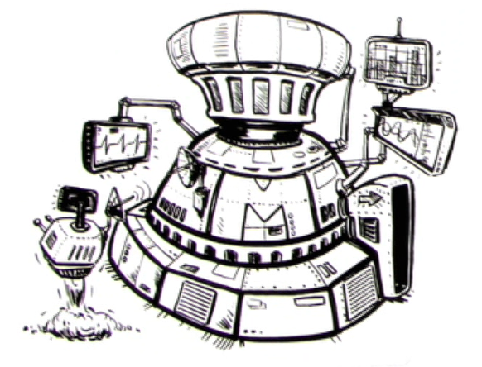
Success!
Capable
Reliable
98% Very Satisfied
But... What next?
Notes:
Couple of years ago, MODESIM complete
2 clusters and perihperal systems (knowledge sharing, reporting)
Highly stable, no outages
Good science being done
Most positive customer feedback for an IT project in Nov
Highest customer satisfaction rating in company – 98% very satisfied (highest possible socre)
But big problem... Where to go from here?
How to continue success?
How to make other 2% very satisfied?

Slide 3
A Cure Worse Than The Disease
Simulations slow
Scientists inefficient
Results not trustworthy
But… very, very easy
Notes:
Go back to original problem, as mentioned by Paul
Simulations on laptops/PCs slow, inefficient
Results not trusted – no testing done on tools and systems
But very straight forward to use
Buttons to click
Minimal setup
No new skills to learn – works like your computer in university!
Scientist’s perspective gone from…

Slide 4
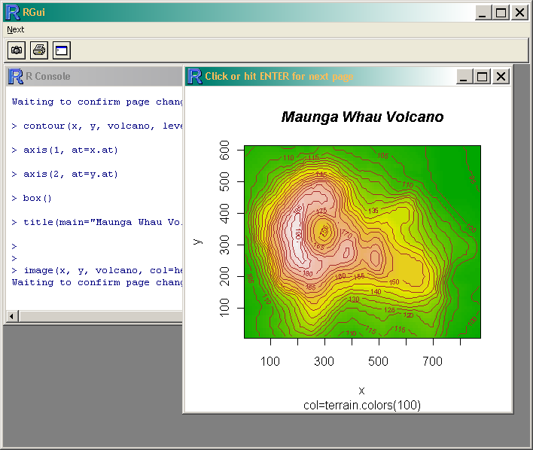
A Cure Worse Than The Disease
Notes:
One click start
Everything works straight off
No config needed
To…

Slide 5
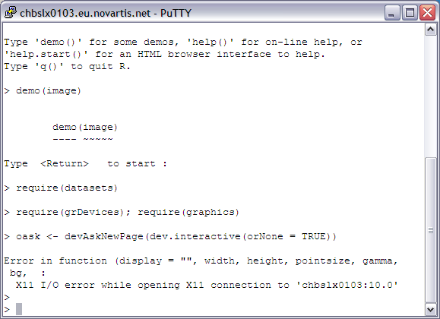
A Cure Worse Than The Disease
Notes:
Command prompt only!
Everything doesn’t work straight off
Need extra, manual config for simple things like plots
Non-discoverable – need to know the secret code book!

Slide 6
Reality
Not many people used it
Too scary
Most still used laptops
Notes:
So reality hits – only about a dozen from ~150 users actually use it!
Interface too scary for Windows users
Learning curve too steep – Linux, cmd prompt, queuing, scripting
Most scientists still working only on laptops
Also compliance issue – too hard to be compliant with SOPs
Realisation – most of the scientists aren’t techies
Few are, assume the rest of their colleagues are as well
These are the only ones who talk to IT
Thus we IT people get the impression all scientists are techies

Slide 7
It’s a Windows World, Linux is Just Living in it
Camouflage Linux
Nice, friendly buttons
Hide the command prompt
It should just work
Notes:
How to fix this problem, attract less IT oriented scientists - look at what they’re comfortable with
Windows GUI
Familiarity -layout of interface, simple menus, tools and functions more readily discoverable
Solution – camouflage
Hide Linux, make it look like Windows
Easy to find buttons for all functions
Bury the cmd prompt as far as possible
Most importantly, make sure everything just works
Path of least resistance is the correct, compliant one

Slide 8
Solution
Gnome
Customisation
NoMachine NX
Notes:
Solution in three parts
Gnome for GUI desktop
Customised layout, menus and appearance
NoMachine NX for access
“Citrix for Linux”
Resulted in…

Slide 9
MODESIM NX
Notes:
Menu only shows support tools
Also called it ‘Start’ for even more Windows like feel
Links to common data sources
Also altered Nautilus layout – more Windows Explorer like
Reconnectable

Slide 10
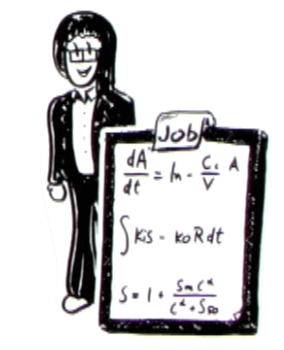
Success Again!
Usage increased
Maintained feedback rating
50% productivity increase
Notes:
Got least technical scientist to test out
In own words – hates anything to do with computers
But likes this… a lot
Encouraged more scientists to use MODESIM
Also from wider group
Includes users who have never used a cluster or server for simulations before
Business leaders assessed impact
Estimate at least a 50% increase in each scientists productivity from this alone
Shallower learning curve
Leads to increased usage of cluster
In turn simulations turned around faster
Scientists spend more time on analysis, less on using IT systems
So good, but could be a lot better
Queuing system (SGE) mostly cmd line based

Slide 11
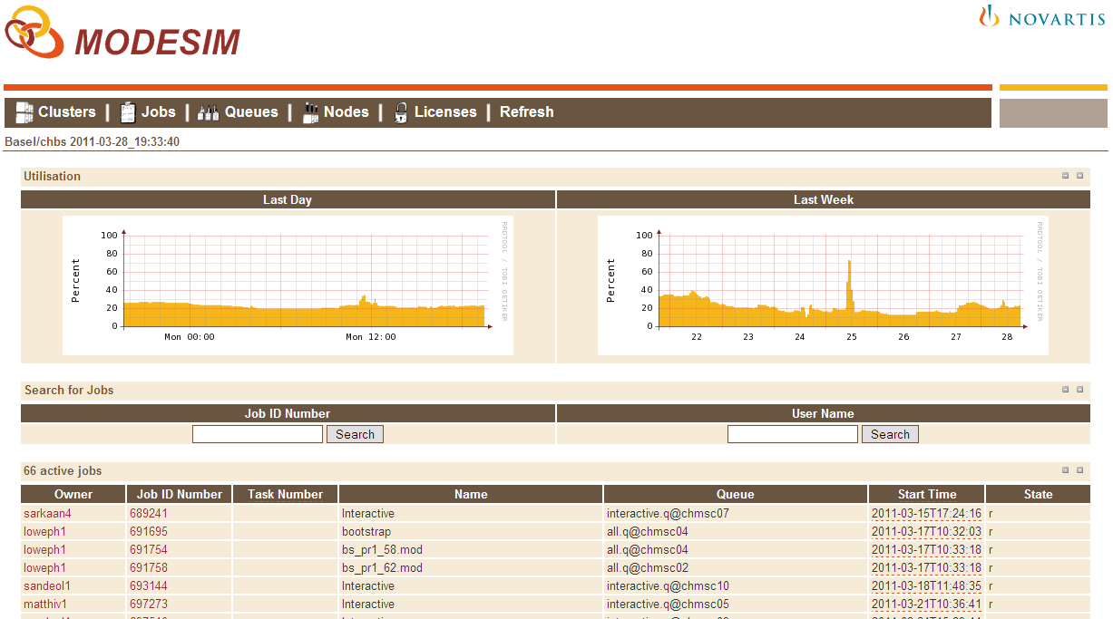
Qstat Web App
Notes:
Web app for viewing status of jobs
Covers functionality of most commonly used SGE command – qstat
Simple presentation for at a glance info – most commonly asked questions
How busy is the cluster?
How many licenses are available?
Why does my job have an error?
Re-phrase qstat output into more obvious format
E.g. “hard resource_list” to “Resources and Licenses Requested”
No login required – instant access from Windows computer

Slide 12
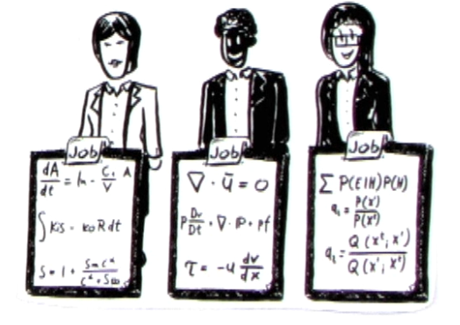
Even More Success!!
Advertised available capacity
Encouraged greater usage
Attracted more scientists
Notes:
Extra, unplanned benefit – advertised capacity
Before: Self reinforcing loop – people thought it would be busy, so did use it
People felt guilty for using it, afraid they blocked other people
End result: long quiet periods until someone dared to have another go
Now: at a glance status page shows utilisation of all clusters
Broke the loop
Lead to more and bigger jobs
Greater use of more intensive parallel jobs, due to less fear of blocking others
More transparency on who’s doing what – particularly license usage
Curiosity – who the heck’s that and how are they running 100 Rs at once!?

Slide 13
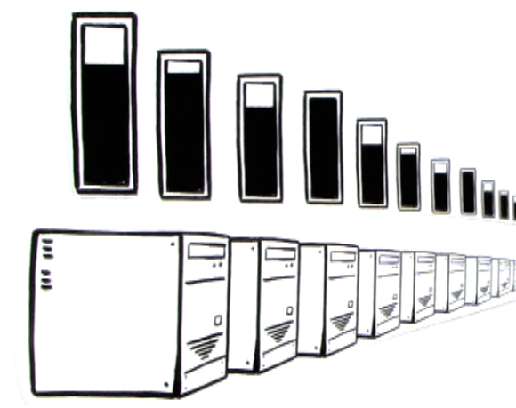
What Next?
Make it even easier!
More web apps
Job submission
Historical job information
SLA reports
Notes:
Brings us back to where to go from here?
Make it easier still of course!
Aim to deemphasise the IT, be as invisible and effortless for scientists as possible
Again, help them focus on what to ask, not how
Greater use of web apps – less need to see any of Linux including NX desktop
Ideas for expansions of Qstat Web App
Job submission – upload code (R, NONMEM) and have system sort out how to run it for you
History – see info on recently completed jobs – how long they took, possible causes of performance bottlenecks
Helps scientist understand how long results take to get, how to speed it up
SLA reporting automatically
Less paperwork for IT team
Freed up to focus time on improvements and support
Greater transparency – whole user community can see team’s performance vs. a few leaders

Slide 14
Notes:
Q&A

