Slide 1
PRISME Forum
Ewan Hunter PhD
Director Technical Support EMEA
May 3-4, 2011

Slide 2


Corporate Overview
Company founded in 2002; corporate headquarters in Cambridge, MA
Updated corporate strategy
  Rebranded end of November 2010
  Refocusing the company to capture strategic value (Personalized Medicine)
  8 commercial partners to date
Privately held: Series A, Flagship ventures, Pappas ventures
Experienced leadership team:
  David de Graaf, Ph.D., President and Chief Executive Officer
  Louis Latino, Executive Vice President, Sales & Marketing
  Julian Ray, Ph.D., Senior Vice President, Technology & Engineering
  David Fryburg, M.D., Chief Medical Officer
  John Tagliamonte, Senior Vice President, Corporate Development
  Chris Thomajan, Chief Financial Officer

Slide 3

Selventa Vision and Mission
Vision
Your strategic partner in finding optimal treatments for the right patients
Mission
Apply patient data-driven analytics to increase the value of portfolios

Slide 4

Selventa Is a Personalized Healthcare Company Devoted to Accelerating Portfolio Optimization Through Patient Stratification
IP
Strategic Partnerships
(Personalized healthcare)
Scientific Consulting
(Biological expertise)
GTP Software
(Inter-operable software that exploits computable scientific knowledge and provides mechanistic explanations of complex molecular data)
The Biological Expression Language (BEL) Framework
(Computable BEL and open suite of tools for scientific knowledge representation)
Drug A
Optimal Therapy for the Right Patients

Slide 5

The BEL Language
The Blueprint for Knowledge Sharing in Biomedical Sciences

Slide 6
BEL Represents Scientific Findings with Qualitative Causal Relationships
PubMed ID: 9999999999
“We demonstrate that RNA expression of Y is mediated through activation of the X transcription factor”
ta(p(X)) increases r(Y);
“increased transcriptional activity of protein designated by X increased the abundance of RNA designated by Y”
PubMed ID: 9999999998
“We demonstrate that phosphorylation of X at T32 results in suppression of the transcriptional activity of the transcription factor X”
p(X, P@T32) directlyDecreases ta(p(X));
“increased abundance of the protein designated by X phosphorylated at threonine 32 directly decreased transcriptional activity of the protein designated by X”

Slide 7
BEL Uses Standard
Vocabularies and Ontologies
Terms are defined by functions that reference external ids
  p(EG:207)
    “the abundance of the protein designated by EntrezGene id 207”
    (AKT1 Human)
  p(UP:P31749)
    “the abundance of the protein designated by UniProt id P31749”
    (AKT1 Human)
  bp(GO:0006915)
    “the biological process designated by the GO id 0006915”
    (apoptosis)
External ids can include names in well-defined namespaces
  p(HUGO:AKT1)
    “the abundance of the protein designated by HUGO gene symbol ‘AKT1’”
  bp(MESH:apoptosis)
    “the biological process designated by the MESH heading ‘apoptosis’”

Slide 8
BEL Manages Equivalences Between External IDs
Original statements in BEL Documents:
  ka(p(EG:207)) decreases bp(GO:0006915);
  ka(p(UP:P31749)) directlyDecreases ka(p(UP:P49841));
Equivalence relationships specified to BEL Compiler:
  GO:0006915 ➔ MESH:apoptosis
  EG:207 ➔ HUGO:AKT1
  UP:P31749 ➔ HUGO:AKT1
  UP:P49841 ➔ HUGO:GSK3B
Processed Statements:
  ka(p(HUGO:AKT1)) decreases bp(MESH:apoptosis);
    “kinase activity of AKT1 decreases apoptosis”
  ka(p(HUGO:AKT1)) directlyDecreases ka(p(HUGO:GSK3B));
    “kinase activity of AKT1 directly decreases kinase activity of GSK3B”

Slide 9
Multiple Representation Levels Coexist
Obesity
Insulin
Organism Level
Adipose
Organ or Tissue Level
Macrophage infiltration
Positive Correlation
Causal Increase
Cellular Process Level
Cell Death
Apoptosis
r(Q)
ka(p(Z))
Molecular Level
p(Y)

Slide 10
Contexts Annotate Statements
Source: PMID 1234567
Cell Type: Fibroblast
Tissue: Lung
Causal relationships demonstrated in lung fibroblasts, reported in PMID 1234567
ka(p(X)) increases p(Z);
p(X) increases r(Y);
Each Statement is distinct:
These Statements have different sets of contexts
Cell Type: Endothelial Cell
Causal relationship demonstrated in liver endothelial cells , reported in PMID 1234567
Tissue: Liver
p(X) increases r(Y);

Slide 11
BEL Framework
Suite of software components which facilitate the interchange of biological scientific facts between user-communities and between applications
Supports 3 types of workflows:
  Knowledge Creation/Management
    Generating and editing knowledge as BEL Documents
    Sharing knowledge
    Moving knowledge between applications or knowledge sources (e.g. NLP methods)
  Knowledge Publishing
    Assembling knowledge by combining BEL Documents into KAMs
    Moving KAMs between BEL-enabled applications
  Knowledge Use By Applications
    Using published knowledge in BEL-enabled applications such as the GTP

Slide 12



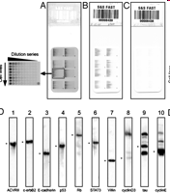
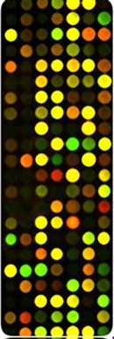
Using BEL Documents
Text Mine Public or Proprietary Sources
Capture the results of text-mining algorithms in a portable format
Publish Key Findings in an Area of Biology
Create comprehensive documents that capture the critical findings for an area of research
Review, Edit and Organize Knowledge
Capture Experimental Results
BEL Documents
Manage public or proprietary findings in a form that abstracts biological relationships while preserving experimental context
Edit and organize knowledge published in BEL to create new knowledge resources meeting defined quality standards
Transform Database, Pathway or Other Structured Content
Integrate knowledge derived from databases, pathway knowledge bases and other structured sources using BEL

Slide 13
Knowledge Assembly Model
Directed network of biological facts assembled by the BEL Compiler derived from one or more BEL Documents
Network is composed of KamElements
  KamVertex – references a biological entity defined in a BEL Document
  KamEdge – asserts a biological relationship between two biological entities evidenced by one or more BEL Statements defined in a BEL Document
Each KamEdge references one or more BEL Statements and associated provenance and contexts
Can be exported into an encrypted, portable format which can be imported into another KAM Store
KAMs are stored using internal references for biological entities which map to an encrypted symbol table which can only be decrypted by the BEL Framework API

Slide 14
Knowledge User Workflow
BEL Framework and Applications
Application
BEL Framework
BEL Framework API
KAM Store
Multiple KAMs can be imported for use by the application
BEL Compiler
Encrypted portable KAM
BEL Documents

Slide 15
BEL Framework API
Java API providing access to KAMs in a KAM Store
SPARQL API providing access to a RDF representation of the KAM
Allows users to dynamically filter a KAM by specifying a set of include/exclude filters:
  Provenance filters
  Context filters
  KamVertex filters
  KamEdge filters
Allows access to underlying evidence support for KamEdges
  Statements and contexts
  Information derived from the BEL Document headers

Slide 16
BEL Framework Web Service API
Extends the BEL Framework API to the web
Provides a SOAP-based and RESTful Web Service API to allow non-java based applications to access and query KAMs stored in a KAM Store
Includes a self-contained web server
Can be deployed on a server and configured to work with http/https and configurable ports

Slide 17
Comparing BEL with BioPAX
BEL
BioPAX
Represents scientific findings in molecular biology in a form which is both computable and intuitive for life scientists
Represents biological pathways at the molecular and cellular level and to facilitate the exchange of pathway data
Focus: capture of causal relationships to ultimately enable inference by applications
Focus: represent detailed molecular interactions and abstraction to pathways
Can flexibly annotate each represented finding with rich contextual information
Elements in a pathway can be supported with evidence codes from external vocabularies
Facilitates representation of incomplete knowledge, where findings may demonstrate causality but not mechanism
Oriented towards precise representation of interactions and reactions
Designed with a simple structure to empower a broad range of biologists to effectively curate and review knowledge
Designed to provide a data exchange format for pathway data that will represent the key elements of the data models from a wide range of popular pathway databases.
Enables the creation of use-neutral knowledge resources which can subsequently be assembled to create specific models
Pathways are specific models; it would be feasible to assemble BioPAX pathways starting with BEL documents

Slide 18
Comparing BEL with SBML
BEL
SBML
Represents scientific findings in molecular biology in a form which is both computable and intuitive for life scientists
A machine-readable format for representing biological models.
Focus: capture of qualitative causal relationships to ultimately enable inference by applications
Focus: describing systems where biological entities are involved in, and modified by, processes that occur over time
Enables the creation of use-neutral knowledge resources which can subsequently be assembled to create specific models
A potential avenue for future BEL extensions would be to enable the capture of additional quantitative information associated with scientific findings, facilitating the assembly of SBML models from information in BEL documents.
SBML describes specific models.

Slide 19
Example of Portfolio Design through Stratification of Patients
Identifying Disease Driving Mechanisms Resulting in Infliximab Non-response in Ulcerative Colitis

Slide 20
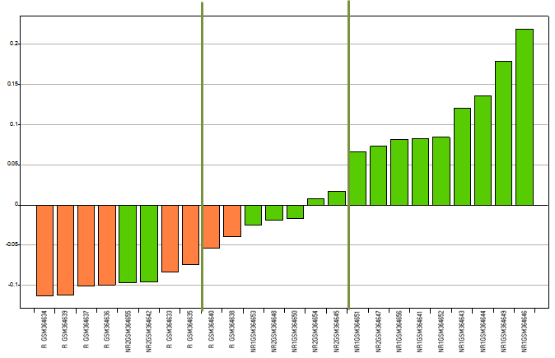
Identification of Optimal Treatments for the Right Patients
1
2
3
Calculate strength of molecular processes in a patient population
Identify disease-driving mechanisms in non-responders
Assess Strength of Disease Driving Mechanism in Individual Patients
4
5
6
Generate a classifier that differentiates patients with high and low activation of disease-driving mechanism
Assess classifier performance in an independent test set
Portfolio design based on identified mechanisms
% AUROC

Slide 21
Addressing Infliximab Non-Response in Ulcerative Colitis
Objective:
  Leverage Selventa’s key technology, which is powered by the Genstruct® Technology Platform (GTP), to identify mechanistic differences between responders and non-responders
An example of a value creation case study:
  Identification of non-TNF-driven disease mechanisms in ulcerative colitis (UC)
    PMIDs 19956723, 19700435
Infliximab
Heterogeneous Group of UC Patients
✓
Responders
Non-responders
    Selventa identified potential targets that can drive UC in non-responding population
Clinical Response
45-69%
31-55%
TNF-driven
Yes
No

Slide 22
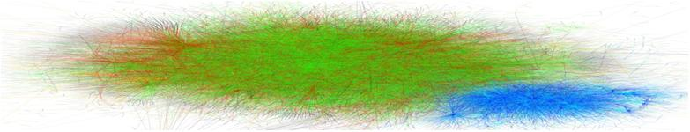
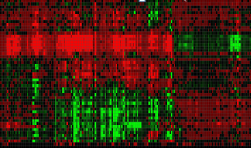
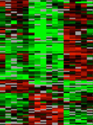
Knowledge Encoded in BEL Is a Substrate for RCR and Identifies Mechanistic Causes of the Data
(e.g. Increase in TNF)
For Example:
 TNF
Identification of mechanistic causes leading to differential gene expression changes
 exp(IL8)
exp(TNF)
 exp(ANKH)
 exp(S)
 exp(T)
Knowledgebase
A collection of cause-and-effect relationships
For Example:
TNF
exp(IL8)
exp(TNF)
exp(ANKH)
exp(S)
exp(T)
Reverse Causal Reasoning
For Example:
 exp(IL8)
 exp(ANKH)
exp(TNF)
 exp(S)
 exp(T)
Differentially expressed genes

Slide 23
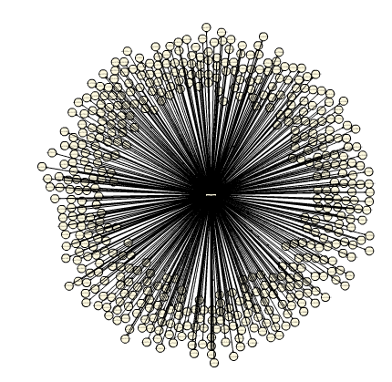
TNF-specific Signature in the Knowledgebase
TNF can potentially regulate 1853 genes based on 691 unique peer-reviewed publications
Patient 1 vs. Control has 110 of these significantly changed
TNF

Slide 24
Statistical Significance Is Determined by Calculating Richness and Concordance
Experiment: Patient 1 (UC) compared to control
mRNA measured with Affymetrix microarray: 12791 measured transcripts (genes)
Richness: 4.0 E-10
Based on Hypergeometric Distribution – Sampling without replacement
691 significant gene expression changes (5%)
TNF can potentially control mRNA expression of 1853 genes
TNF
Observed modulation of mRNA for 110 of the 1853 genes (6%)
90 observed changes consistent with increased TNF (82%)
Concordance: 2.1 E-5
Based on Binomial Distribution – Probability of making correct predictions
20 observed changes consistent with decreased TNF (18%)
24
Notes:
24

Slide 25
Apply a Strength Metric to Stratify IBD Patients for TNF Pathway Activation
Target gene signature
 Gene 1
The strength metric is calculated on a target gene signature
  The strength algorithm calculates the geometric mean of the fold changes in the gene signature
  A list of gene fold changes can be collapsed into a single number
A quantitative value is assigned to each patient for their level of signaling specific to the target
  Assesses the relative signaling strength of a target network in each patient of a population
  Patients can then be stratified on a continuum of network strength
 Gene 2
 Gene 3
 Gene 4
Mechanism
 Gene 5
Mechanism regulates genes in these directions based on published literature
 Gene 6
 Gene 7
 Gene 8
Patient 1
Patient 2
Patient 3
Fold change
0
Gene 1 2 3 4 5 6 7 8
1 2 3 4 5 6 7 8
1 2 3 4 5 6 7 8
Strength score
High
Med
Low
Notes:
25

Slide 26
Generation of Strength Scores for Mechanisms
Selventa’s technology assesses the relative strength of hundreds of mechanisms for each individual patient
  Strength score is calculated for > 2,000 direct mechanisms in the Knowledgebase
Non-response stems from alternative disease driving mechanisms
  Reflected in difference in strength of activation of molecular processes between responders and non-responders

Slide 27
Infliximab, a TNF-Inhibitor, Ameliorates UC in ~60% of Patients
Infliximab
Ulcerative Colitis Disease Model
TNF

Slide 28
RCR Demonstrates Sustained TNF-like Downstream Signaling in Non-responders after Infliximab
Infliximab
Ulcerative Colitis Disease Model
TNF
Pre-treatment
Post-treatment
NR
R
NR
R
Signaling downstream of TNF
High
Low
*comparisons relative to control
Antibody is in excess, sustained signaling is likely due to alternative upstream controller

Slide 29
TNF Hypothesis Is Supported in Responders and Non-responders
Infliximab
Ulcerative Colitis Disease Model
TNF
Pre-treatment
Post-treatment
NR
R
NR
R
Signaling downstream of TNF
High
Low
*comparisons relative to control

Slide 30
Non-responders and Responders Have Different TNF-like Signatures at Baseline
Identification of Subtle Differences Between Responders and Non-Responders
Activation of alternative upstream controllers for TNF regulated genes in NR?
TNF regulated genes
High
Low

Slide 31
Alternative Disease-driving Mechanisms in Non-responders
Infliximab
Ulcerative Colitis Disease Model
TNF
?

Slide 32
Alternative Upstream Controllers for TNF-Regulated Genes in Non-responders
TNF-regulated genes unique to non-responders implicate TNF-independent disease-driving mechanism in non-responders
  These mechanisms can be targeted in the non-responder population
IL6
signaling
Individual nodes that support each mechanism
Mechanism 1
VEGF
signaling
Angiotensin
signaling
Mechanism 4
Mechanism 3
EGFR
signaling
A group of causally related hypotheses provides a mechanism which is amenable to therapeutic intervention
Mechanism 7
ERK
signaling
Mechanism 6
P38
signaling
Mechanism 5
TLR
signaling

Slide 33
Personalized Healthcare
Patients Are Stratified Based on IL6 Strength
Bottom 8
Top 9
Actual Response:
IL6 Strength
Infliximab Non-Responders
Infliximab Responders
Patients
Patients with the highest and lowest levels of IL6 signaling strength were selected for use in gene classifier generation
  Training set GSE16879

Slide 34
Personalized Healthcare
Patients Are Stratified Based on Disease-Driving Mechanism
Bottom 10
Top 11
Actual Response:
Mechanism 1 Strength
Infliximab Non-Responders
Infliximab Responders
Patients
Patients with the highest and lowest levels of Mechanism 1 signaling strength were selected for use in gene classifier generation
  Training set GSE16879
34

Slide 35
Personalized Healthcare
Patients Are Stratified Based on Disease-Driving Mechanism
Bottom 5
Top 10
Actual Response:
Mechanism 3 Strength
Infliximab Non-Responders
Infliximab Responders
Patients
Patients with the highest and lowest levels of Mechanism 3 signaling strength were selected for use in gene classifier generation
  Training set GSE16879
35

Slide 36
Mechanisms Work Together or Separately
R²=0.64
R²=0.73
IL6
IL6
Mech 3
Mech 1
R²=0.79
Mechanism 1 and 3 may overlap, but IL6 is an independent driver
Mech 1
Mech 3

Slide 37
Portfolio Design Based on Mechanisms
Discovery & Pre-clinical Development
Phase I
Phase II
Phase III
Therapeutic
Diagnostic™
Data
1
X
2
X
3

Slide 38
Summary
Market Need
Drug Options
Patients of a Specific Disease
Selventa Solution
Drug A
Patient Stratification
Identification of Disease Mechanisms
Drug B
Biomarker
Panels
Drug C
Drug X
Portfolio Optimization
Identification of Therapeutic Interventions
Validation and Clinical Success
Drug A
Optimal Therapy for the Right Patients

