Slide 1
ModSpace: Analytical Knowledge Management
Richard Pugh, Managing Director
rich@mango-solutions.com
4th May 2011

Slide 2
Agenda
Mango Solutions
Analytical Knowledge
ModSpace
      The Project
      The Application
      Technical Details
      Wider Applicability
      The Alternatives
      The Development Path
Summary & Questions

Slide 3
Mango Solutions

Slide 4
Mango Solutions
Private Company founded in 2002
Headquartered in the UK
Offices in Switzerland, USA and China
Global Team of 38
Strong year-on-year growth since 2002

Slide 5

Mango Solutions
People
Skills
Services
Products
Analytical Expertise
‘R’/S+
Training
ModSpace
Project Managers
Matlab, Python
Commercial Support
Navigator
Business Analysis
SAS
Technical Consulting
Push2Doc
Technical Architects
Java/C++
Business Consulting
iNCAS
Developers
Oracle
Software Development
ValidR
Dedicated Testers
Web Reporting
Software Development
Quality Manager

Slide 6













Mango in M&S
Work with M&S Groups from most top 20 pharma companies
Provide training, consulting, support and application development services
Also participate in cross-company projects such as IMI initiative

Slide 7
Analytical Knowledge

Slide 8
Analysis
Analysis is the practice of producing a model (or “rule of thumb”) to describe a set of data
We need to understand
    How well a model “fits” the data?
    How accurately a model performs?
    What variability we can expect in our answers?

Slide 9
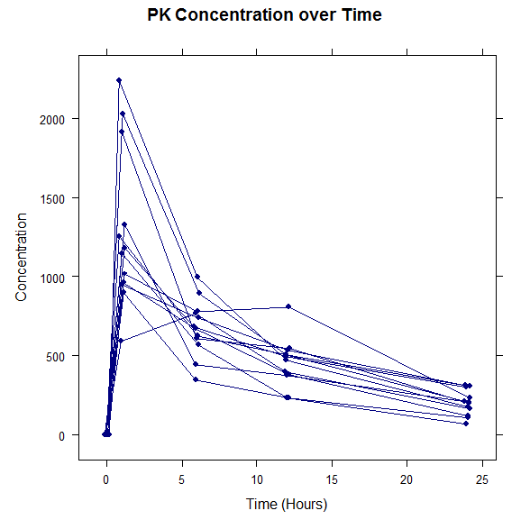
Data
Model Outputs
Models

Slide 10
Analytical Knowledge
Contained in
    Datasets
    Analytical Programming Scripts
    Graphics, textual and tabular outputs
  Models described mathematically in different analytical languages, and split across a set of files

Slide 11
Why Store Analytical Knowledge
More decisions being made more quickly on more data
Analytic IP often difficult to reuse both by other analysts and beyond
Difficult to clarify “what exists” before wheels are recreated, often not helped by typical “analytic” reporting lines

Slide 12
Challenges for AKM
Analytical Knowledge is typically complex and highly valuable
Variety of analytical languages used
      SAS - Large Corporation
      R – Open Source Language
Analysts are primarily not programmers
      Often no coding standards
      Little use of versioning

Slide 13
ModSpace
The Project

Slide 14
ModSpace Project
Part of Technical Mango-Novartis Partnership
Agile Software Development project
Part of Novartis’ “MODSIM” platform (more later!)
Project Timelines
      Initial PoC in January 2009
      Initial URS May 2009
      Agile Implementation from May to Nov 2009
      Into Production December 2009

Slide 15
ModSpace Project
“we should write whitepapers using this as an example of how a software development project should be run”
Good initial PoC with visual design outputs
Agile Development with Fixed Scope
Very strong input from the business
Excellent working relationship

Slide 16
ModSpace Project
Project Aims
      Central storage and description of “models”
      Easy to find and download models
      Feedback mechanism
      Add versioning to analytical files
      Encourage use of coding standards
  Initial Project name “Moogle” hints at vision!

Slide 17
Design Concepts
Allow description of a set of files as a “model”
Storage of different file types
File-type-specific parsers to extract as much meta data as possible based on file structure
Experience based on social media applications

Slide 18
Project Outcomes
Big success story within the Mango-Novartis Technical Partnership
Lots of Good Information being stored
Some unexpected uses (e.g. storing videos of training courses)
Some challenges ahead around curation as more complex element types are stored

Slide 19
ModSpace
The Application

Slide 20
Some Terminology
Element – A Single File
Entry – A Set of Files that, together, form a Group of Files that someone may want to find (e.g. a “model”)

Slide 21
Application Workflow
Add & Describe Information
Collaborate with other Analysts
Publish Information to the wider group
Search for Information
Standardised view of Information
Download Information
Provide Feedback on Information
Create Communities
Produce Management Reports

Slide 22
Add Information
Upload Files and Directories OR link to existing Version Control Repository
Type-specific parsers and storage
Parsers can encourage or enforce coding standards
Creates entry in version control engine

Slide 23









Add Information
Identify File Type
Parse and Extract Element Meta
Store Elements
Create and Describe Entry

Slide 24
Collaborate
Initially, the files are hidden from view
Can add members to the “Entry” to collaborate on files before publishing to wider group
Members can be anywhere on network (e.g. different countries)

Slide 25
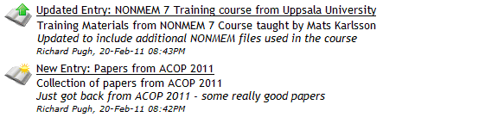
Publish
Tags the “entry” and adds a “commit” comment
News item automatically generated
Added to the general news feed for users

Slide 26
Search for Information
Apache Lucene search engine behind the scenes:
      Simple search
      Advanced search
      Google-Syntax search
      Filtering of Results
      Suggestions and Spelling-Matching

Slide 27
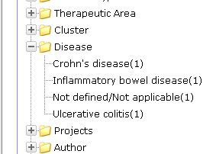
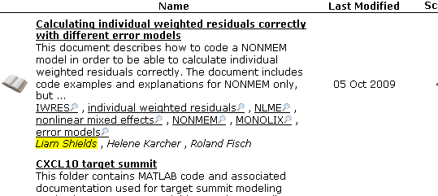
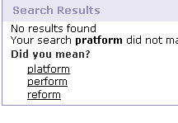
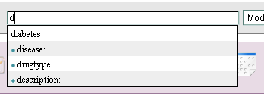
Search for Information

Slide 28
Standardised View of Information
Each Entry has the same initial “view” to allow easy analysis of applicability
Each element has type-specific views
      Single page Meta Description
      Syntax-Highlighted File Preview
      History view of Versioning

Slide 29
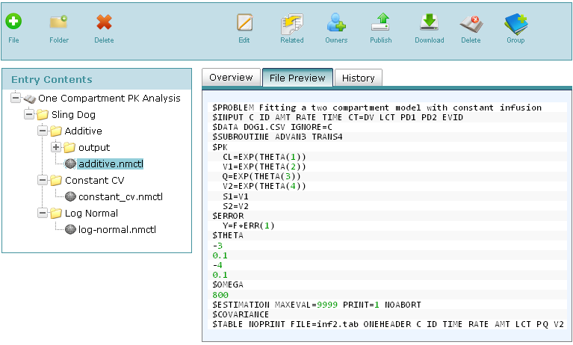
Standardised View of Information

Slide 30
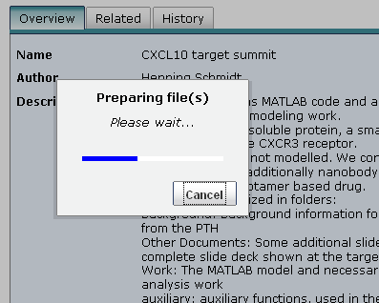
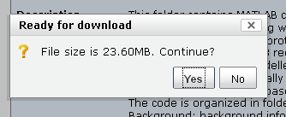
Download Information
Download single “Elements” or entire “Entry”
Extract as Zip or work directly with version control repo
Entry is “Bookmarked” and “Feedback” event triggered

Slide 31
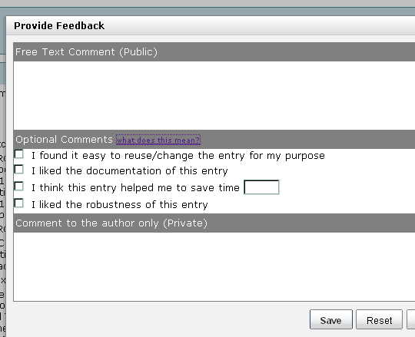
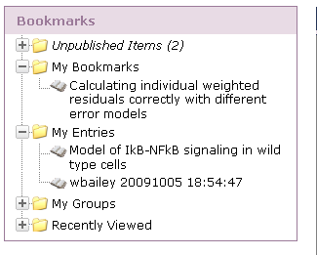
Provide Feedback
Feedback allows users to rate/comment on entries
Provides feedback mechanism for bug fixes
Feedback Information available for Management Reports

Slide 32
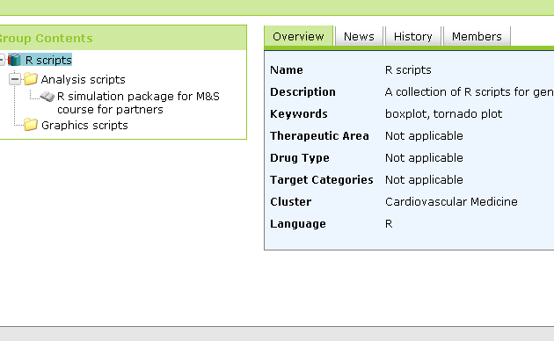
Create Communities
Create “Groups”, a collection of bookmarks within a specific category
Has it’s own membership list and metadata

Slide 33
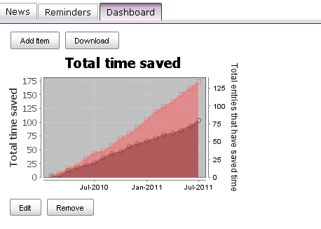
Produce Management Reports
Run Reports on Stored Meta Information and Feedback
Create Standard Dashboards to assess value of Stored Information by User, Department etc

Slide 34
ModSpace
The Technical Details

Slide 35

Technical Details
Web-based Java application
Apache Lucene Search Engine
Hibernate Data Layer so Database Agnostic
Interfaces with LDAP, PAM etc for security
Easy to Administer

Slide 36
ModSpace
Wider Applicability

Slide 37
Wider Application of Software
The “Recognised” elements can be extended and modified
Version Control is enforced without user Knowledge
Coding Standards can be encouraged OR enforced
Feedback can be informal OR formal (i.e. peer review)

Slide 38
Wider Application of Software
ModSpace customers and prospects include:
      The Bank of England for model management
      An Insurance company for building communities for open source softwares
      A pharma company who wants to create a “SAS Code Repository and Community”

Slide 39
ModSpace
The Alternatives

Slide 40
Put your files on a Central Server
Limited search
No way to describe a “set of files” as a single “thing”
No versioning and file management
No intuitive interface
No encouragement of standards and best practices

Slide 41
Use Sharepoint
Limited search
Doesn’t distinguish between “a script” and “a document”
No way to describe a “set of files” as a single “thing”
No encouragement of standards and best practices

Slide 42
Use a Version Control System
Limited search
No way to describe a “set of files” as a single “thing”
No intuitive interface
No encouragement of standards and best practices

Slide 43
ModSpace
The Development Path

Slide 44
Formal Entry Structure
Enforcement of Project (File/Directory) Structure
Validates Project Structure to Enforce Best Practices
      Directory Structure and Naming
      Existence of Files
Additional Meta can be associated that Extends standard set of meta
      Project Identification Number
      Project Manager

Slide 45
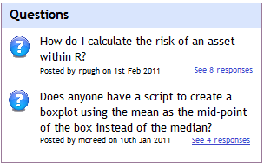
Discussion Groups
What happens if you don’t find what you’re looking for?
      Search online
      Send an email to “all@”
Adding Q&A feature so the question and answer are stored and searchable

Slide 46
Storage Types
Currently, elements are stored in Version Control OR on file system based on type (data vs script)
Can be extended so (for example):
      Documents Stored in SharePoint or Documentum
      Data Stored in Database

Slide 47
Synchronisation with Version Control
Can now:
      Create an Entry in ModSpace
      Connect to it via IDE (e.g. Eclipse)
      Edit Files within Eclipse
      See “needs synchronisation” message in ModSpace
      Sync the Files
Allows for programming Users and “Web” Users to work on same project

Slide 48
Storage in Tech-Agnostic Format
Part of the “ddmore” Initiative (part of “IMI”)
Proposed Workflow
  Analyst A codes model in Language A
  Code checked into ModSpace
  Code stored as an “Implementation” of the Model, which is also stored in a general format
  Analyst B downloads the Model in Language B, adapts the Model and checks in code
  Analyst A sees changes reflected in Language A

Slide 49
Summary

Slide 50
Summary
Analytical Knowledge is typically split across files which need to be stored and described together
The ModSpace Project was a bespoke software development project with Novartis
ModSpace provides a general platform for analytical knowledge management

Slide 51
Demo Modspace

