Slide 1


Slide 2

Virtualization of R&D – How should IT and Service Vendors Respond?
Neil de Crescenzo, SVP and GM, Oracle Health Sciences
Presentation for The PRISME Forum Special Interest Group
October 17, 2011

Slide 3
Safe Harbor Statement
The following is intended to outline our general product direction. It is intended for information purposes only, and may not be incorporated into any contract. It is not a commitment to deliver any material, code, or functionality, and should not be relied upon in making purchasing decisions.
The development, release, and timing of any features or functionality described for Oracle’s products remains at the sole discretion of Oracle.
3
Notes:
3

Slide 4

Oracle co-wrote a thought leadership series on life sciences trends in 2009
http://www.touchbriefings.com/ebooks/A1p3ok/oracle-virtual/resources/
4
Notes:
Virtualization in Pharma R&D
Managing Risk: Embracing the New Paradigm in Global Pharmacovigilance
Forward Thinking: Harnessing the Power of CTMS
Late Phase Development: Maximizing the Value of Real-World Data
eHealthcare: Patient Management Without Walls

Slide 5
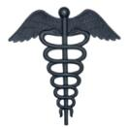


Evolving to a networked model of clinical development and translational research/medicine
CRO
Academia,
CRO &
Sponsor
Sponsor
Healthcare
Healthcare
Sponsor
Basic Research
Discovery &
Development
Point of Care
Academia
CRO
Source: adapted from DataMonitor
5
Notes:
Evolution of industry business model where parties move from separate & isolated entities to towards a “2020 network model”, where Sponsor is focused on core activities and IP.

Slide 6
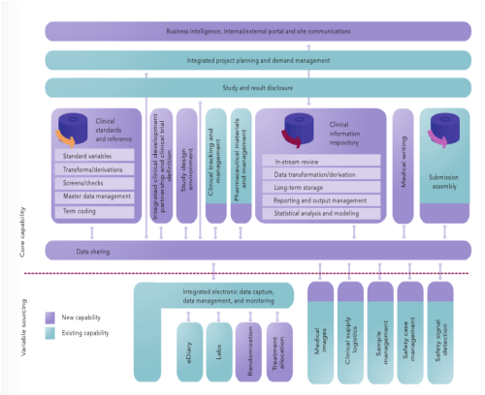

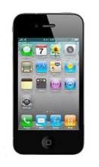


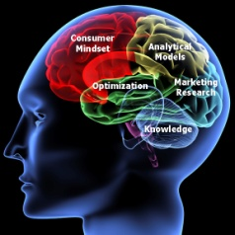


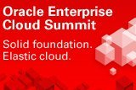



What should IT and service vendors do to facilitate virtualized R&D?
Build open platforms
Liberate data and insights with open connectivity
Build on today’s IT paradigms
6

Slide 7

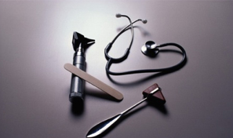

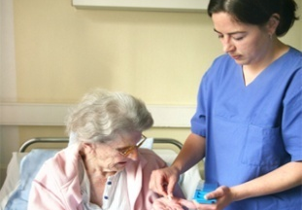

These action support the new health sciences paradigm
Integrating the healthcare and life sciences ecosystems
Industry Priorities
Better and Safer Therapies
Better and
Safer Care
Better Outcomes
and Value
Better Access
and Control
R&D
Productivity
Translational
Medicine
Quality
& Safety
Personalized
Care
Participatory
& Preventive
Care
Discovery
Research
Diagnostics
Pharma/Biotech
Medical Device
Development
Clinical
Research
Care
Delivery
Care
Management
Population/
Global Health
Leading to “value-based” healthcare
7
Notes:
Objective: Clarify the end-to-end coverage of the Oracle Health Sciences platform.
1. Everything you need to create a learning platform to enable Personalized Healthcare.

Slide 8
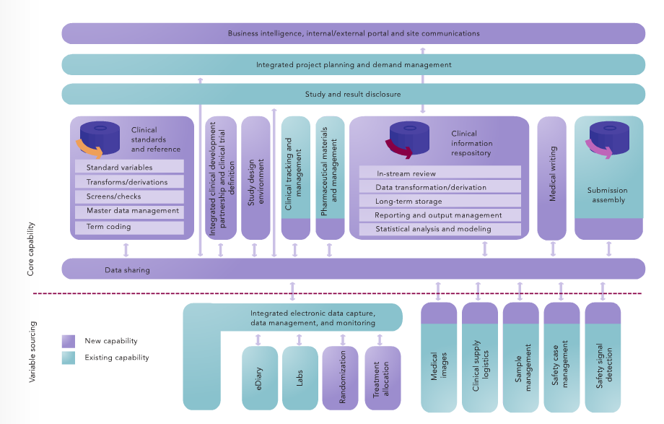

Building an open platform for Clinical Development Simplified Clinical Development (SCD) at GSK
©
8

Slide 9
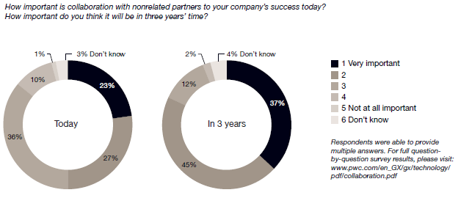
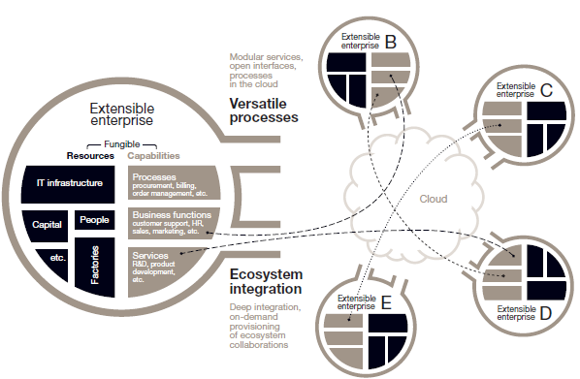
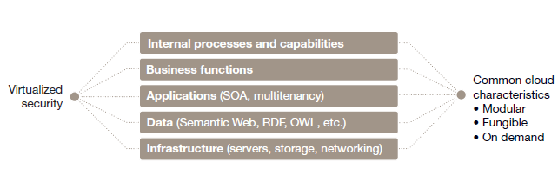
Cloud computing supports flexibility and cross-organizational collaboration
Cloud computing spending to increase from $41 billion in 2011 to $241 billion in 2020 (Forrester Research)
Growth now fueled by outsourcing business services as much as outsourced IT services
Moving from data exchange to integrated business processes and workflows
Businesses within an ecosystem collaborate as if organizational boundaries did not exist
Source: PriceWaterhouse Coopers
“Cloud computing represents the dawn of the extensible enterprise.” PriceWaterhouseCoopers
9

Slide 10

Public clouds enable people, applications, and data to collaborate and develop insights
Provision Your Service. Set up a profile, get an Oracle SSO account, and configure service details.
Get a Subscription. Predictable pricing, fixed monthly rates, no term obligation, and no hidden fees.
Add Users. Add administrators, developers, and end users.
Enrich with Content and Packaged Tools. Add third party content and packaged productivity apps.
Operate. Scale, monitor, configure, upgrade, or diagnose. Use our tools or your own.
Flex-Deploy. Use a hybrid lifecycle. Your end users and code can deploy on premise or in our cloud.
BioPharma
Diagnostics
Medical Devices
Healthcare Payers
Healthcare Providers
Government Payers
Regulatory Agencies
Patients & Families
Open, standards based, flexible platforms that connect domain experts, data and applications in a regulatory-compliant framework
Source: http://cloud.oracle.com/mycloud/f?p=service:how_it_works:0
10

Slide 11
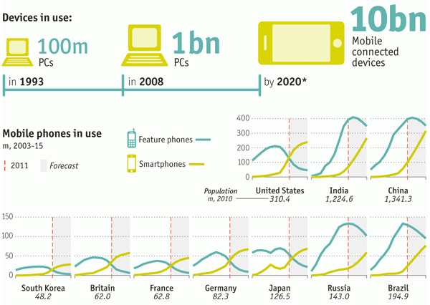
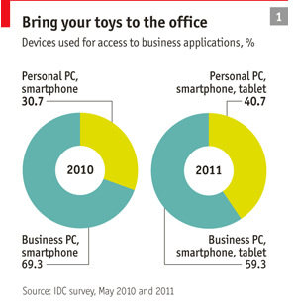
Mobile technologies and apps used “at home” are often replacing “company-approved” approaches
“…IT departments often greatly underestimate how much employees are using their own technology, including social networks and other web services, for work.” – The Economist, October 8, 2011
11

Slide 12
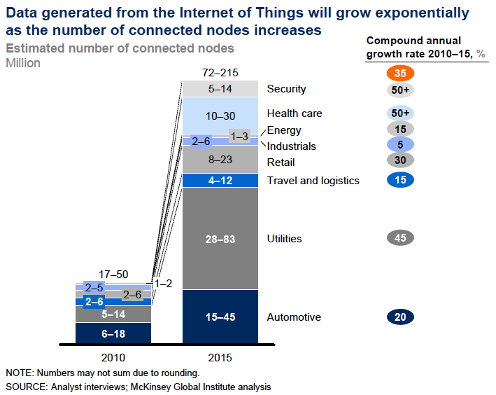
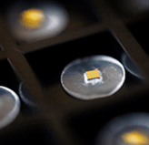
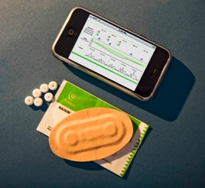

The “Internet of Things” is far more disruptive than just mobile communications (or the iPad)
Proteus ingestible event markers (IEMs) are tiny, digestible sensors made from food ingredients.
The IEM creates an ultra-low-power, private, digital signal detected by a microelectronic recorder configured as a small bandage style skin-patch.
The detector date- and time-stamps, decodes, and records information such as type of drug, dose, and place of manufacture, and also measures and reports physiologic parameters such as heart rate, activity, and respiratory rate. Detector data can be combined at the server level with other telemetered parameters such as blood pressure, weight, blood glucose, and patient-generated feedback.
GSMA estimates 24 billion connected devices in 2020
Discovery and insights will increasingly be fuelled by “thing-generated” data
Sources: McKinsey Quarterly, https://www.mckinseyquarterly.com/The_Internet_of_Things_2538;
Proteus Biomedical website: http://www.proteusbiomed.com/technology/
12

Slide 13
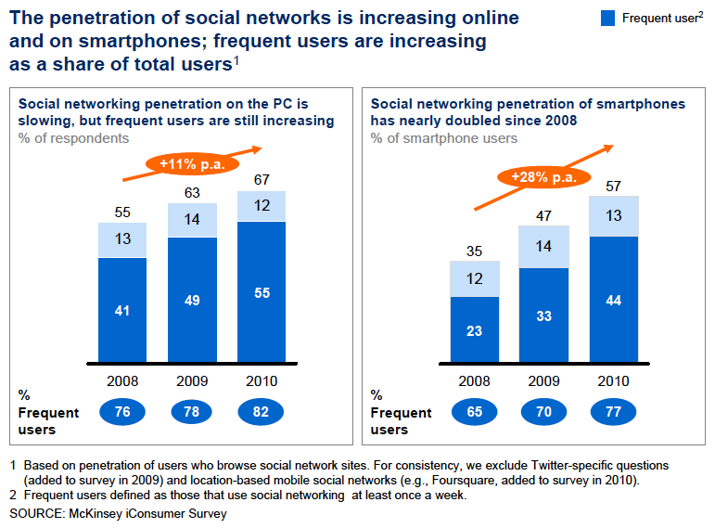
Social networks and the ubiquity of mobile communications create a new usage paradigm
13

Slide 14
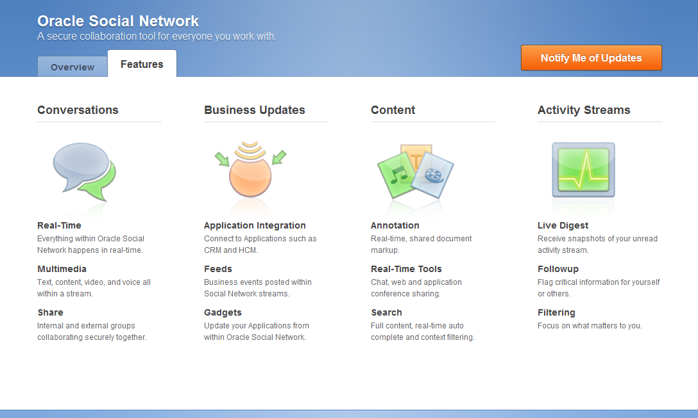




Social networks will be built for professionals and institutions but connected to outside networks
Business Insights
CTMS, EDC, EHA, Safety, LSH/CDC/LSW, TRC, IRT, OLX, LabPas, CDA
14

Slide 15

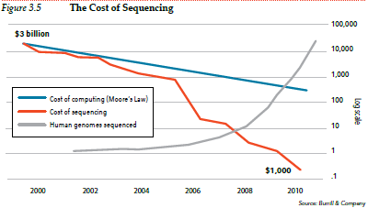
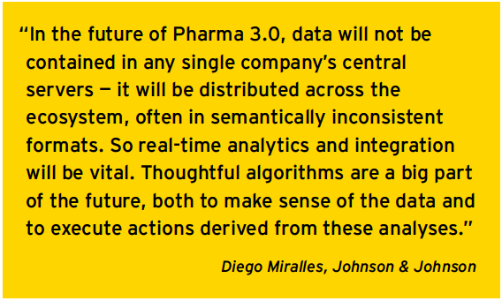
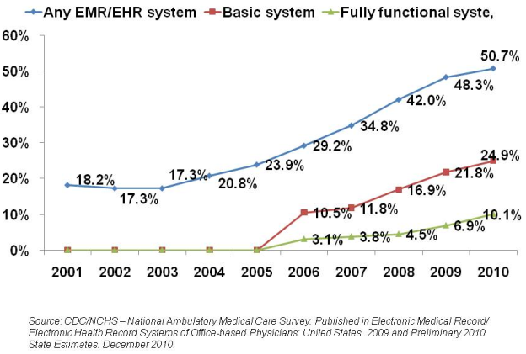
‘Omics, clinical/medical data, and imaging will drive data volumes but more importantly insights
Source: Ernst & Young Progressions 2011 report on Pharma 3.0
15

Slide 16
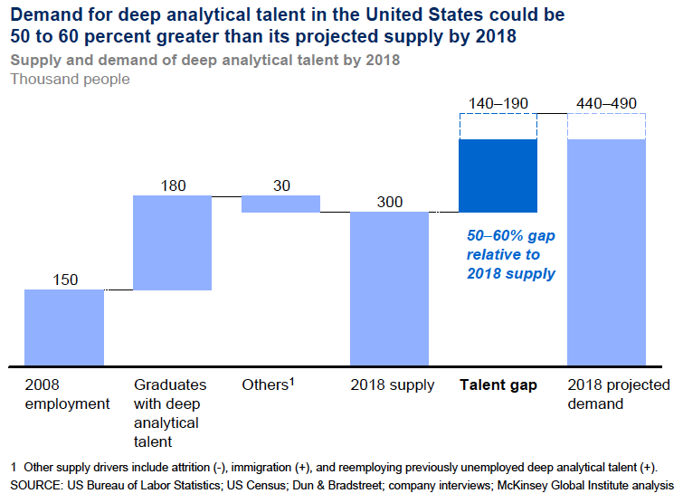
Social networks combined with insights driven by analytics will help address the analytics talent gap
16

Slide 17
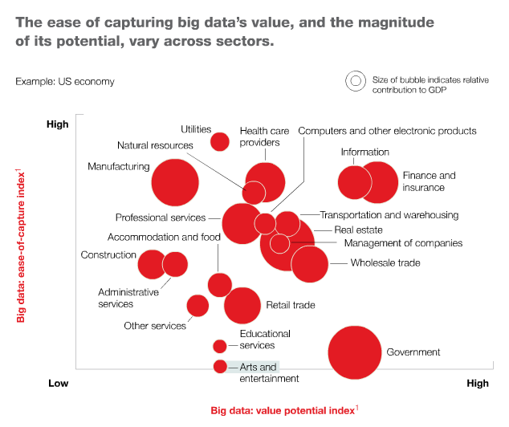
The “Internet of Things” plus extreme data volumes and heterogeneity create a “Big Data” challenge…and opportunity
Source: McKinsey Quarterly, https://www.mckinseyquarterly.com/Strategy/Innovation/Are_you_ready_for_the_era_of_big_data_2864#sidebar
17
Notes:
https://www.mckinseyquarterly.com/Strategy/Innovation/Are_you_ready_for_the_era_of_big_data_2864#sidebar
“foot view. It is the kind of data that encourages the practice of
apophenia: seeing patterns where none actually exist, simply because massive quantities
of data can offer connections that radiate in all directions. Due to this, it is crucial to
begin asking questions about the analytic assumptions, methodological frameworks, and
underlying biases embedded in the Big Data phenomenon” – “Six Provocations for Big Data” MSFT and University of New South Wales

Slide 18
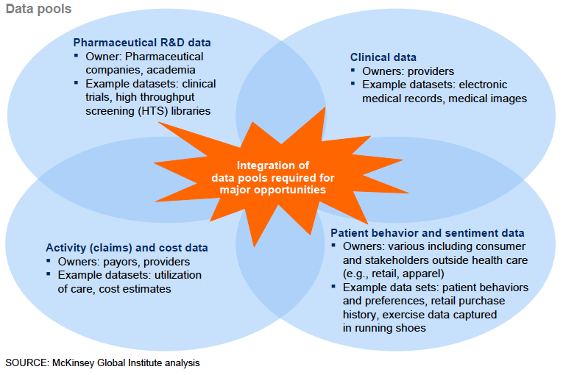
Four data pools exist in health sciences that can be leveraged within a common data mgt infrastructure
18

Slide 19
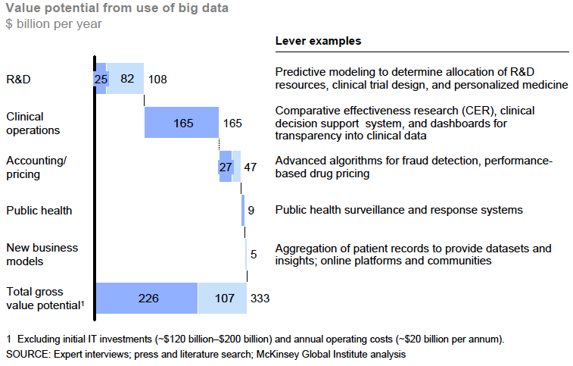
A data mgt infrastructure across the health sciences ecosystem captures the majority of the ROI
19

Slide 20
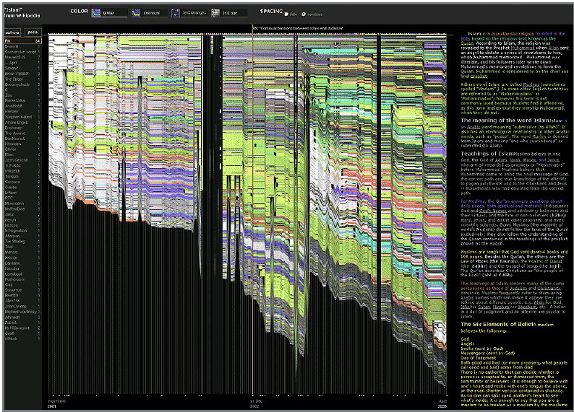
Analytics will move from “reporting” to auto-generating insights – even for protocols…
“History flow” visualizes the evolution of a document through time and the contribution of multiple authors.
Time appears on the horizontal axis, while contributions are on the vertical axis; each author has a different color code and the vertical length off a bar indicates the amount of text written by each author.
Source: McKinsey Institute and Fernanda B. Viegas, Martin Wattenberg, and Kushal Dave, Studying cooperation and conflict between authors with history flow visualizations, CHI2004 proceedings of the SIGCHI conference on human factors in computing systems, 2004.
20
Notes:
https://www.mckinseyquarterly.com/Strategy/Innovation/Are_you_ready_for_the_era_of_big_data_2864#sidebar
“foot view. It is the kind of data that encourages the practice of
apophenia: seeing patterns where none actually exist, simply because massive quantities
of data can offer connections that radiate in all directions. Due to this, it is crucial to
begin asking questions about the analytic assumptions, methodological frameworks, and
underlying biases embedded in the Big Data phenomenon” – “Six Provocations for Big Data” MSFT and University of New South Wales

Slide 21




Communities can add value for professionals in health sciences and increasingly patients and families
Brings together experts in oncology, information technology, computational biology, pharmaceutical drug development, and personalized medicine
Captures, organizes, analyzes, integrates and presents most up-to-date medical facts from a vast array of sources
Currently has a 10,000 oncologist, collaborative network
Helps enables community physicians to practice more precise medicine for complex conditions
Provides members with knowledge needed to treat patients with the more accurate, individualized medicine
Goal is to provide “Knowledge Medicine” for cancer care
PharmaWall is a fully moderated application that allows companies to engage with Facebook® users in a regulatory-friendly social setting.
21

Slide 22


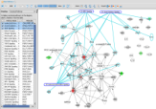
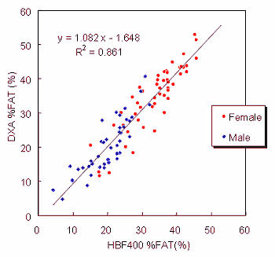
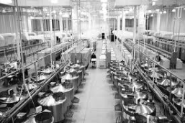

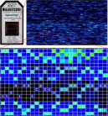
Example: Scaling Clinical Research with Oracle’s Translational Research Center (TRC)
Proactive consenting
Sample data access
Testing
Data management
Analytics/insights
PATIENTS
Data &
Results
Clinical
Data
PATIENT / DISEASE
STRATIFICATION
Sample
Info
Translational
Research
Center
SAMPLE
COLLECTION
Data &
Results
Best-Fit Treatment
Options Report
Sample
Volumes
NEW ADMITS
ANALYTICS
OMICs
Data
BIOREPOSITORY
LABORATORY
22

Slide 23
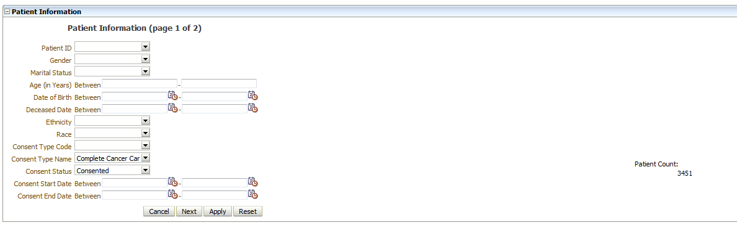
Cohort Selection
Gene expression profiling of Grade-IV Glioblastoma patients
Select patients who
  have consented to Complete Cancer Care (CCC)
  have diagnosed with Grade-IV Glioblastoma
  have specimen necrosis < 50%
  have specimen nuclei > 80%
23
Notes:
Target customers if appropriate

Slide 24
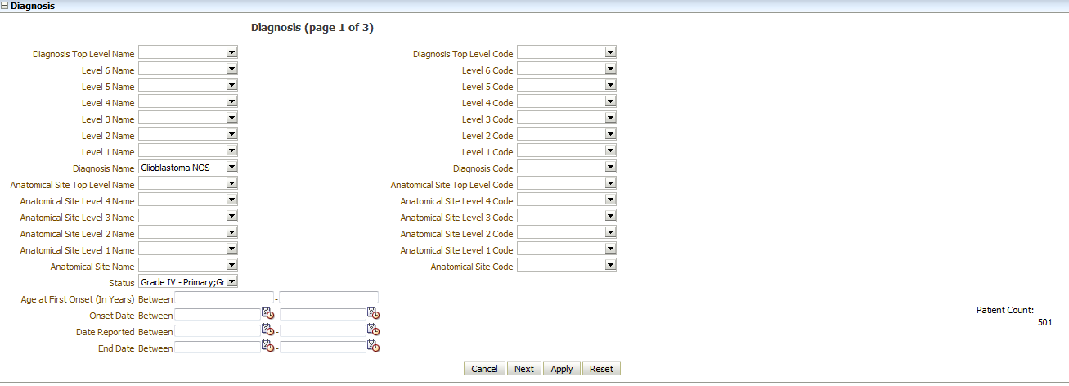
Cohort Selection
Gene expression profiling of Grade-IV Glioblastoma patients
Select patients who
  have consented to Complete Cancer Care (CCC)
  have diagnosed with Grade-IV Glioblastoma
  have specimen necrosis < 50%
  have specimen nuclei > 80%
24
Notes:
Target customers if appropriate

Slide 25
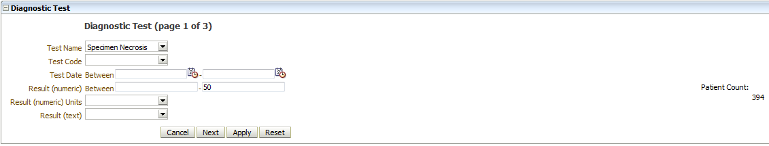

Cohort Selection
Gene expression profiling of Grade-IV Glioblastoma patients
Select patients who
  have consented to Complete Cancer Care (CCC)
  have diagnosed with Grade-IV Glioblastoma
  have specimen necrosis < 50%
  have specimen nuclei > 80%
25
Notes:
Target customers if appropriate

Slide 26
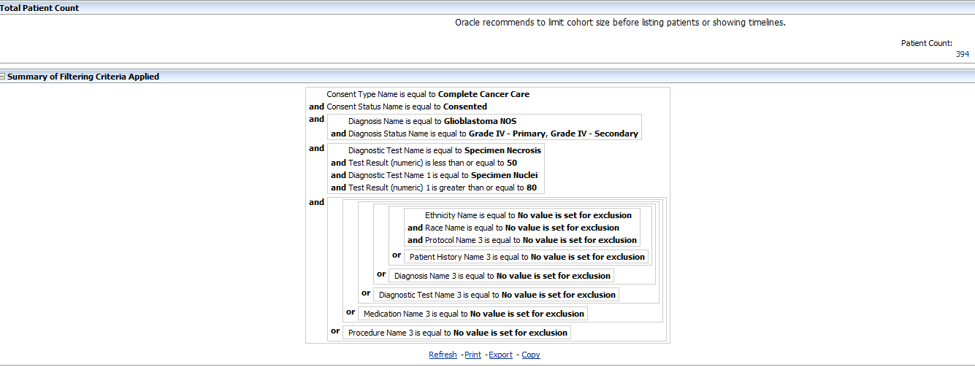
Cohort Selection and Exporting the Results
Gene expression profiling of Grade-IV Glioblastoma patients
Select patients who
  have consented to Complete Cancer Care (CCC)
  have diagnosed with Grade-IV Glioblastoma
  have specimen necrosis < 50%
  have specimen nuclei > 80%
Patient count: 394
26
Notes:
Target customers if appropriate

Slide 27
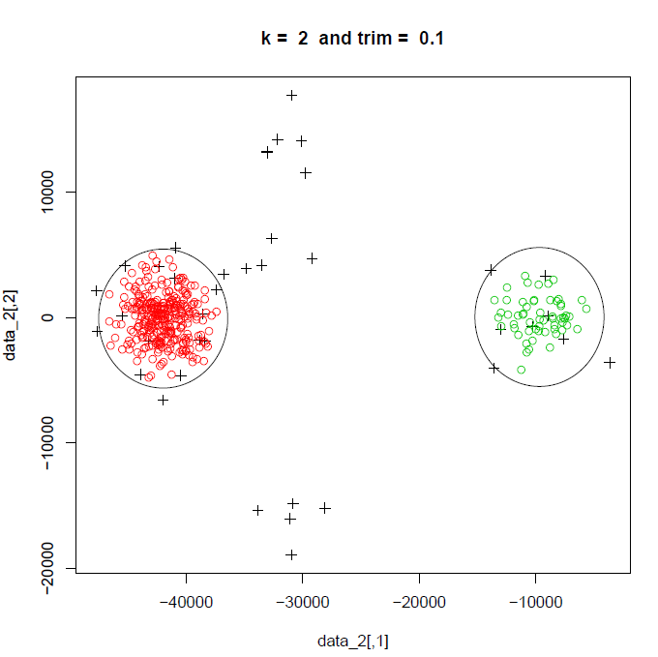
Clustering results based on a subset of genes
27

Slide 28
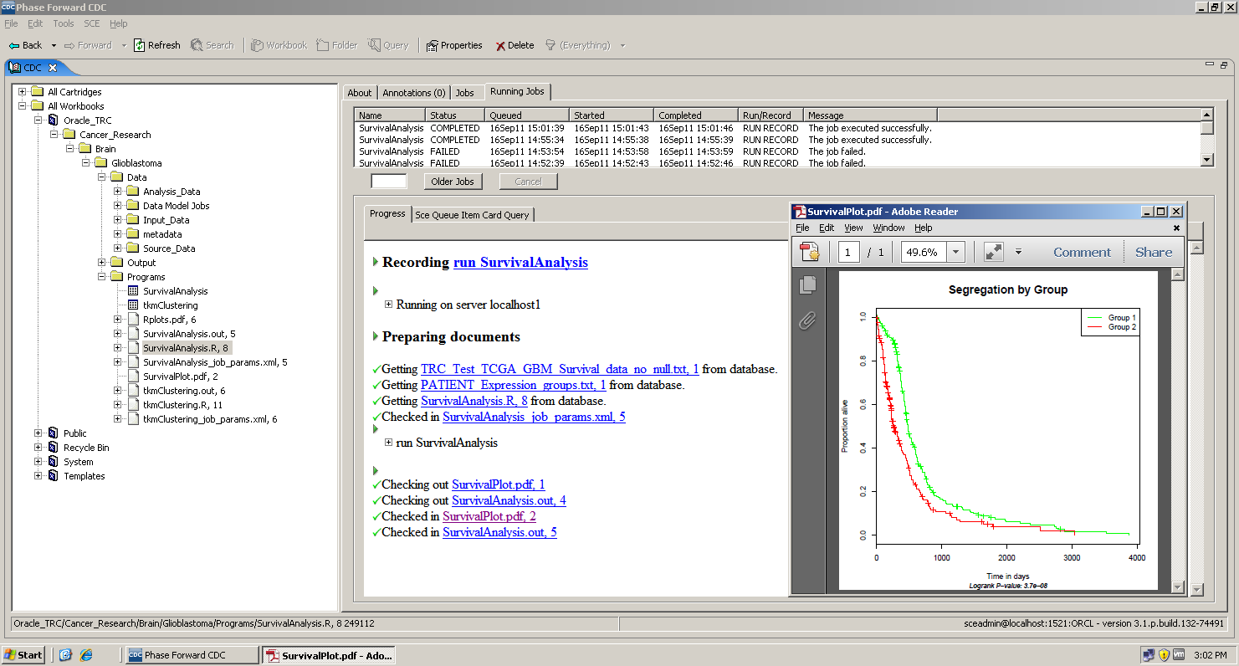
Kaplan-Meier survival analysis of these two groups
28

Slide 29
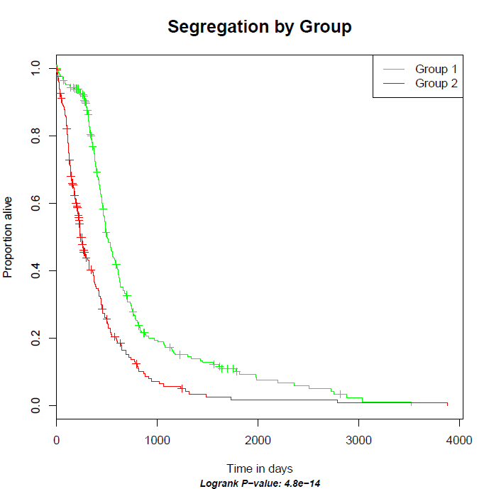
Analysis yields insights on patients survival differences based on molecular signature
29

Slide 30
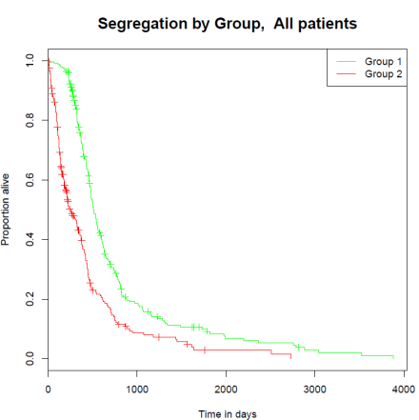
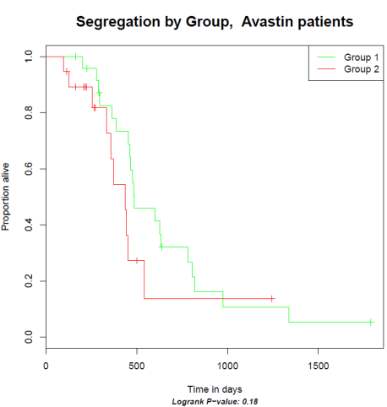
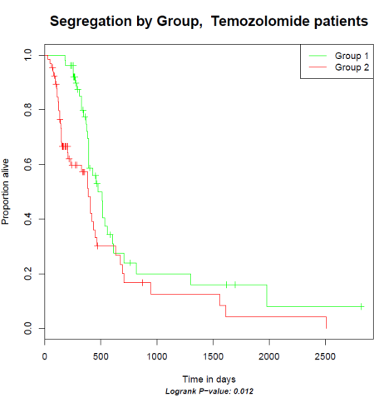
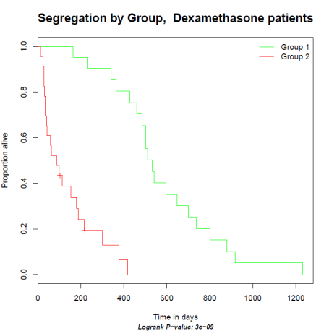
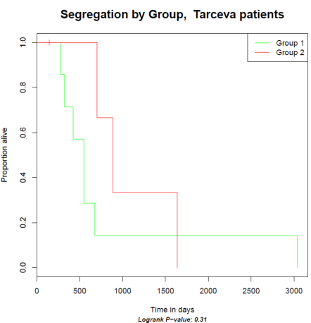

The two groups are further stratified based on medication
Insight
30

Slide 31
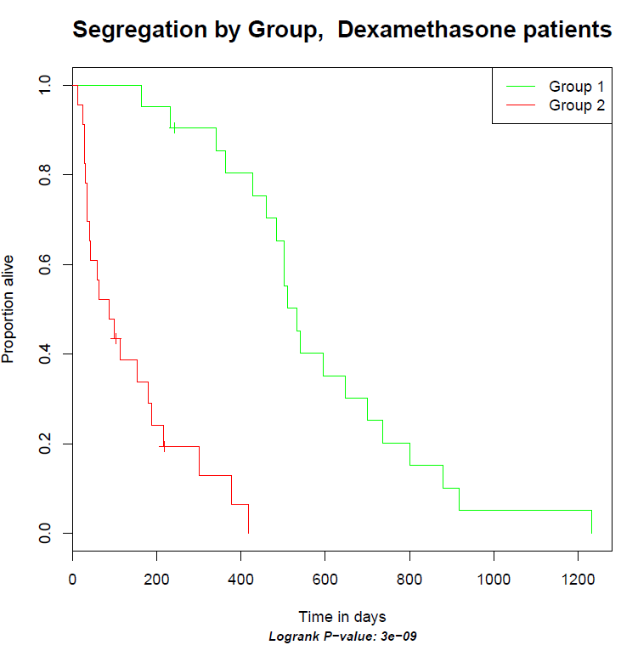
Actionable insight: patients in group 2 do not respond well to Dexomethasone
Save unnecessary expense by not treating these patients with therapy that is likely to not benefit them
Increase quality of life by sparing them unwanted side effects of likely ineffective therapies
Enroll these patients in any available new investigational drug trials based on their tumor genetic profile
31

Slide 32
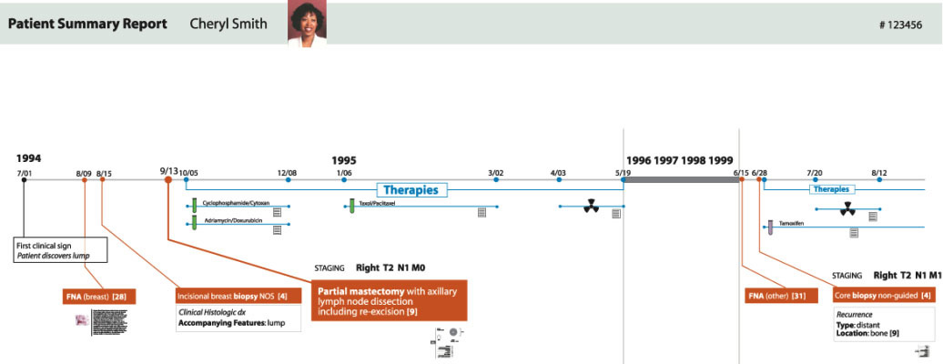
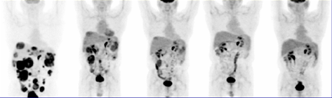

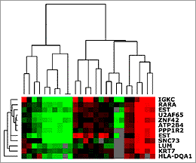
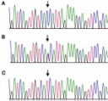
Transforming care through personalized medicine
Molecular Profiling of tumor biopsy
Treatment with therapies targeted toward genetic context of tumor
Further biopsy to assess genetic makeup of remaining tumor
Further treatment using alternative targeted therapies
Monitoring of blood biomarkers
Monitor objective tumor response with imaging
32
Notes:
Targeted therapy in action. Physical sympton (lump) detected. Ideal world you’d have got to them before they detected it themselves. You can treat asymptomatically. Give them a therapy, that you know will work that is targeted for that specific gene.
This assumes you have:
Biomarkers – must come up with these tools that get applied
Done cancer tissue versus normal tissue
Test and validate that these genes are important in predicting elements of the disease
These biomarkers may also be drug targets
Run a drug discovery program
EMR and omic data both inform the discovery –
Social element – comes during biomarker discovery
Whole community needs to validate them.

Slide 33


