Slide 1
On Scylla and Charybdis…
Johan van der Lei
Dept. Medical Informatics
Erasmus Medical Center
Rotterdam, Holland

Slide 2
Johan van der Lei
Medical background
Don’t like computers
Need the machines

Slide 3
medical informatics
dates from the second half of the 1970s
based on French: informatique medicale
Other terms:
health informatics
medical computer science
medical information sciences
computers in medicine
biomedical informatics

Slide 4
medical informatics
…. comprises the theoretical and practical aspects of information processing and communication, based on knowledge and experience derived from processes in medicine and health care.
Van Bemmel

Slide 5
medical informatics
…. is the science of using system-analytic tools … to develop procedures (algorithms) for management, process control, decision-making and scientific analysis of medical knowledge.
Shortliffe

Slide 6
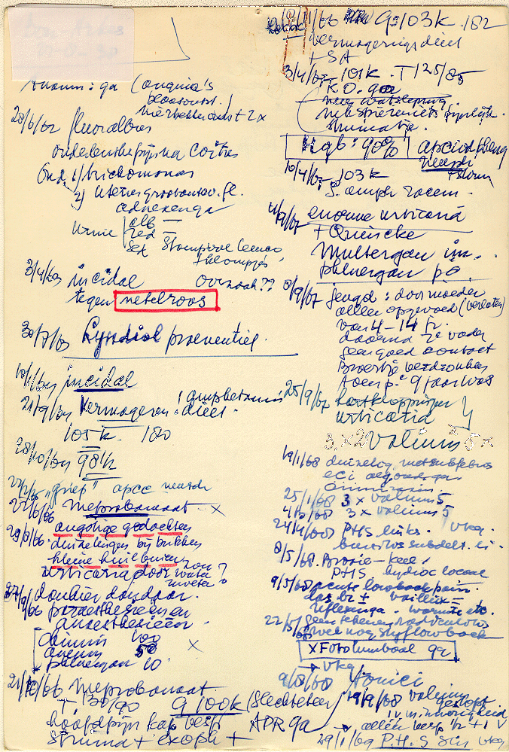

Slide 7
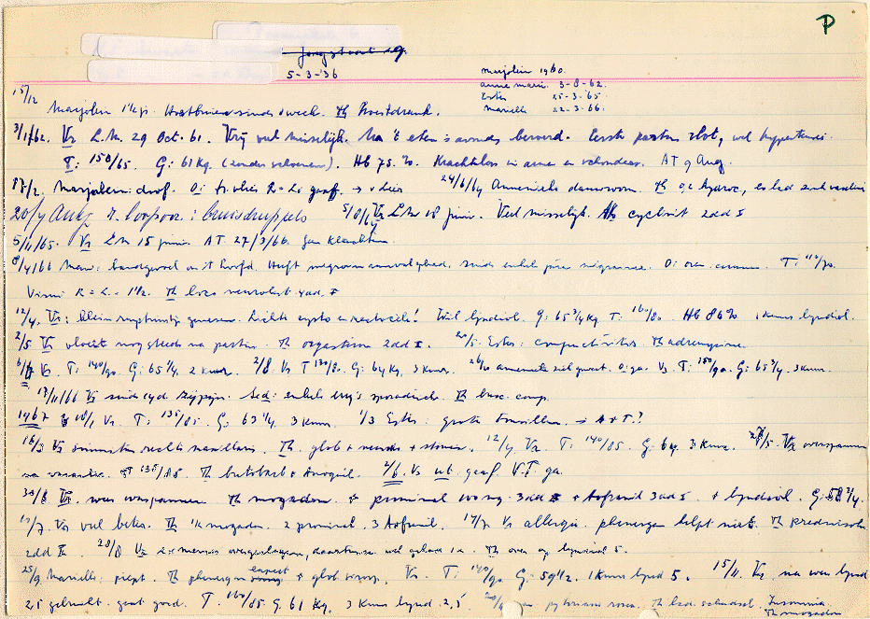

Slide 8
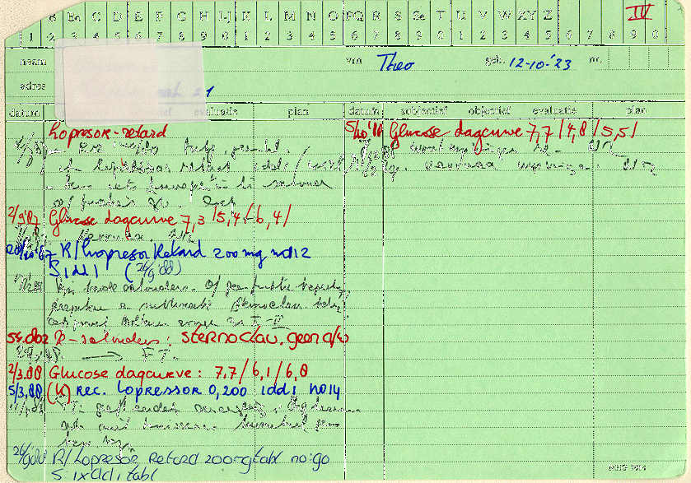

Slide 9
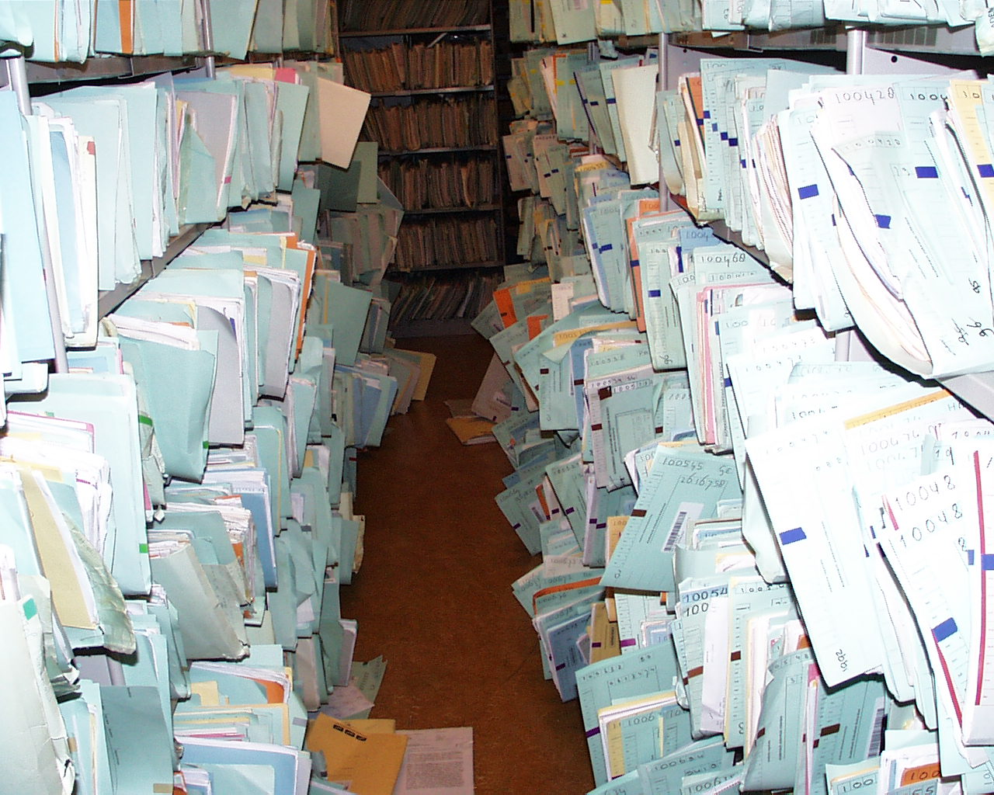

Slide 10
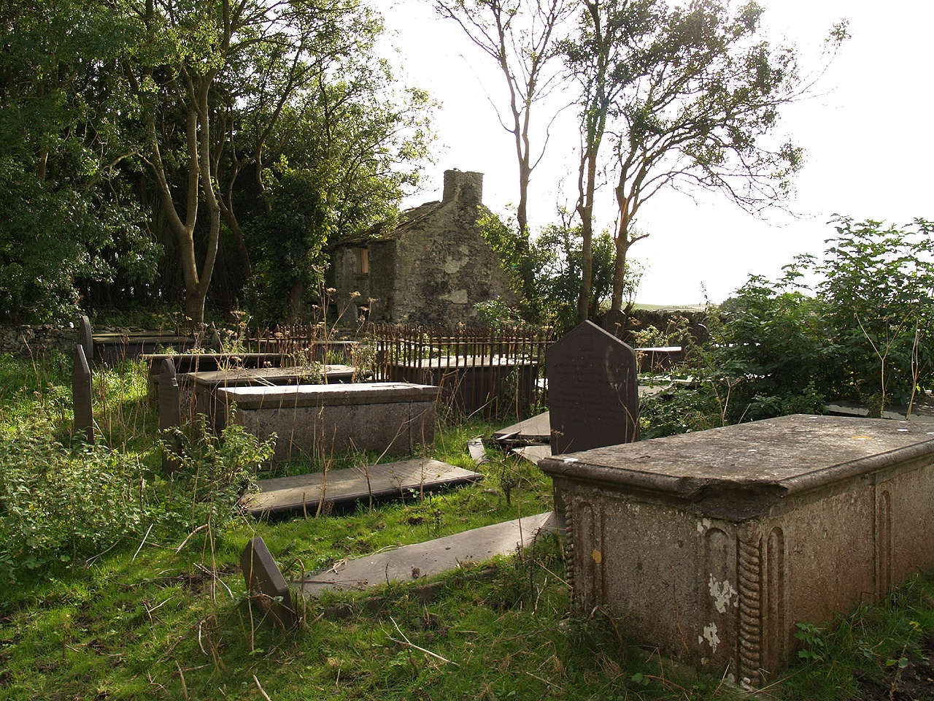

Slide 11
The Odyssey, book 12
…. Next came Charybdis, who swallows the sea in a whirlpool, then spits it up again. Avoiding this we skirted the cliff where Scylla exacts her toll. Each of her six slavering maws grabbed a sailor and wolfed him down.

Slide 12
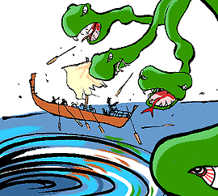

Slide 13
Scylla and Charybdis
Minor Greek gods
Represent natural processes
Cannot be controlled
Failure to recognise either: you get killed
Does not require choice but
Requires navigation

Slide 14
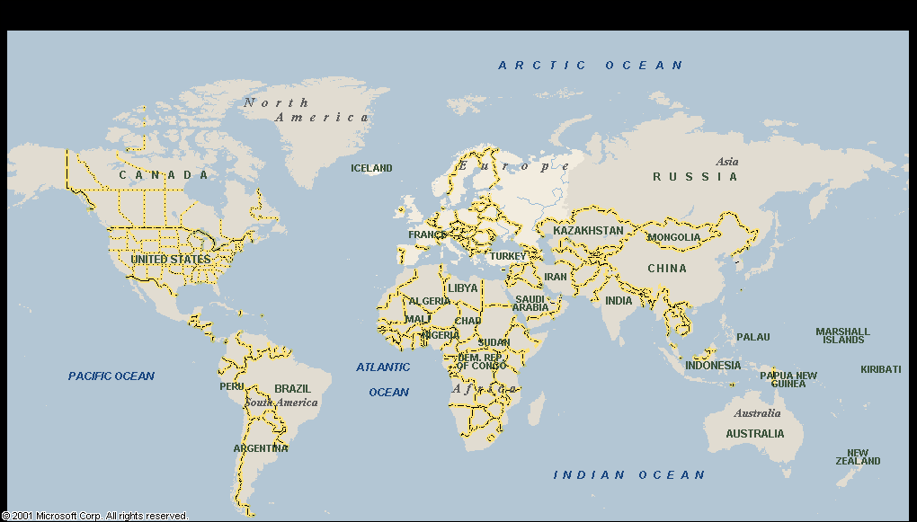

Slide 15
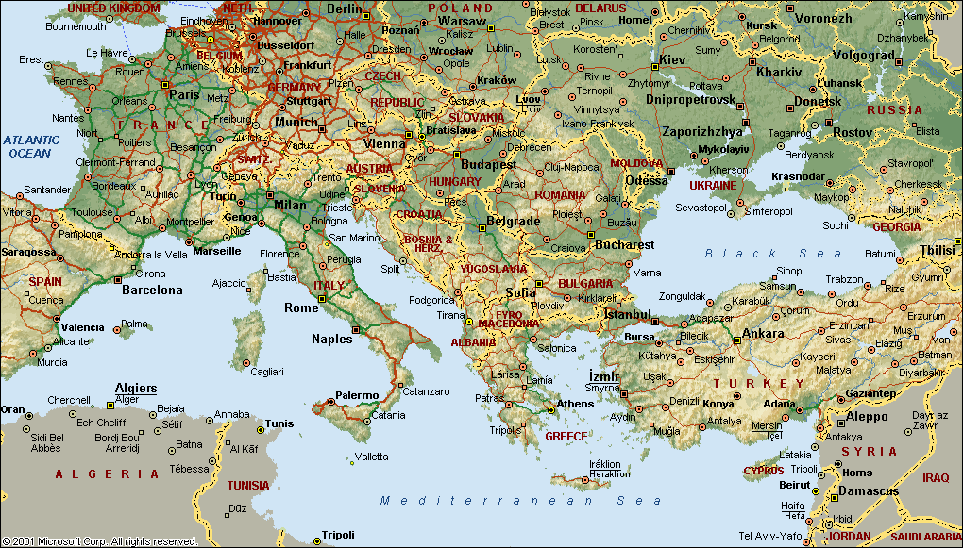

Slide 16
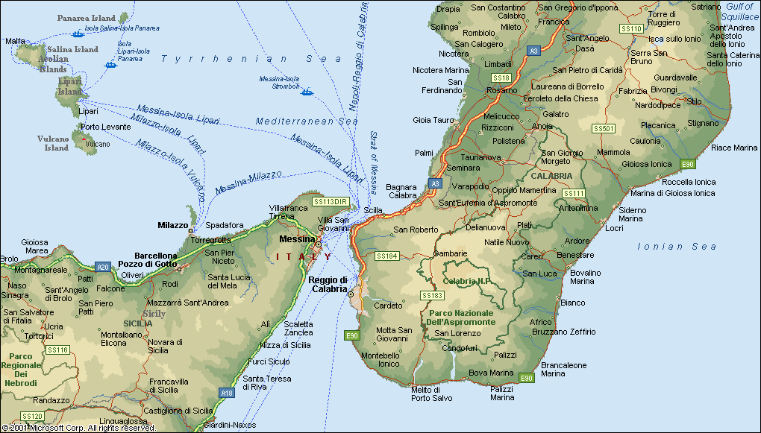

Slide 17
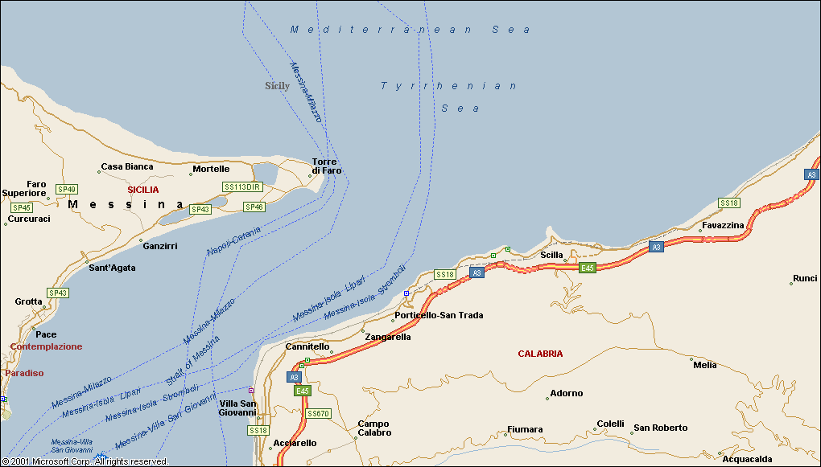

Slide 18
Meet Scylla
Paper records:
not accessible
not enough structure
Electronic records:
data available for many purposes
billing
patient care
quality
control costs
research
etc etc etc etc …….

Slide 19
100
90
80
number of installed systems
number of systems with CPR
70
60
50
Percentage of primary care practices
40
30
20
10
0
78
80
82
84
86
88
90
92
94
96
Year
Growth of CPR systems in primary care

Slide 20
Meet Charybdis
J.F. Burnum
The misinformation era: The fall of the medical record. Annals of Internal Medicine, 1989;110:482-4
“With the advent of the information era in medicine, we are pouring out a torrent of medical record misinformation.”
“All medical record information should be regarded as suspect; much of it is fiction.”

Slide 21
EPR: Medical Data
Human Artefacts
Do not exist “an sich”
“Real-world entities” observed and described by humans

Slide 22
Use of Data!
Registration has a purpose
Purpose determines
what
how

Slide 23
Ignore Purpose:
Physicians hide information (Burnum 89)
Everybody optimises income (Hsia 88)
Control is exerted (Comm ACM 90)
Analysis difficult (Zwetsloot 90)

Slide 24
Computers and patient data
Remove the protection provided by paper
Change fundamentally the nature of data

Slide 25
….. but
The more things change, the more they stay the same
1515

Slide 27
Erasmus
“Erasmus, who never realized how insulting he was, always gave cause to misunderstanding and conflict. Norms and values were not yet adapted to the art of printing that increased the publicity of the written word thousand fold. Only slowly the distinction between the public, meant for many, and the private, meant for just a few, emerged.”
Johan Huizinga, Erasmus, 1924

Slide 28
Reflection
Data were recorded for a purpose ….
We are mixing purposes ….
We encounter conflicts
Conflicting results
Conflicting priorities
Conflicting roles
Start to understand different requirements

Slide 29
First law of medical informatics
data shall be used only for the purpose for which they were collected
collateral:
if no purpose was defined, they should not be used

Slide 30
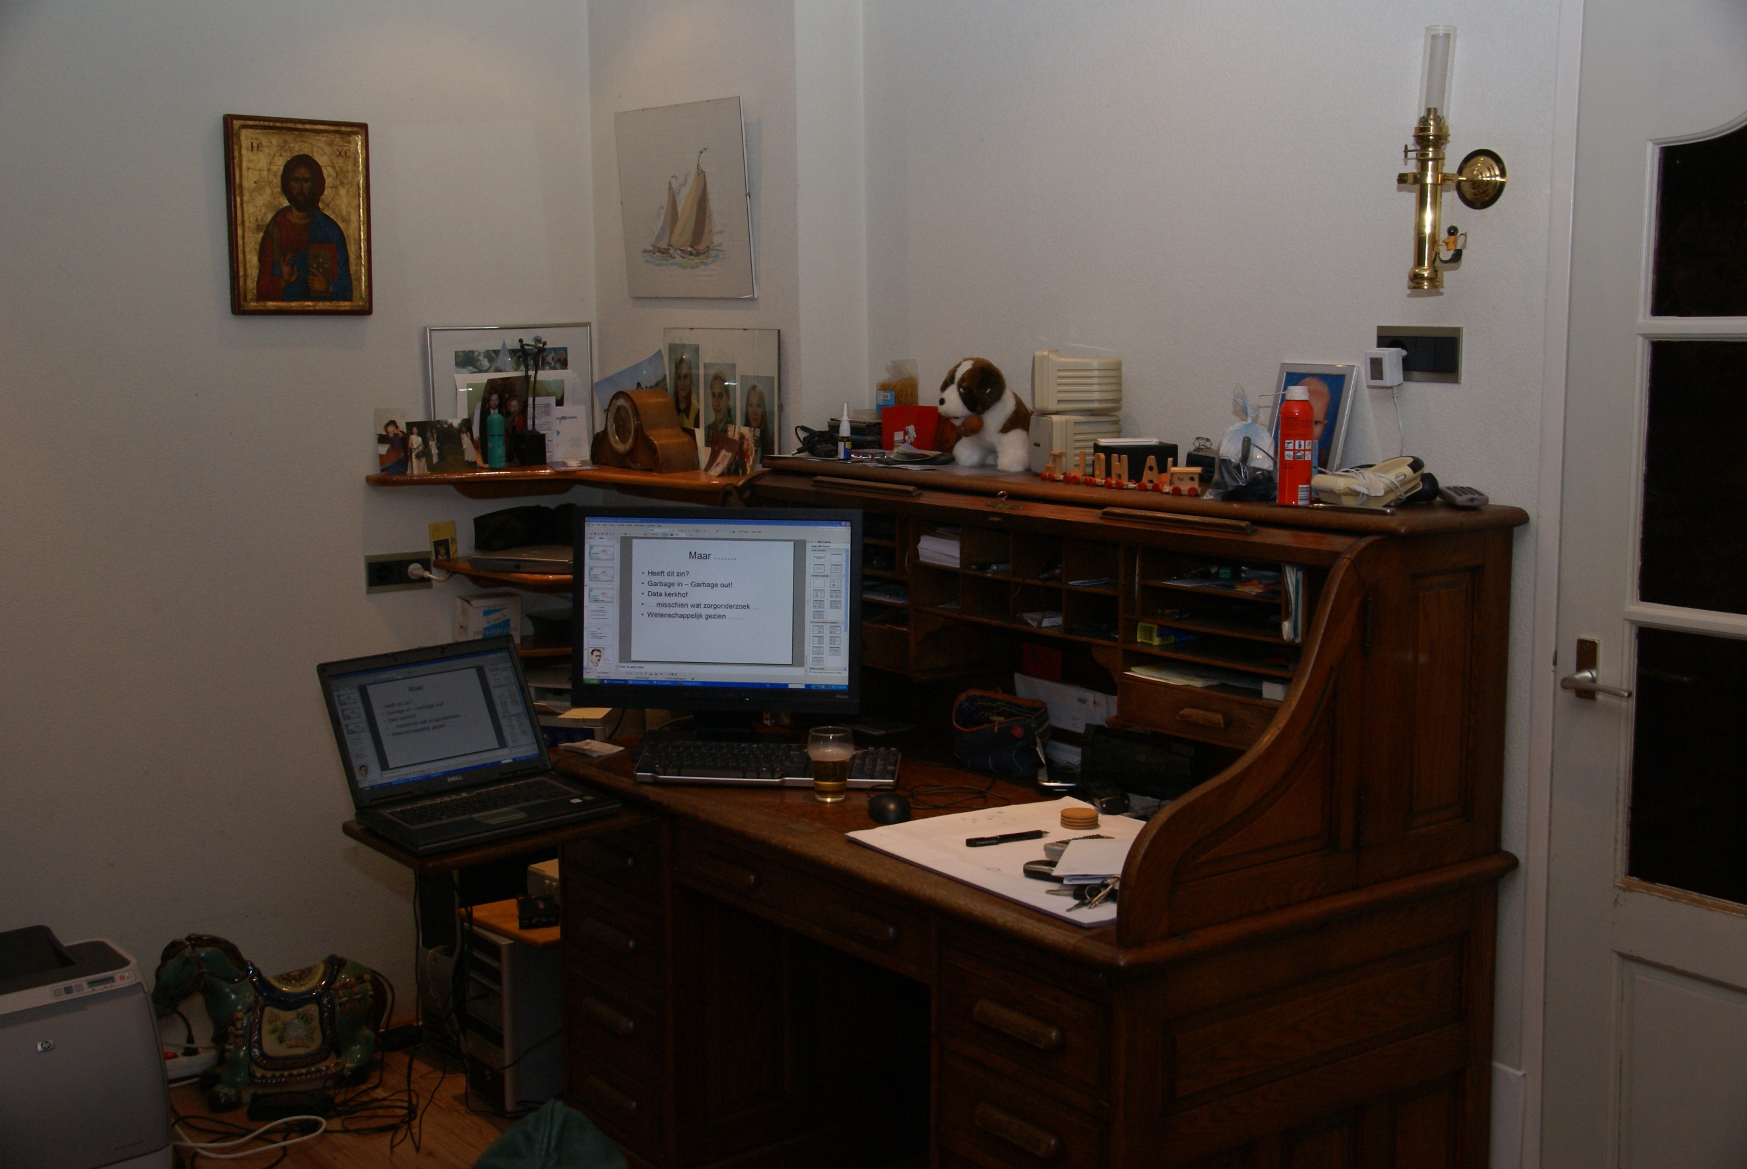

Slide 31
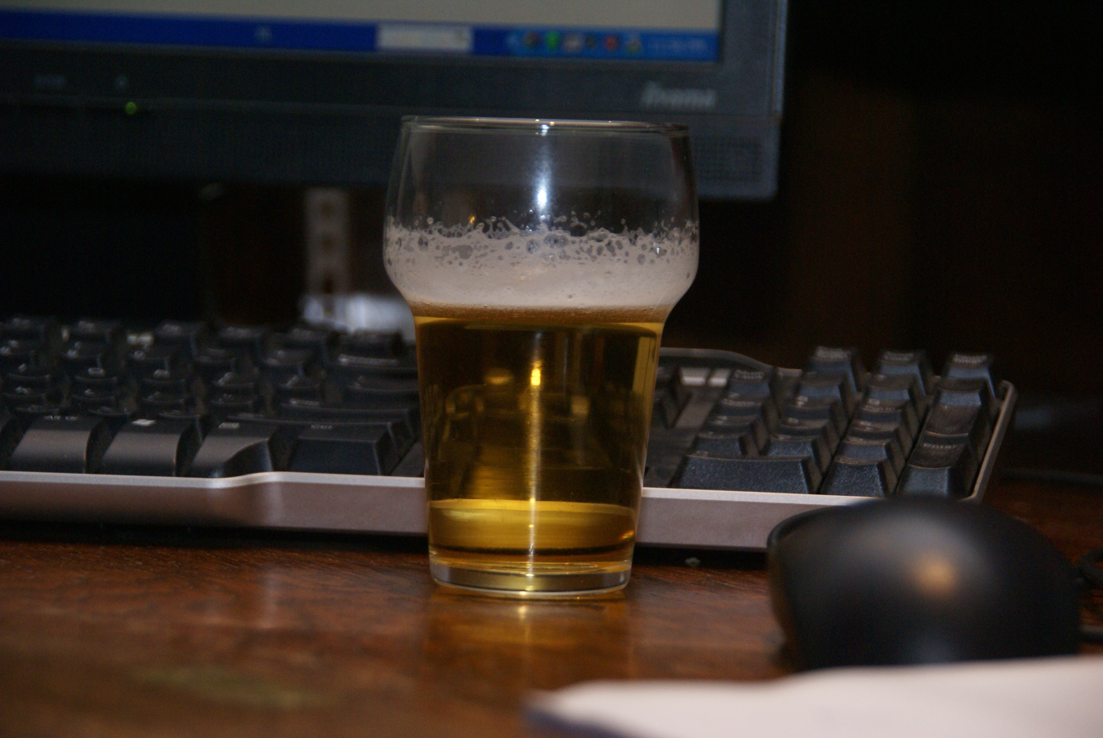

Slide 32
When working ..
From data starvation to
Data diarrhea
Navigate between Scylla and Charybdis
Acknowledge the fundamental change
You cannot predict the wind
Set short-term goals
Start worrying …..

Slide 33
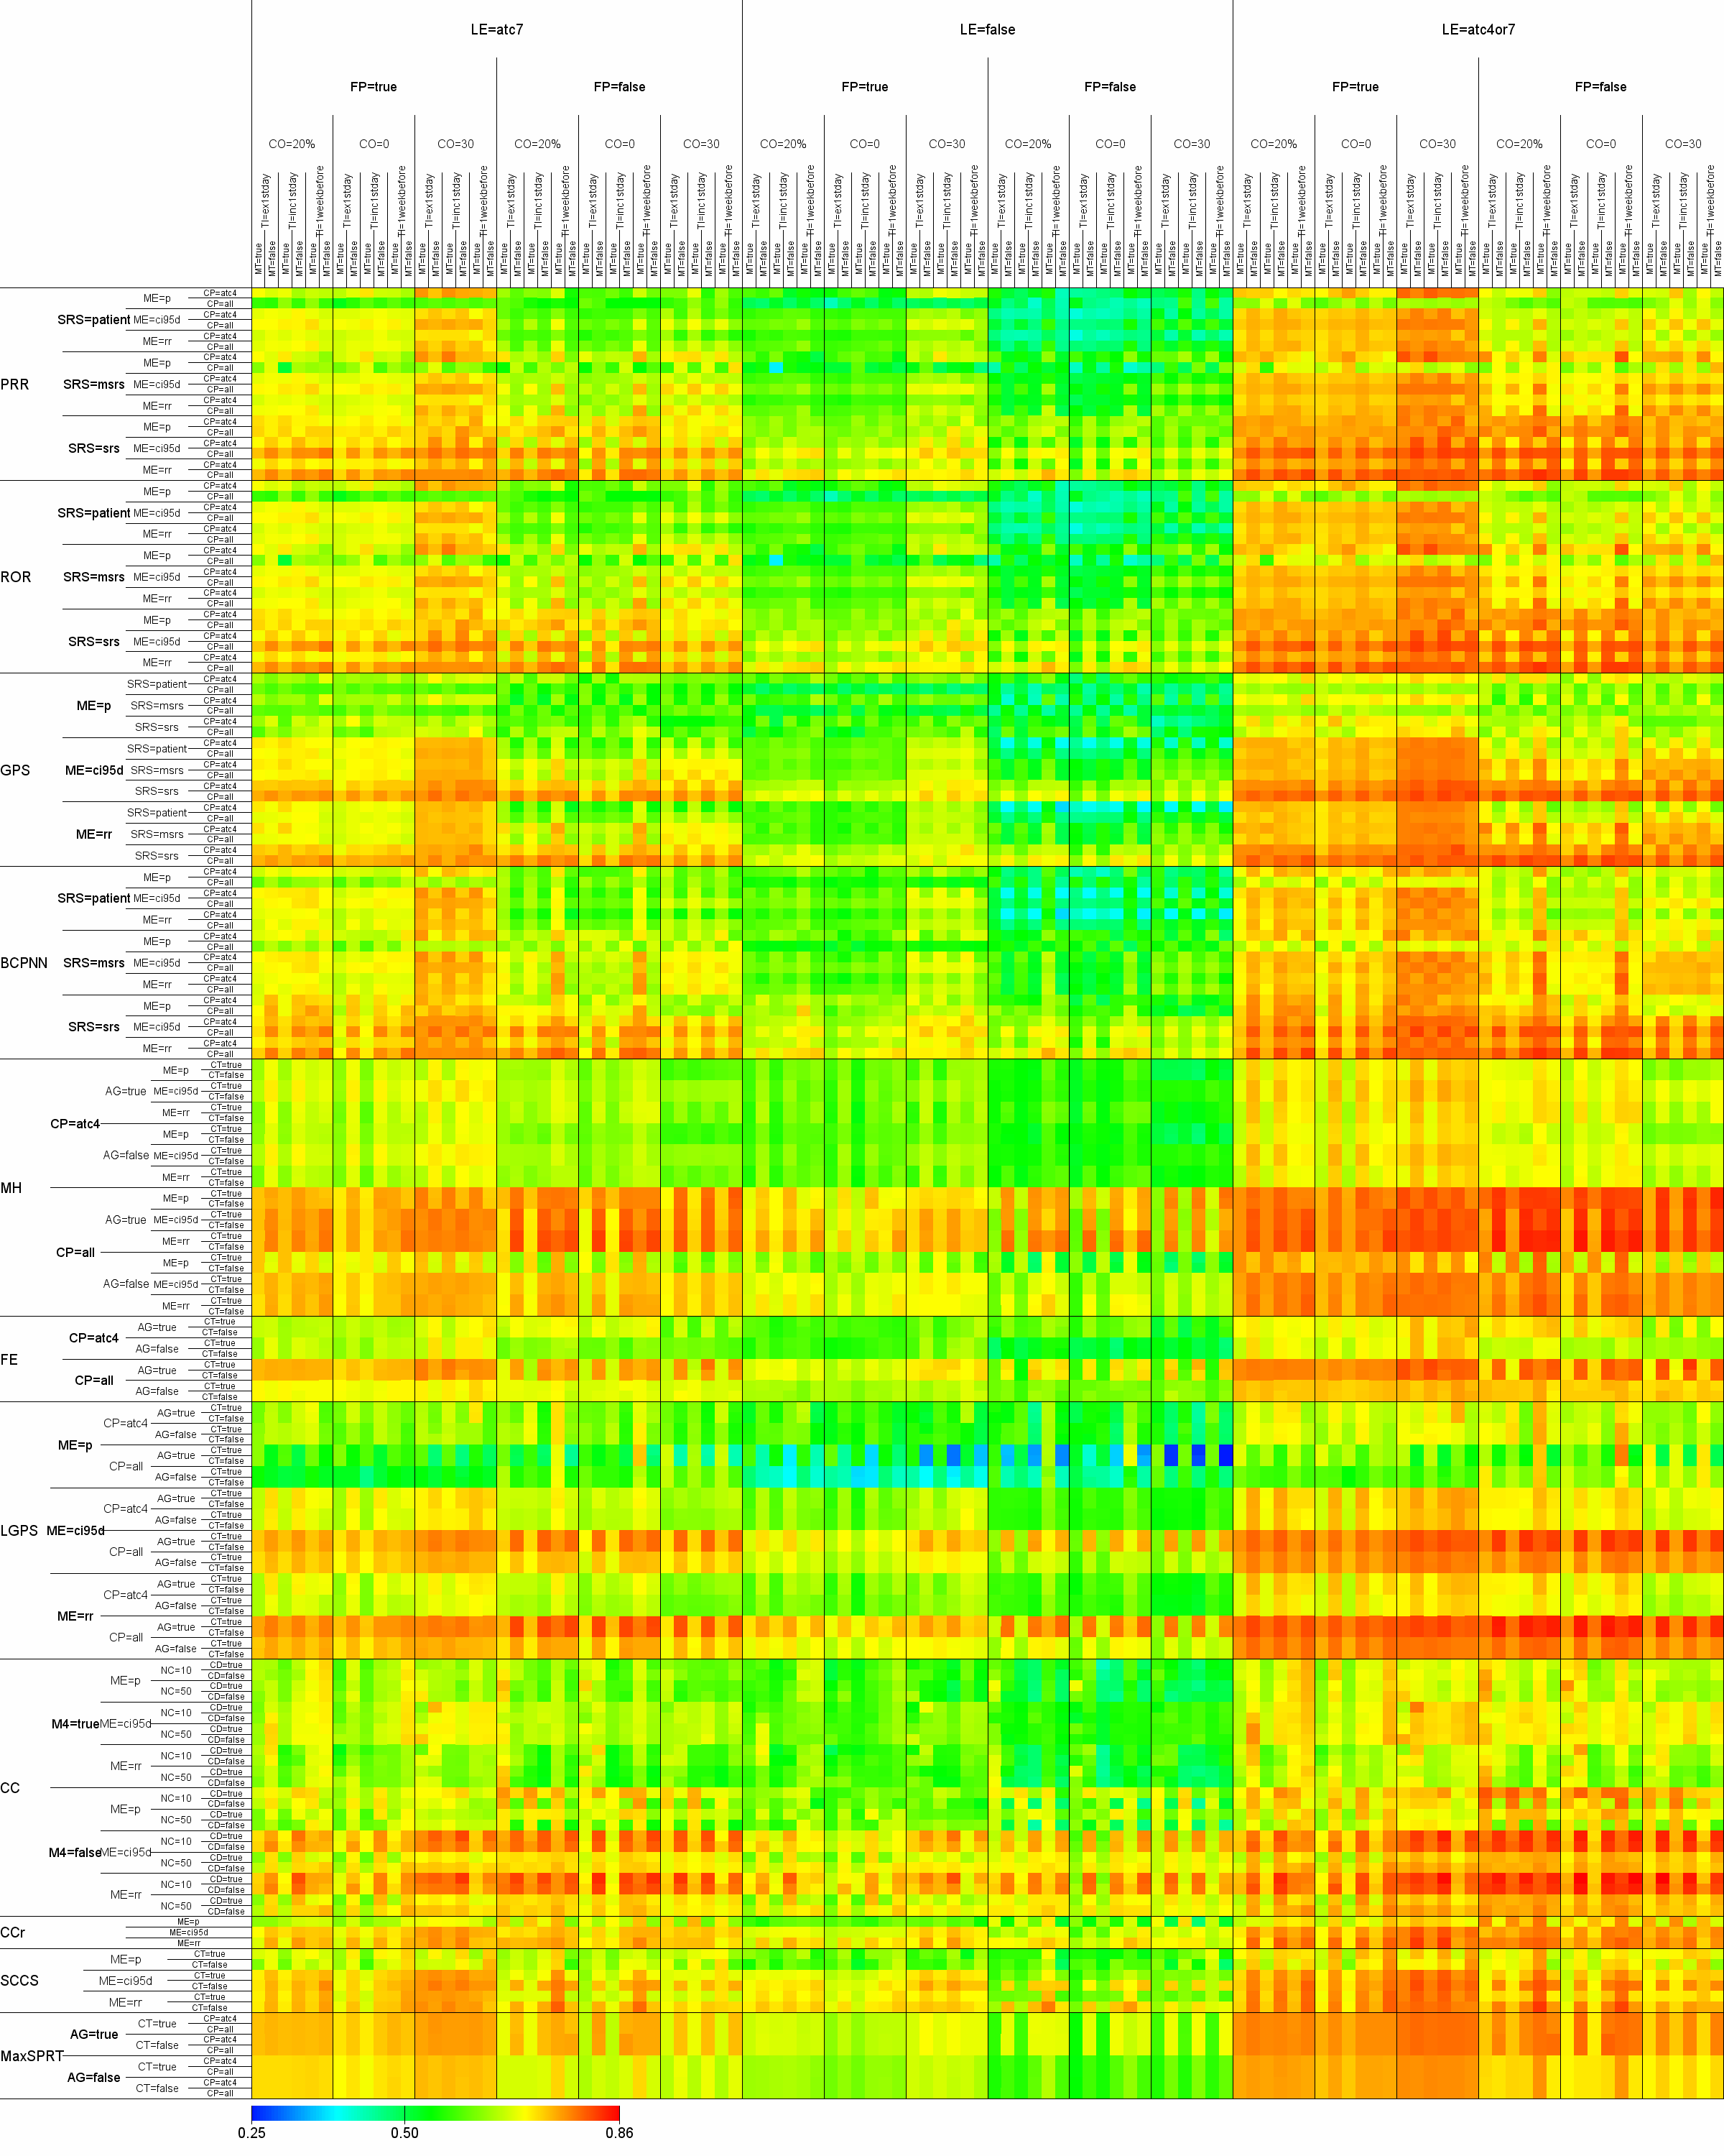
Each dot represents a set
of parameters + a method
18,252 dots

Slide 34
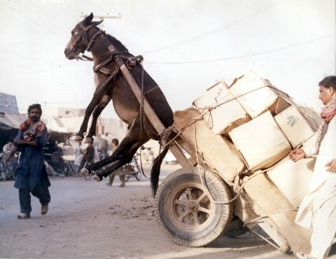

Slide 35
T.S. Eliot
1888 – 1965
1934: The Rock

Slide 36
T.S. Eliot
Where is the life we have lost in living?
Where is the wisdom we have lost in knowledge?
Where is the knowledge we have lost in information?
and,
Where is the information we have lost in data?

