Slide 1




The openEHR Foundation
- Some Lessons of Experience in Standardising the EHR
David Ingram
Emeritus Professor of Health Informatics at UCL
Founder and President of the openEHR Foundation
Director of Charing Systems Ltd
Patient-Centred Approaches to R&D
PRISME Forum , May 22nd 2012

Slide 2
The openEHR Foundation
- Some Lessons of Experience in Standardising the EHR
Context - five decades of innovation in health care and IT
The openEHR Foundation - working towards EHR standards, experimentally
Some related new open source and open data initiatives

Slide 3
Personal Journey
late 1960’s - Industry - medical devices, laboratory automation, hospital development
early 1970’s - NHS - building systems for radiotherapy, nuclear medicine and intensive care
mid/late 1970’s – Basic research - Mathematical modelling of body systems
1980’s – Educational computing - Clinical skills and informatics
1990’s – Translational research - Systematising health records
2000’s – Social Enterprise - openEHR Foundation
2010’s - Business - Charing Systems Ltd, aims to help clinical communities and system developers use and integrate open-source resources within their services and products

Slide 4
Context - Five decades of innovation in health care and IT

Slide 5
Co-evolving health care and informatics focus over 5 decades
Pervasiveness of information systems
Bioinformatics, e-Health
Personalised Medicine, & Self- Management
Health Systems, Data Standards, ontology
Quality
& Safety
Health Care
Primary Care
& Public Health
Medical Practice
Healthcare Management
Medical Physics
Clinical Specialism
1960’s
1970’s
1980’s
1990’s
2000’s
2010’s
Mainframe/IBM Mini/DEC Micro/Microsoft Internet/Google Grid/Smartphone/Cloud…
/Intel
Apple/Amazon/Facebook,..
Notes:
40 years from Ledley and Lusted: chromosome karyotyping using bayesian analysis
waste
In 1995 more than $US140 billion was spent on IT projects in the USA that were either cancelled or "re-defined”
84 percent of projects failed to deliver what the stakeholders needed and wanted
Dec/Jan ‘96 edition of Software Magazine

Slide 6
The current scene
Biomedical science is being transformed
  ‘bioinformatics is core discipline of biology’ – Royal Society 2005
Health care and research are increasingly technology and information intensive
  ‘information is the heart of medicine’ – BMA 1994
Multiple legacy information systems and frameworks are in use
  supporting and linking health care, research and industry
Governments want a pervasive and standardised (open source) ICT infrastructure for health care
Many initiatives, commercial and public domain, are creating relevant infrastructures

Slide 7
The Circle of Knowledge
philosophy
religion
mathematics
arts
information sciences
language, literature
systems, measurement
abstraction
industry, commerce
meaning,
context
physical science
economics
life science
law
rationalisation
environment
politics
medicine
demography
education
social structure
The Circle of Knowledge: encyclopaedia, Ranganarthan, 1950
UNESCO, The Basic System of Order

Slide 8
Records capture and organise knowledge and data to represent and communicate facts, opinions and events, in context and with implied meaning
Common usage of these terms is loose and varied, although Latin and Greek roots help to preserve some clarity
Information - has specialist meanings in physics and engineering.
‘Knowledge for the purpose of effective action’ is an interesting one here. Also:
Data -
‘Facts, given, from which others may be inferred’
Knowledge
Data
Information
The purposes for which the record is captured, organised and communicated, reflect in both its structure and its meaning

Slide 9
Patient, meaning & context lost amidst complexity
Life sciences
Knowledge
...the greatest consequence of improving information technology may be to organise intellectual inquiry around grand challenges rather than traditional disciplines
Neil Gershenfeld, MIT, 2001.
Environmental sciences
bioinformatics
Bioscience
Engineering
sciences
Medical sciences
Technology
Medicine
Systems biology
Systems engineering
Physics
DATA
DATA
Systems medicine
Systems theory
Computation,
systems,
measurement
Clinical sciences
Population science
Health informatics
Mathematics
Social and Economic Sciences
Ethics and law
Epidemiology
Management sciences
After Ranganarthan, the circle of knowledge

Slide 10
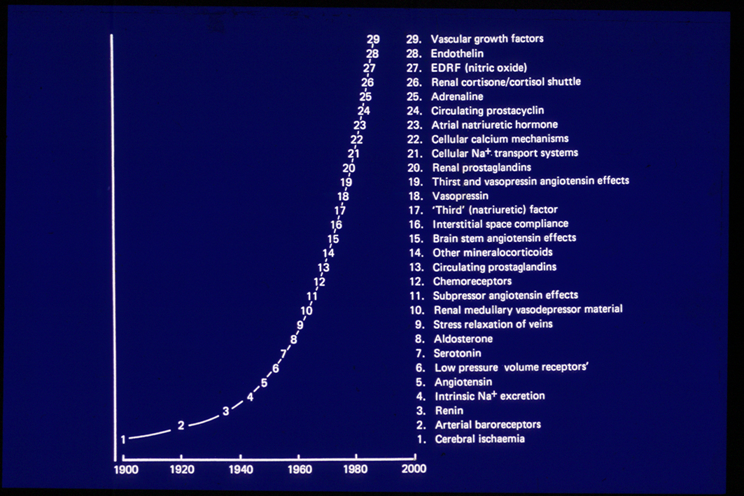
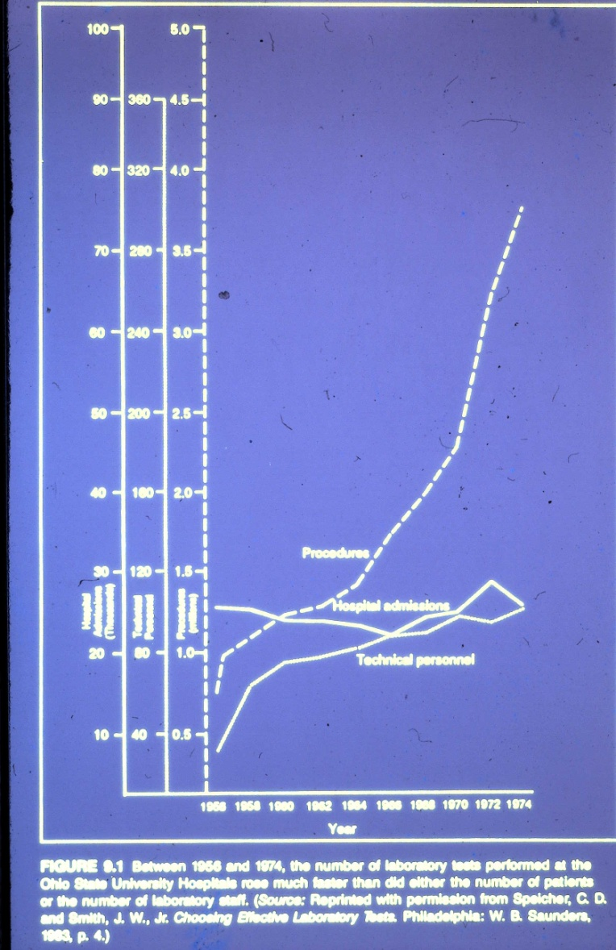
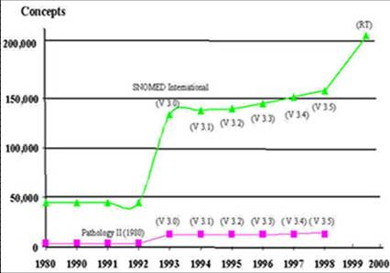
A study at Berkeley estimated that after taking 300,000 y to generate 12 Exabytes (10¹⁸) of information, the rate of accumulation today is around 5 Exabytes per annum.

Slide 11
In summary
  Massive change in pretty well all aspects of health care and IT
  Continuing fragmentation and re-integration of professional discipline and teamwork
  Knowledge/information/data overload coupled with loss of focus on patients and care
  Repeating failure to align national information policy with the state of the art of what is computable and implementable
  Health IT characterised by local successes, dependent on visionary innovators, but global failures
Oxfam – Think globally, act locally
Health IT spending has tended to do the opposite

Slide 12
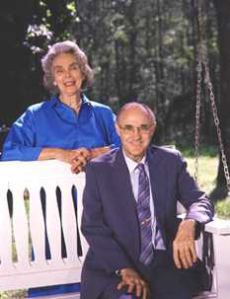
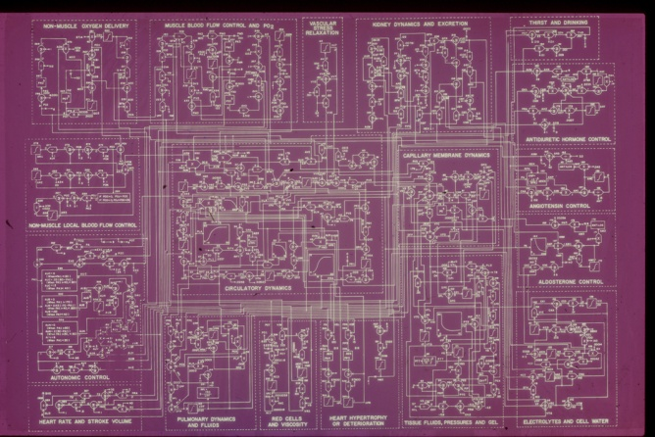
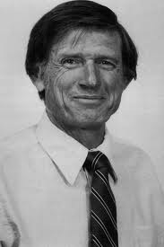
Amazing pioneers
Guyton, 1974 !
Arthur Guyton (with Ruth), President of the American Physiological Society, who transformed quantitative analysis of the circulatory system – forerunner of the Virtual Physiological Human
Octo Barnett, Professor of Medicine and Computer Science, who conceived and developed MUMPS at Harvard Medical School, underpinning the most successful period of innovation in hospital IT systems, worldwide
Successful pioneers combine attention to detail, leadership, courage and ability to work across boundaries. This is the pathway from local excellence to achieving global impact and change

Slide 13
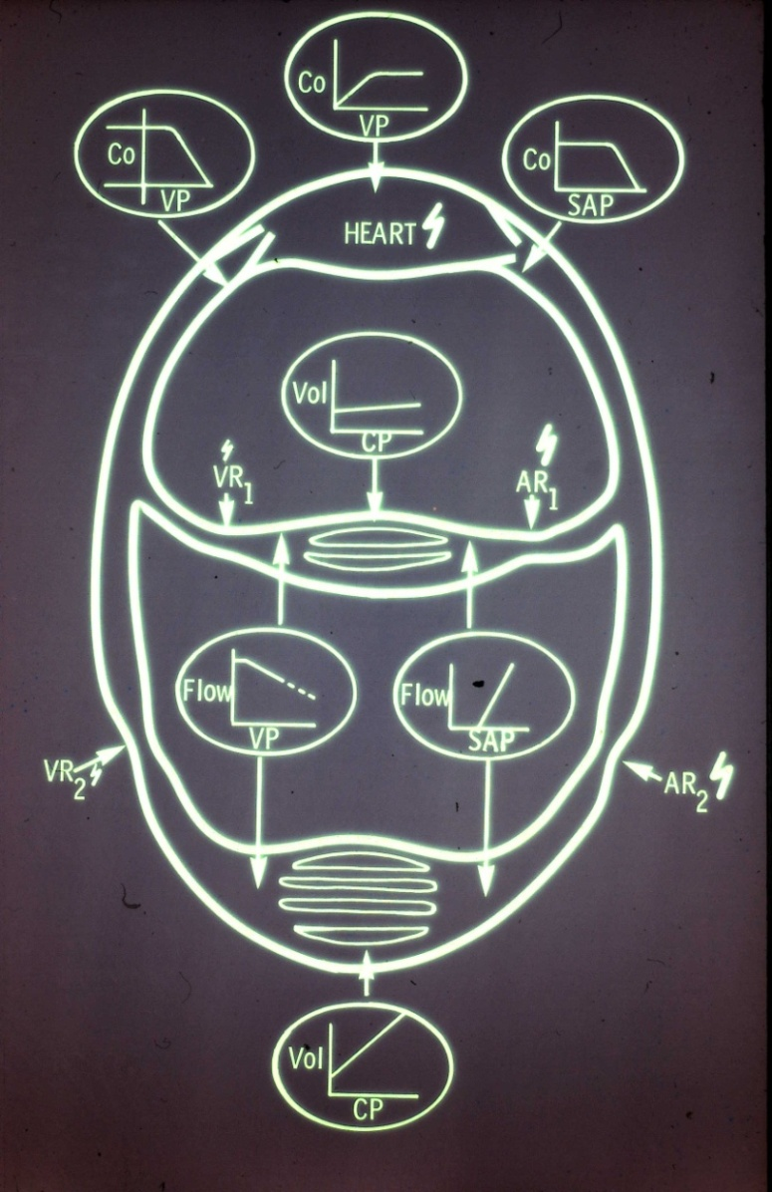
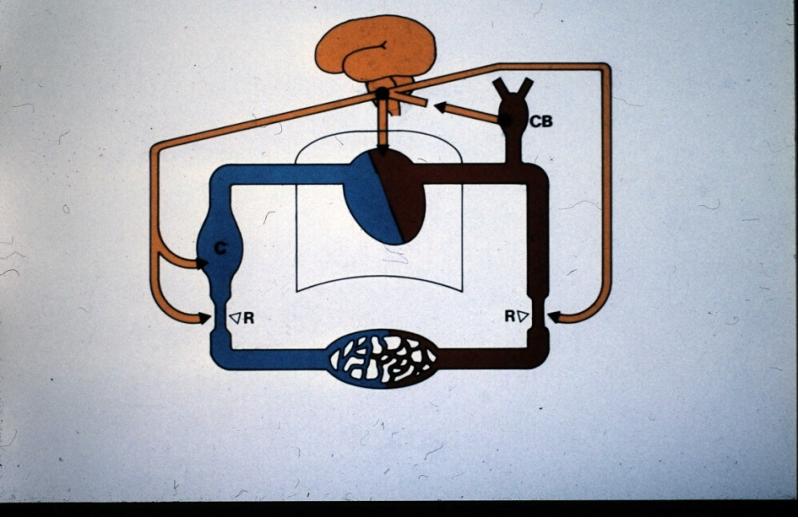
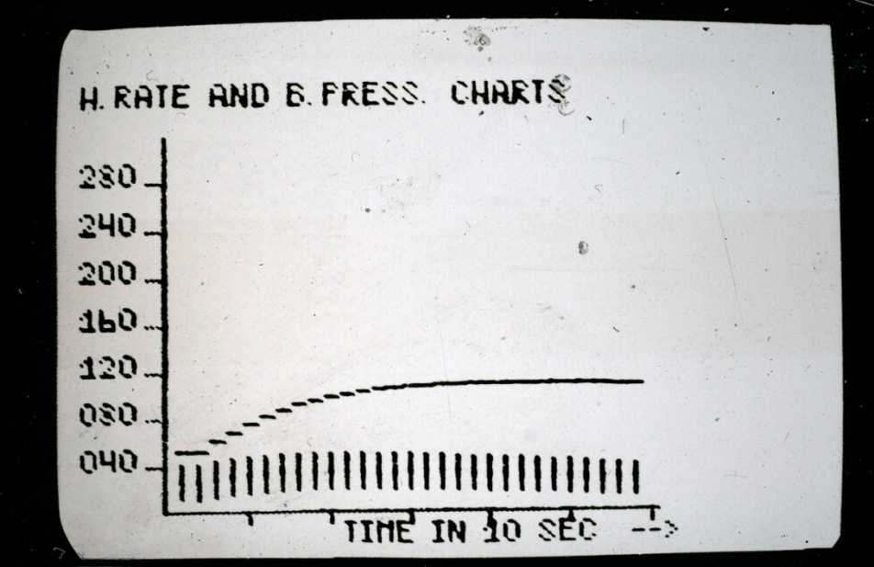
Ingram and Dickinson, 1971

Slide 14
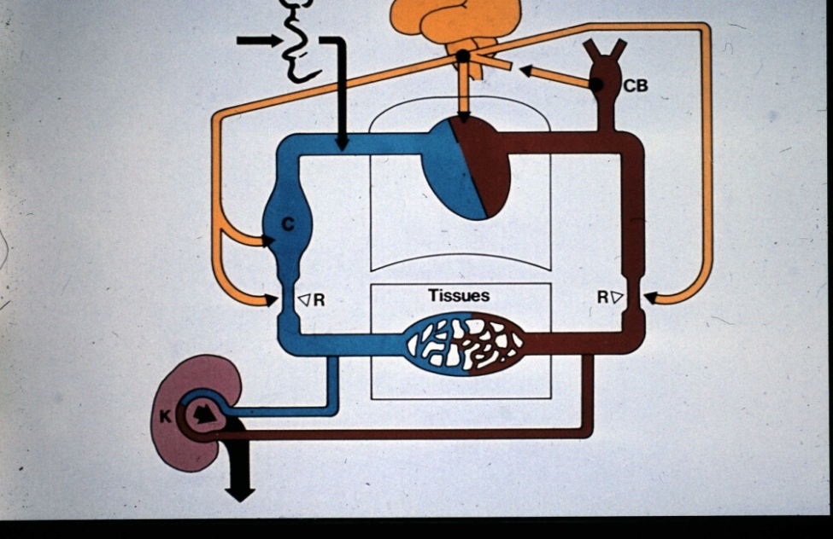
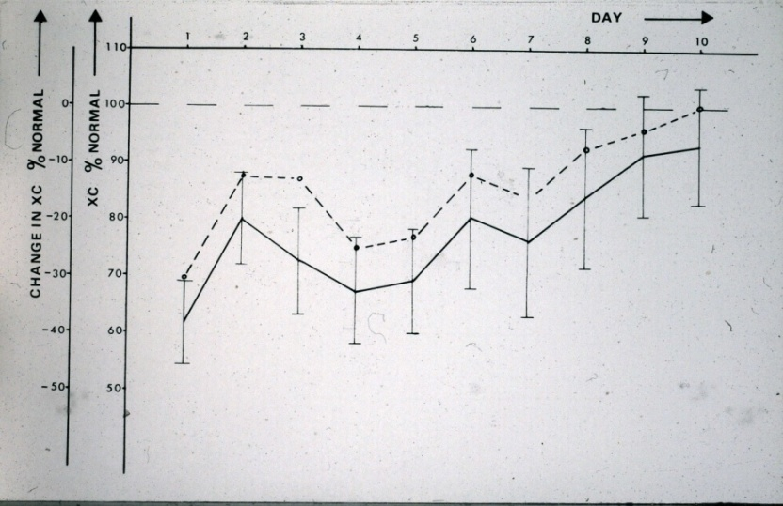
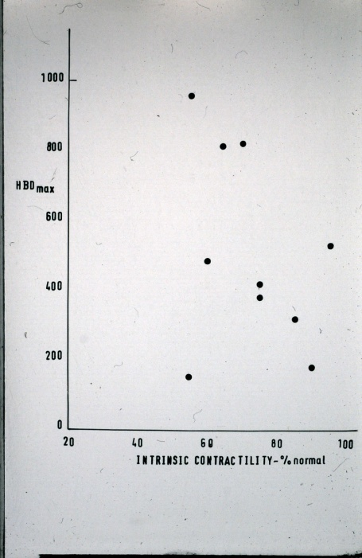
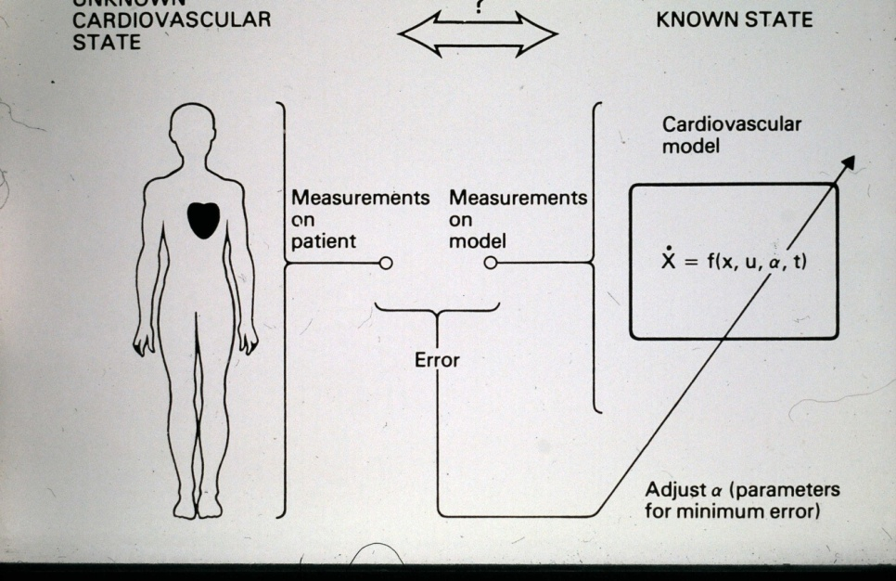
Ingram, 1973

Slide 15
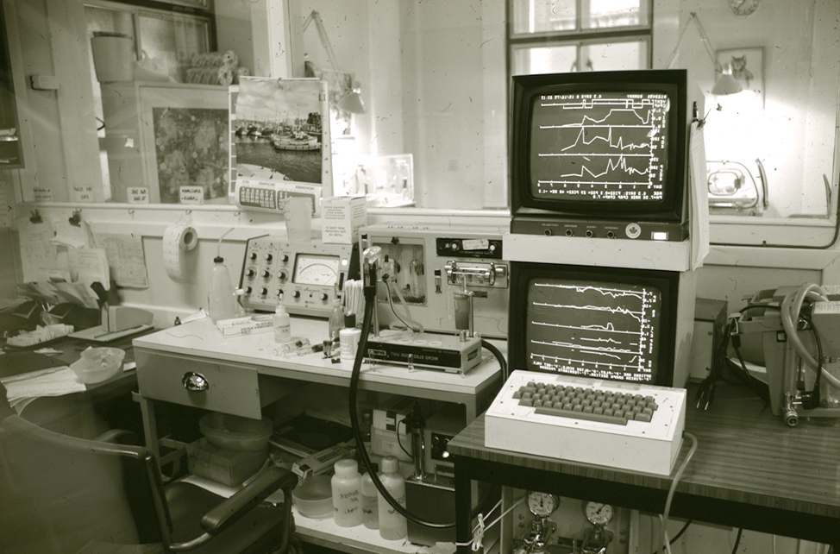
First encounter with electronic health records
University College Hospital, London - Neonatal Unit, 1974

Slide 16
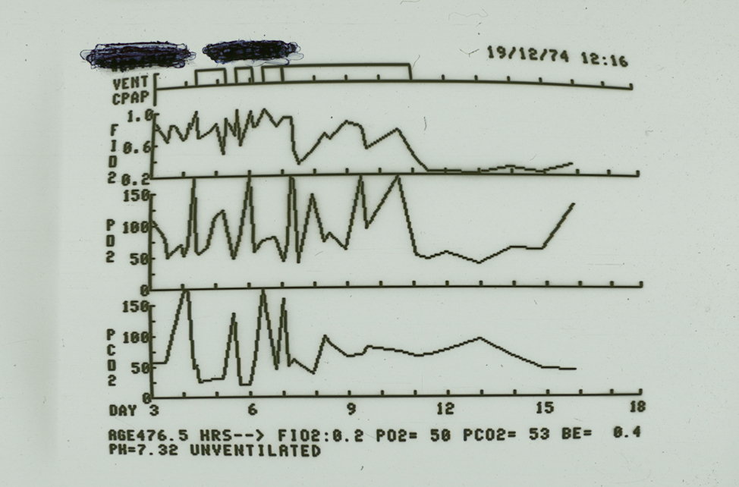
Electronic record of neonatal artificial ventilation management
Ingram and Allan, 1974 – Gas exchange and acid-base balance in neonates

Slide 17
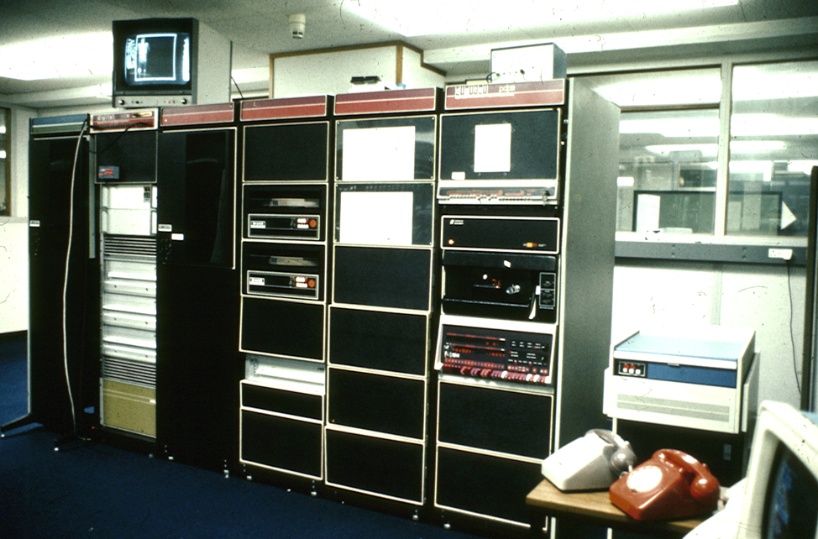
A successful research and development project
But none of this work exists or could run today, due to factors such as:
obsolescence of the hardware and software technologies
inability to sustain, develop and improve innovation to the level of viable product
First Digital Equipment Corporation PDP11/45, RSX11-D system in UK.
Providing 24x7 clinical service for several years

Slide 18
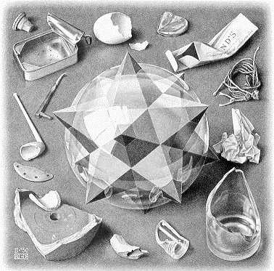
IT can help the good get better - and the bad get worse !
Escher: Order and Chaos
“To err is human, to really mess things up use a computer”!

Slide 19
The Best -
Health IT in all NHS acute hospital trusts c 2000
- Clinical approval and value for money
30 years experience of tertiary cancer institute IT systems development and operation at Royal Marsden Hospital, London
Demonstrating the importance of sustained innovation

Slide 20
Health IT in all NHS acute hospital trusts c 2000
- % of information items obtained by paper only

Slide 21
Health IT in all NHS acute hospital trusts c 2000
- Total expenditure and obtaining information

Slide 22
Communication and integration of services, across patient communities tells a different story
Survey of 750 patients with chronic conditions in each of USA, UK, Canada, Australia, New Zealand
  UK: 2/3 of patients not engaged in discussion about own treatment and care; 40% did not have goals of treatment made clear; 20% received conflicting information from different professionals
  UK: 20% were victims of medical error in past 2 years, 9% with serious consequences
  UK: 13% (US 22%) sent for duplicate tests, 1/2 have to repeat health history for different professionals, medical records not reaching consultation on time
Health Affairs, May 2003

Slide 23
State of patient records leaves a lot to be desired
UK Audit Commission report on Patient Health Records, 1995
36% of case notes not immediately available
Multiple records for patient in 75% of hospitals
40% of records poorly kept or not up-to-date
30% of history sheets inadequate
20% of prescriptions illegible
90% of discharge summaries contain no reference to information given to patients or relatives
US Institute of Medicine reported similar findings

Slide 24
Regulation - the letter of the law
Meanwhile private investigators can acquire personal medical records within days

Slide 25
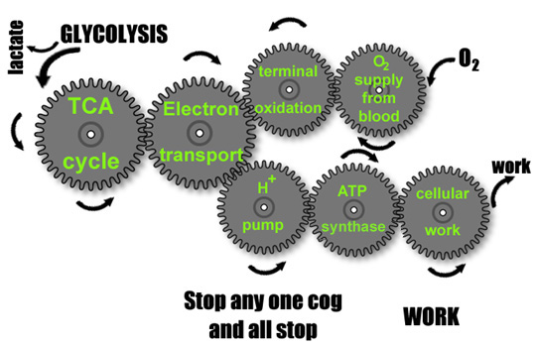
Integration – a mechanical analogy
Living systems are clearly complex and highly integrated
This conveys the meaning that the mechanisms must integrate if the system as a whole is to work (and the wheels to turn) - so far so good

Slide 26
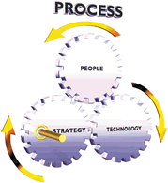
Loose talk!
A consultant writes:‘ Our approach towards CRM stems from the interaction of 4 key elements: Strategy, People, Technology and Process. These 4 elements combine in a "Cogwheel process" that drives the organisation.‘
CRM=Customer Relationships Management
!
These gearwheels can’t turn
Try too hard and one will surely break the system
Loose talk, based on little or no evidence, purporting to integrate policy, requirements, and design & implementation of systems causes trouble – this is aspirational engineering

Slide 27
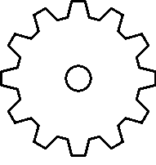
There’s a lot around and it has led to health care information systems that are dangerously opaque and entangled
Clinical aspects
Technical aspects
This entanglement costs us all, hugely, in many ways
Impacting: confidentiality?
safety? efficiency?
Cost and efficiency for sure!
Organisational aspects

Slide 28
Barriers to progress
Data standards
Global – local requirements
Governance
Sustainability
Multi-level, competing initiatives, lacking common strategy
Restrictive IP – much that needs to be openly shared, debated and learned from is hidden from view

Slide 29
The openEHR Foundation - Working towards EHR standards, experimentally
An international, on-line community, pooling efforts so that clinicians, developers and patients, everywhere, can work towards and benefit from compatible and high quality electronic healthcare records, based on an open, freely sharable, tried and tested common approach
www.openEHR.org

Slide 30
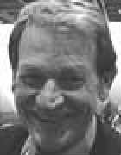
EU Framework Programme: Objectives for Health Care, 1989
Unify European activities by providing the means for efficient communication of medical records and knowledge so that these may be understood and compatible, thereby permitting the integration of health information systems
  Strengthen competitiveness ... , Improve the quality of life ...
AIM Framework 4, The GEHR Project, 1991-1994; to research and prototype the foundations of electronic health record architecture
FP5, Services for Citizens; FP6, Knowledge Centres and the GRID; FP7, Integrated projects, Networks of Excellence
Niels Rossing, DG of AIM
Notes:
A high priority within health
First time to centre of stage

Slide 31
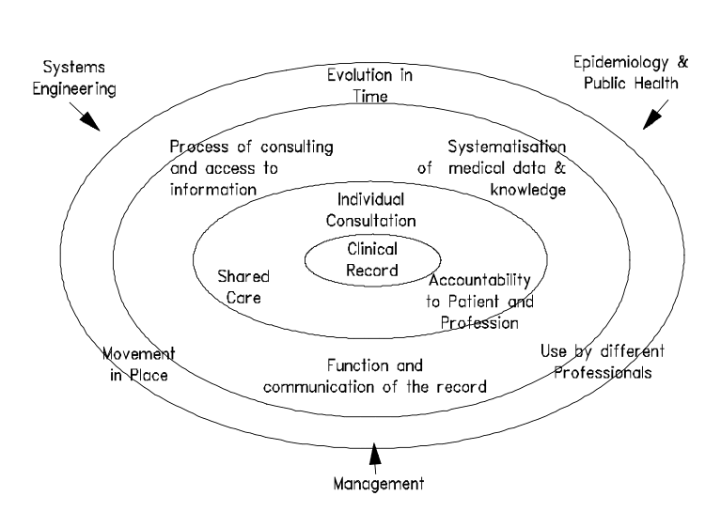
An overview of requirements
Ingram, EU GEHR Project, 1991

Slide 32
Taking forward the GEHR results
European
standardisation
CEN TC/251
International
Standardisation
ISO-HL7-IHTSDO
GEHR
Env 12265
En 13606
ISO En 13606
6WINIT
Local implementation,
evaluation, refinement and
dissemination
CIMI
MEDICATE
Innovation in Health
SynEx
openEHR
E H C R
SupA
Australian GEHR & Ocean Informatics
Ongoing
research &
development
GEHR architecture
& object model
E-Science CLEF

Slide 33
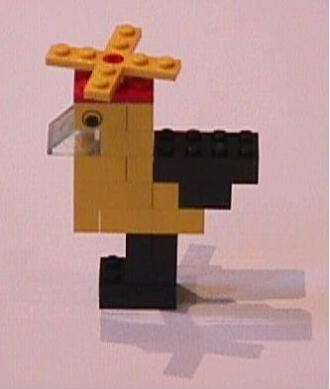
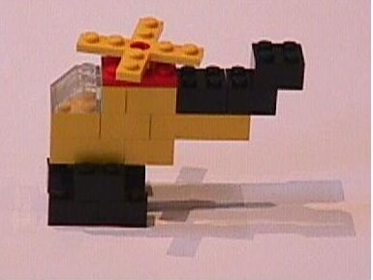
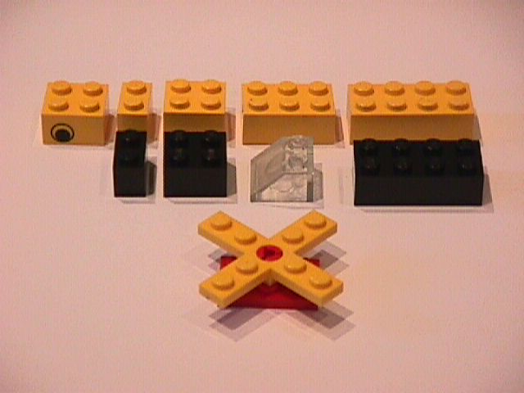
LEGO® design analogy
The components of the openEHR Reference Model are like LEGO bricks
openEHR Archetypes are instructions/designs constraining the use of LEGO bricks to create meaningful structures
Reference Information model
Archetype A
Archetype B

Slide 34
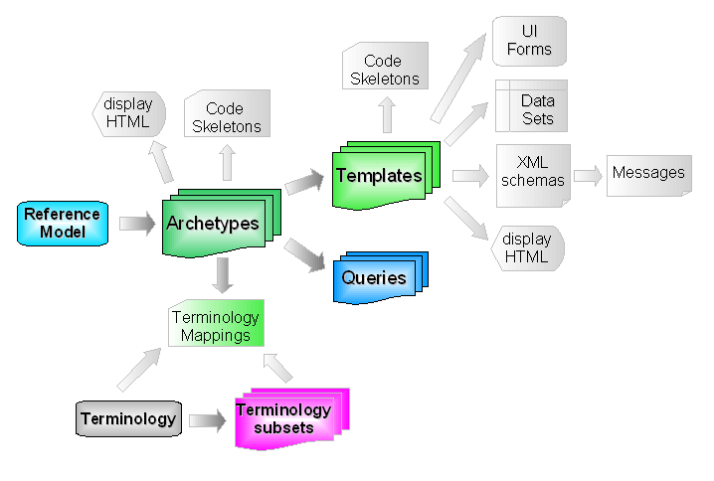
openEHR artefact ecosystem

Slide 35
The essence of openEHR architecture
Locally customised (templated) clinical information archetypes,
managed by generic clinical record middleware.

Slide 36
openEHR exists to help untangle clinical systems, so they can work better
Clinical aspects
Technical aspects
openEHR
Organisational aspects

Slide 37
Goals for EHR semantic interoperability
To support patient safety, quality of care, chronic disease management, extended home-care, patient empowerment
enable the safe, meaningful sharing and combining of health record data
enable the integration and safe use of computerised protocols, alerts and care pathways
link EHR data to explanatory and educational materials
ensure the necessary data quality for secondary uses
Clinical meaning (data, information, knowledge) must be capable of being represented consistently

Slide 38
Responding to the challenge of communicating EHRs
Current attempts to standardise the capture, representation and communication of clinical data rely upon:
generic models for representing clinical data
  e.g. openEHR RM, ISO/EN 13606-1, HL7 CDA Release 2
agreed clinical data structure definitions
  e.g. openEHR/13606 archetypes, templates, data sets
clinical terminology systems
  e.g. SNOMED-CT, LOINC
The challenge is how to combine these most effectively to achieve the faithful and consistent sharing of clinical meaning

Slide 39
Structure and membership
Not-for-profit organisation, based at University College London (UCL)
Established by UCL and Ocean Informatics in 2002, to own the specifications and other collective intellectual property (IP). Based on 16 years of R&D
Now a worldwide collaboration overseen by
  Foundation Board – 5 strong, 4 clinical
  Specifications Group – CEN, ISO, CIMI, IHTSDO
  Software Group – JAVA, Ruby, .NET, Python
  Clinical Editorial Group – 800 clinicians using CKM
  Localisation Group – Japan, New Zealand, Brazil, Europe

Slide 40
openEHR community
is open to individuals or organisations that support its goals and methods, with free individual membership and subscriptions from formal Associates
supports international community and consensus on the principles of a good electronic healthcare record (GEHR), and embodies these within the openEHR specifications and architecture
researches and develops best practice in the formal specification and validation of clinical requirements, design and implementation of EHR systems
works for their international clinical harmonisation and standardisation

Slide 41
Technical motivation of openEHR
The openEHR approach has been to develop a technical and semantic platform for health information systems which addresses four challenges:
  Meaning preservation - throughout systems and communications
  Information sharing – among systems and applications
  Information aggregation - leading to computability
  Evolution - of systems and information over time

Slide 42
Technical approach of openEHR
  A semantic framework within a services architecture
  Development by engineering design team with open review and formal change management
  All specifications are implemented and tested before release
  Specifications all mutually consistent
  Living specifications – a programme for maintenance

Slide 43
Technical deliverables
A powerful reference information model
openEHR archetypes: software-independent clinician-authored models of content
openEHR templates: a formal basis for localised re-use of content models
Practical and bounded use of terminologies
Control over data entry quality
Portable query language for health records
A knowledge-enabled service interface to the EHR

Slide 44
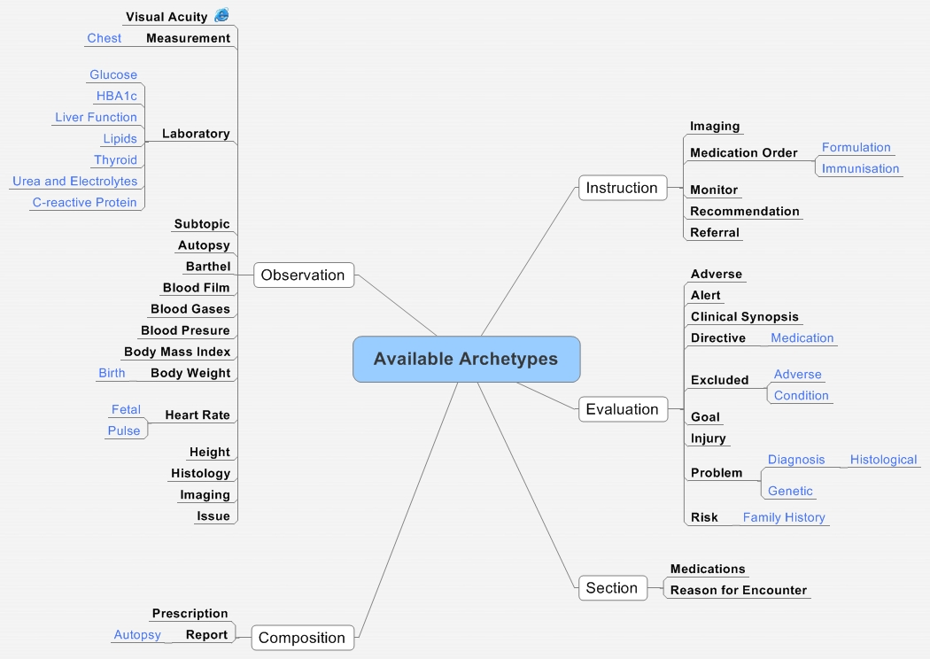
Banks of curated, clinician-defined archetypes

Slide 45
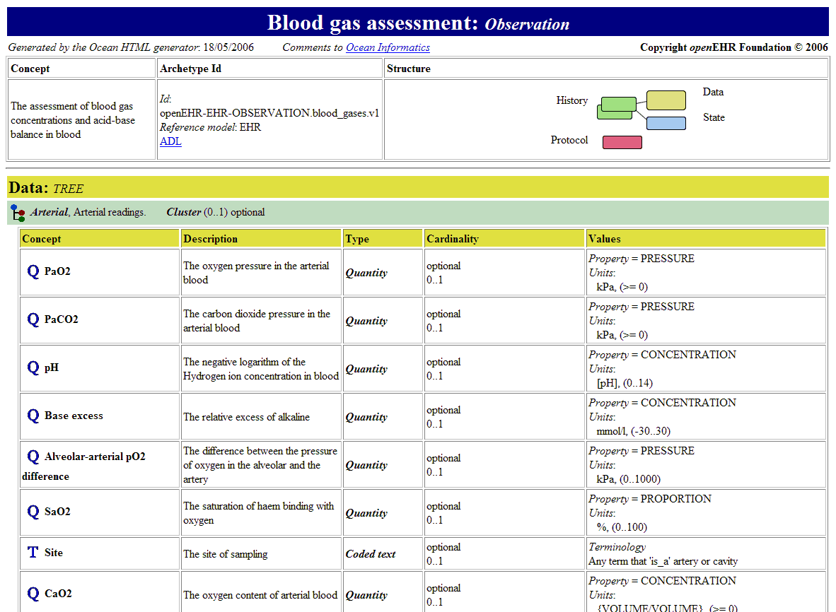
Archetype structure

Slide 46
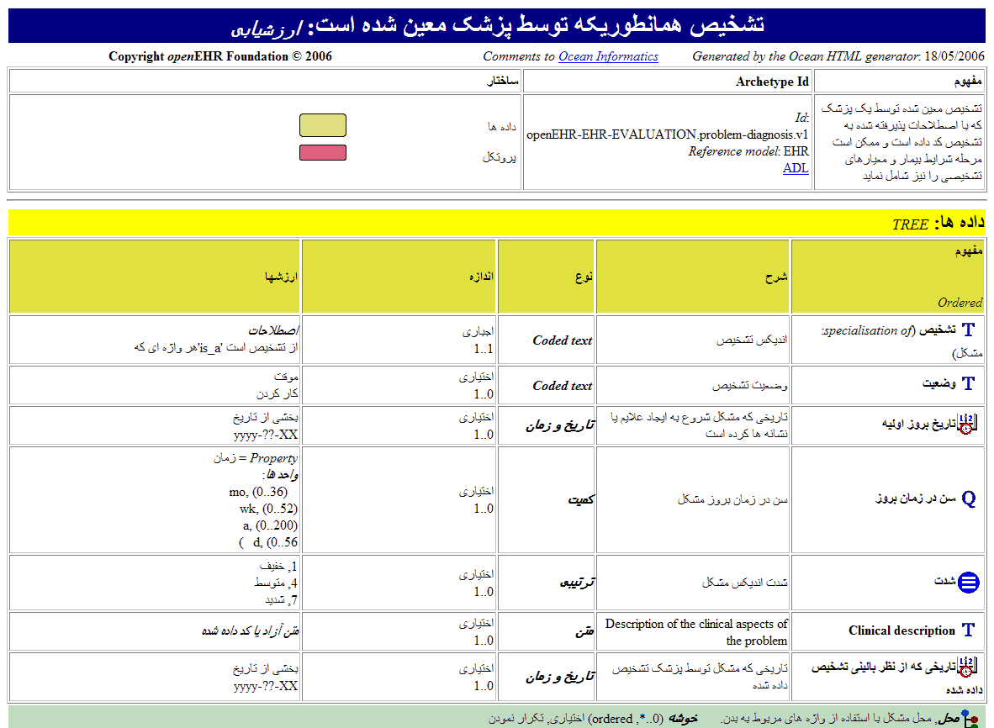
Multi-lingual capability

Slide 47
Clinical challenges for adopting archetypes
Grow communities to author, review and adopt archetypes for different domains
Enrich the tooling to support clinicians
Improve the binding to SNOMED-CT
Define good practice for authorship
Establish quality, governance and certification processes

Slide 48
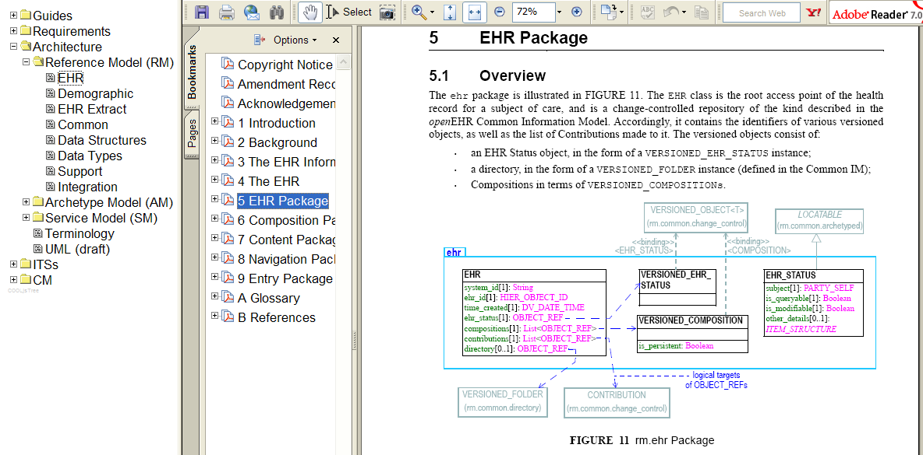
Architecture specifications

Slide 49
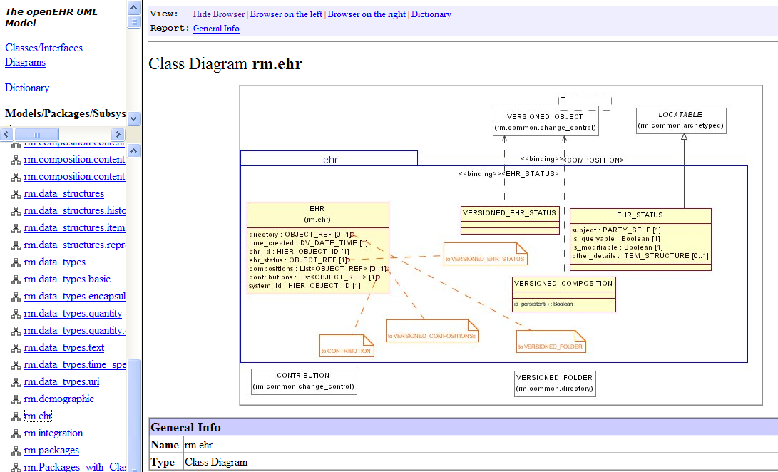
UML representation

Slide 50
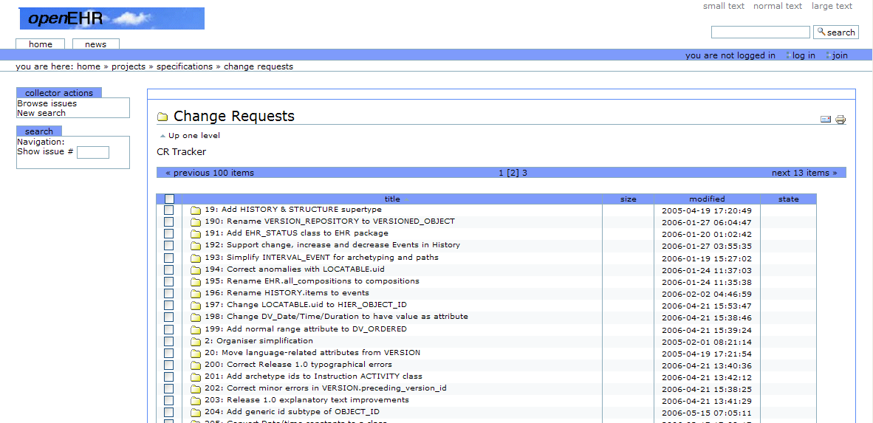
Change management

Slide 51
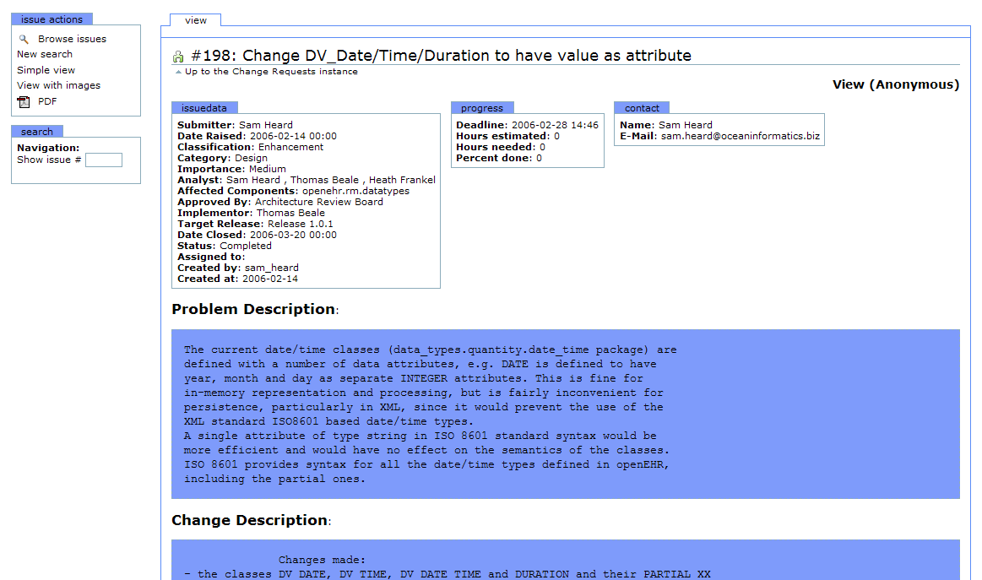
Example: Change request

Slide 52
Features and benefits
Enables clinical control of semantic interoperability through archetypes
Allows evolution of representation of clinical concepts over time
Dissociates electronic health care records from dependency on particular clinical software applications or particular health care information infrastructures
‘Future-proofs’ health records for lifelong care
Has been shown to provide a more sustainable code base for clinical systems, up to 8x more time-efficient to maintain than traditional database methods

Slide 53
State of play, today
Comprehensive EHR specification
  Information model, Archetype model, Communication specification, Service specification
Growing
  base of implementation experience and learning, in real-life settings
  set of tools - .NET, JAVA, Ruby, Python
  community of developers and users, organised within national/regional associations
Linkage with clinical research, clinical trials standards and education

Slide 54
Outcomes
openEHR is now found…
  in CEN/ISO EN13606-1 and -2
  in around 15 commercial products
  in the CIMI content standardisation initiative
  in the e-health programmes of the UK, Denmark, Sweden, Australia and Brazil, with another 10 or so countries moving towards it
  In national chapters in Japan, New Zealand and Brazil
  in dozens of universities
  in a growing number of enterprise clinical and secondary applications

Slide 55
Need to extend openEHR’s governance, in order to:
Broaden input to openEHR policy and strategy, through strategic partnership and collaboration
Strengthen its mission, while enabling it to sustain its focus on clinical implementation
Widen clinical and health informatics community, government and industry acceptability of what it offers
Attract financial support
Promote higher and more active profile and role in e-health programmes
Notes:
55

Slide 56
Some related new open source and open data initiatives
Cancer genomics clinical trials, opthalmology, machine learning

Slide 57

Towards personalized medicine
Clinical champion – Norbert Graf, paediatric oncologist
Data integration
  Clinical data, imaging data, molecular data, etc.
Legal and ethical issues
System biology models
Tools and models
  Clinically driven, re-usable, modular, interoperable
  Evaluated and user friendly
  Validated and standardized for reuse
  Certified
Logistics
  IT infrastructure handling vast amounts of data
  Access to high performance computing
  Availability of data in due time
Sustainability
Notes:
We indeed need a small number of slides presenting the grand vision and overall project goals.
We subsequently need 1-2 slides presenting the technical infrastructure (i.e. its architecture and technology components) we have designed in trying to REALIZE the vision and objectives.
Each and every subsequent presentation will have to refer to these two major axes i.e. a) how does it relate to the vision and project goals and b) how does it relate to the "initial architectural blueprint" we have so far defined.
Once these tao quastions (issues) are answered - each presentation can focus on the specificities of its own "local world".
BUT (in my view) we need to convincingly demonstrate that everything we show is "part of a bigger picture" and that "the elements will gradually form a clear picture".
SO, we will try to add our part into this picture - by adding (modifying/extending) a couple of slides wrt to Architecture and Components.

Slide 58
Why?
The conduct of clinical trials in Europe is characterized by
  Redundant paperwork
  Liability tangle
  Complicated legal and ethical regulations causing an unending bureaucracy
  Lack of easy to use open-source data management systems
Translational Research needs an infrastructure and more funding
  The gap between clinical research and basic research is increasing
p-medicine solving many of the above mentioned items needs:
  Maintenance and
  Sustainability
More patients have to be enrolled in clinico-genomic trials
Patients have to play a more active role in clinical trials
Not all patients do receive the best available treatment
  Wrong treatment harms patients and increases health costs unnecessarily
Information overload covers relevant and reliable information
Curricula of Medical Schools have to adapt to the need of IT possibilities to achieve the goal of a personalized and better medicine in future

Slide 59
Collaborations
SIOP, ENCCA, GPOH, BBMRI, ECRIN, EURECA, …
US Food and Drug Administration (FDA)
  Biovista’s Clinical Outcome Search SpaceTM
    Predictions of adverse events
      Verification with foreign academic community
      Usage in the design of future clinical trials
European Medicines Agency (EMA)
  Biomarker Qualification procedure
    Guidance document for qualification of Biomarker
    Advice and input from
      Innovation Task Force
      Pharmacogenomics Working Group

Slide 60
General aspects
Three cancer domains
  Acute lymphoblastc leukemia
  Breast cancer
  Nephroblastoma
Scenario based
  52 use cases are defined
Legal and ethical framework
  Informed consent
  Anonymization/pseudonymization
  Contracts
Open source, retro- and prospective data
  Clinical, DICOM, molecular, …

Slide 61
Sustainability
Business goals
  Discover knowledge
  Explore hypothesis
  Personalize treatment
  Empower patients
  Share data
  Share knowledge

Slide 62


Sustainability
Ethical
Committee
IDMC
Committee
QA
Committee
Sponsor
IT
Board
Clinical
Research
Groups
Clinical
Board
Funding
Basic
Research
Groups
Scientific
Board
Patient
Groups
Patient
Board
Industry
Licensing
Scientific
Grants
Teaching

Slide 63
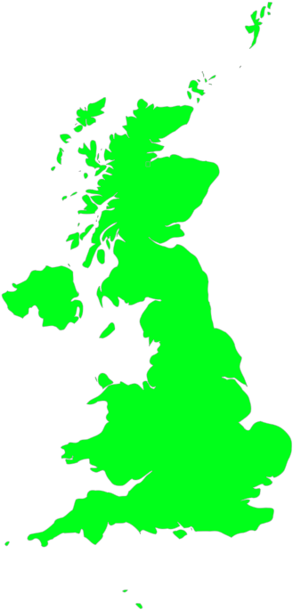

OpenEyes Collaboration for Opthalmology Records
Clinical champion – Bill Aylward, opthalmic surgeon, Moorfields Eye Hospital, UCL Partners
Cataract
Strabismus
Adult A&E
Glaucoma
Core
Medical Retina
ARMD

Slide 64
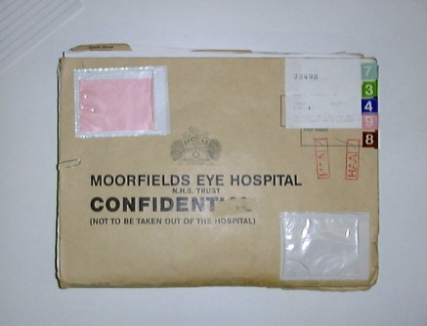


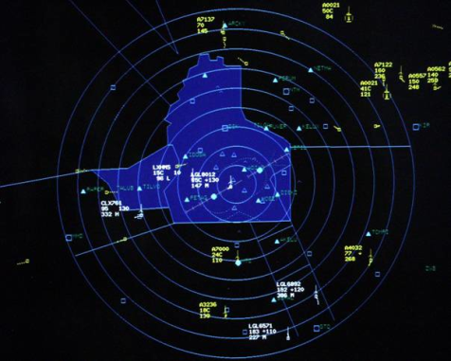
What will OpenEyes do?
1) Get data into electronic form
2) Integration

Slide 65

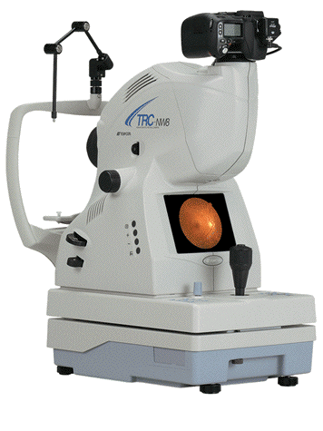
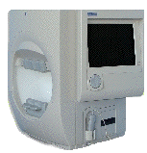

@

Slide 66
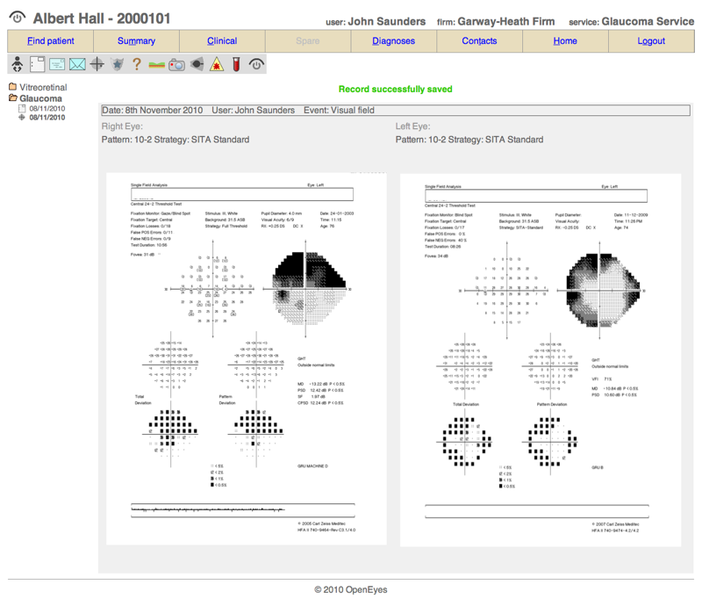

Slide 67
Timeline
Feb 2010 | Project initiated
Nov 2010 | Pilot (Paediatric A&E)
Jan 2012 | V0.9 (Booking, WL management)
Jun 2012 | V1.0 (Cataract/glaucoma)
----- | -----
Dec 2013 | All subspecialties covered

Slide 68
Clinical data management for machine learning: Opereffa framework
Data mining tools and frameworks are usable mostly for statisticians, computer scientists
They are expensive. More expensive if you want to scale
Open-source frameworks help with the cost, but they are still tools for the few, and don’t mean much to clinicians
openEHR has been helping clinicians take control, to deliver efficient clinical information systems
Can it also help them improve CDS/mathematical modelling/machine learning?
Opereffa attempts to find out

Slide 69
Opereffa framework: key goals
Leverage high performance, open source frameworks
Explore the relationship between clinical information system design and machine learning.
Which approaches can improve both information systems and machine intelligence?
Goal: eliminate complicated bridges from clinical world to research domain
Goal: allow clinicians to take control of machine intelligence
Goal: explore design and implementation patterns for openEHR that enable the previous two goals
It all comes down to standards driven persistence and data access: Opereffa and Archetype Query Language (AQL)

Slide 70
Opereffa Architecture
Clinical models
openEHR
HL7
EN 13606
Clinical information systems
Clinical model building
Persistence Transformations Layer
…
Use case optimized persisted data
Hadoop
PostgreSql
MongoDB
Archetype
Query
Language
Clinical model based query language and its extensions
Future work:
Machine learning
Data mining
Decision Support
Data storage and AQL based data access, with relational databases, are already being published open-source

Slide 71
Opereffa framework: plans for future
Proven, open source persistence stacks aligned along the scale axis: PostgreSql, MongoDB, Hadoop
High performance open source parallel processing frameworks for scaling up: Akka, Hadoop
Tooling to eliminate complicated technology & infrastructure management process: Eclipse framework
Number 1 domain to learn from: finance.
Bring all these technologies together with a strongly model driven approach, for outcomes that are portable to other domains.

Slide 72
Case for greater use of open-source frameworks
Promote effective and efficient developer communities
  pioneers traditionally have had to build whole local infrastructures
  many wheels still being reinvented, unnecessarily
Pool costs of development and maintenance of essential infrastructure
Enable research interface – discipline grows through sharing, review and testing of methods
Improve procurement – ability to see what’s under the bonnet
Support integration – combat fragmentation
But there must be a business case – government and industry support is needed for the transition to an open-source community

Slide 73
Thank You
The growing worldwide community of openEHR would welcome your participation in its future development

