Slide 1
Patient-centered observational analytics: New directions toward studying the effects of medical products
Patrick Ryan on behalf of OMOP Research Team
May 22, 2012

Slide 2
Observational Medical Outcomes Partnership
Public-Private Research Partnership established to inform the appropriate use of observational healthcare databases for studying the effects of medical products:
  Conducting methodological research to empirically evaluate the performance of alternative methods on their ability to identify true associations
  Developing tools and capabilities for transforming, characterizing, and analyzing disparate data sources across the health care delivery spectrum
  Establishing a shared resource so that the broader research community can collaboratively advance the science

Slide 3







OMOP Data Community – First Two Years
OMOP Extended Consortium
OMOP Research Core
Research Lab &
Coordinating Center
Centralized data
OSIM2
Distributed Network
178 million persons with patient-level data
5.4 billion drug exposures, 5.8 billion procedures, 2.3 billion clinical observations
Page 3

Slide 4
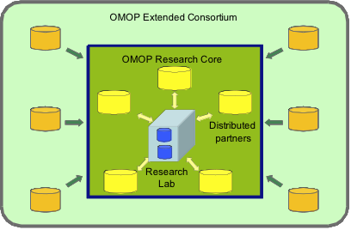
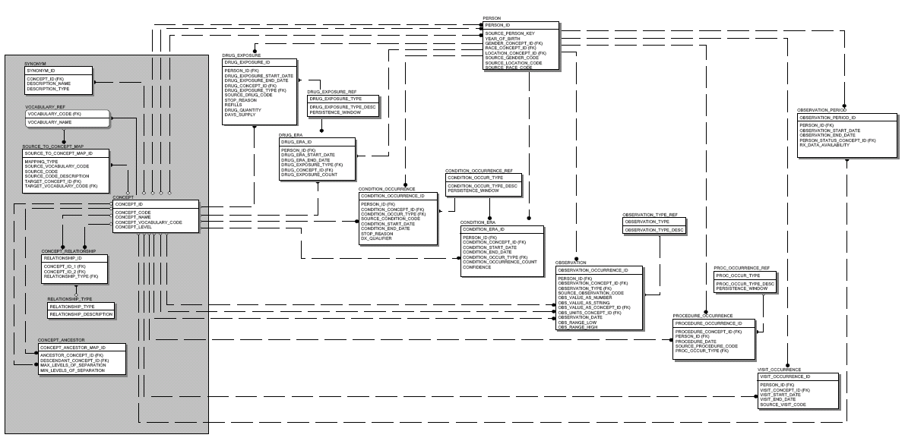
OMOP Research Experiment
Open-source
Standards-based
Systematic data characterization and quality assurance
OMOP Methods Library
Inception
cohort
Case control
Logistic
regression
Common Data Model
10 data sources
Claims and EHRs
170M+ lives
Simulated data (OSIM)
14 methods implemented as standardized procedures
Full transparency with open-source code and documentation
Epidemiology, statistical and machine learning designs

Slide 5
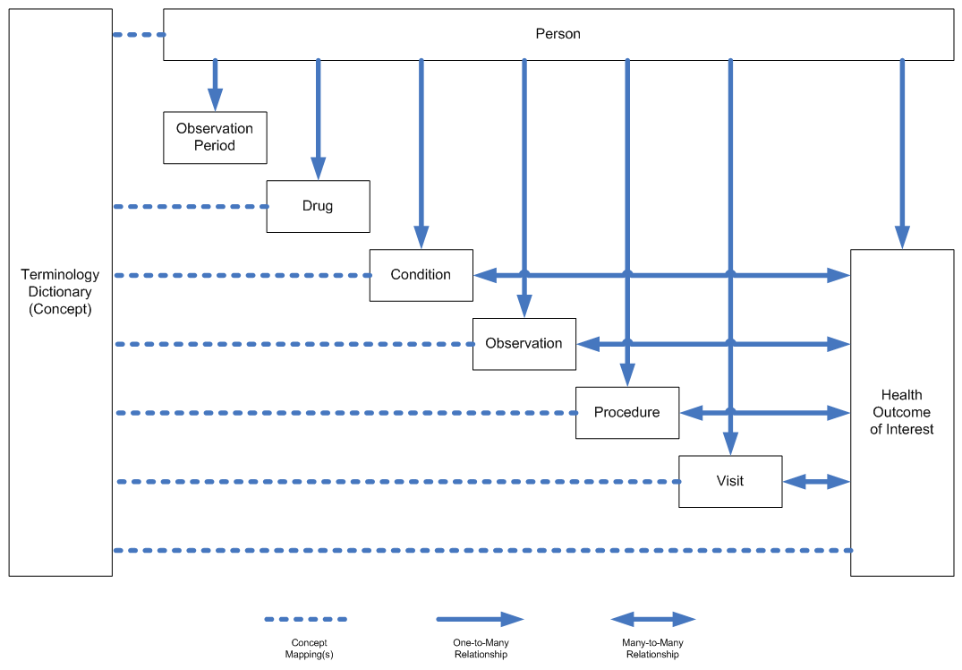
Common Framework
Accommodating Disparate Observational Data Sources
Common Data Model
Standardized Terminologies
Conditions
Drugs

Slide 6
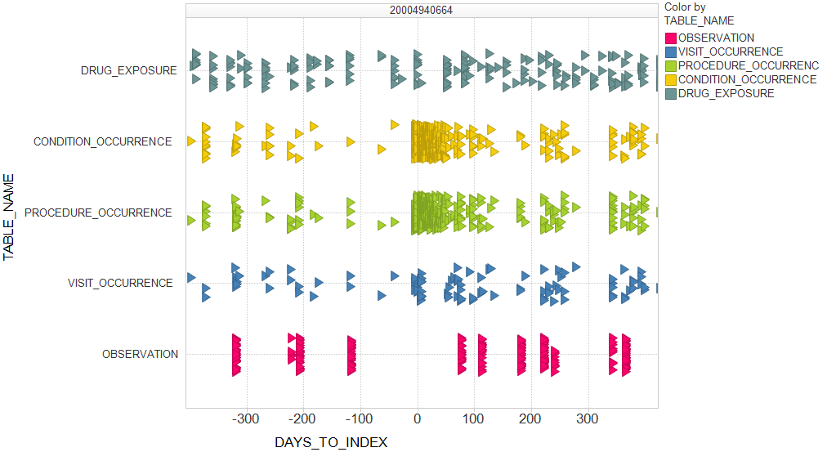
A couple years in the life of a patient in an observational healthcare database

Slide 7
Patient profiles in observational data when studying the effects of medical products
A
B
Recurrent events
Multiple periods of exposure
C
Exposure spanning observation period
Concomitant medications during events
D
Patients without events may contribute to background rate calculations
E
Patients without target drug exposure are prevalent and utilized differently across all methods
F
Most patients in the database have neither the target drug nor the target outcome
Target drug
Target condition
Other conditions
Other drugs

Slide 8
Data used for new user cohort design to estimate average treatment effect
New user design
Focus on comparing rates of events among patients exposed to target drug, relative to rates of events among patients in some referent comparator group
Relative risk can be adjusted for baseline covariates through various strategies, including propensity score
A
B
Patient excluded because insufficient washout from index exposure
C
D
Patient excluded because insufficient washout from index exposure
E
F
Define cohorts based on index exposure (first use after washout period)
Observations prior to index may be used as covariates
Observations on or after index, except for incident outcome, are not considered in analysis
Target drug
Target condition
Other conditions
Other drugs

Slide 9
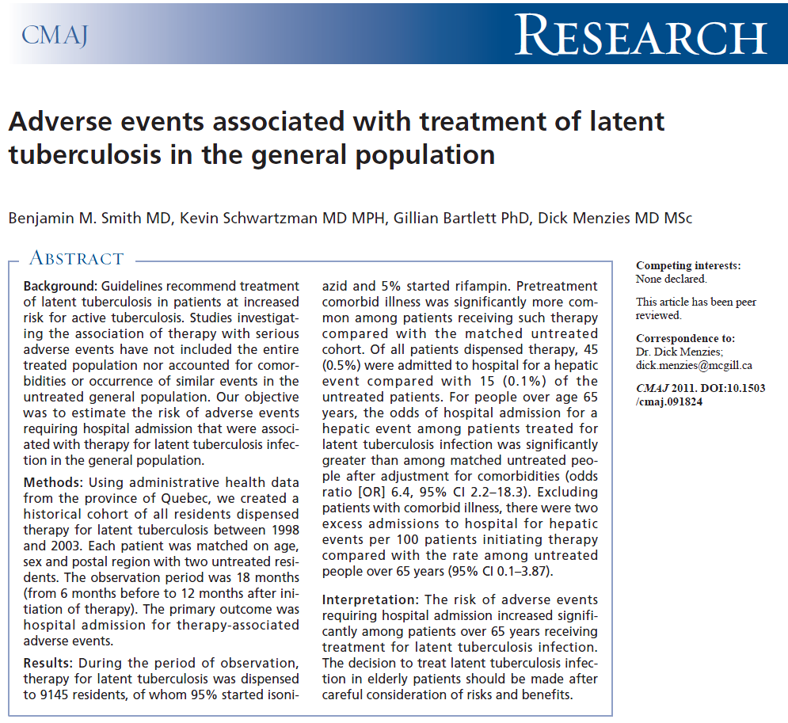

Exploring isoniazid and acute liver injury
Average treatment effect, patients > 65 years of age:
OR = 6.4 (2.2 – 18.3)

Slide 10
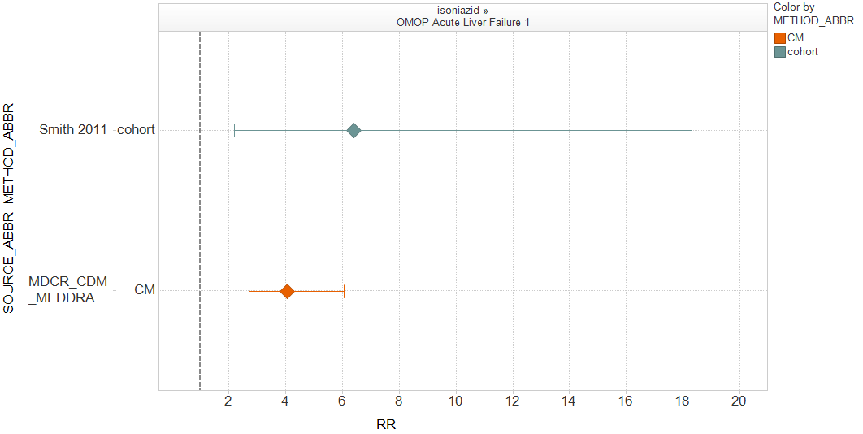
OMOP replication: isoniazid – acute liver injury
Data source: MarketScan Medicare Beneficiaries (MDCR)
Study design: Cohort
Exposure: all patients dispensed new use of isoniazid, 180d washout
Unexposed cohort: Patient with indicated diagnosis (e.g. pulmonary tuberculosis) but no exposure to isoniazid; negative control drug referents
Time-at-risk: Length of exposure + 30 days, censored at incident events
Covariates: age, sex, index year, Charlson score, number of prior visits, all prior medications, all comorbidities, all priority procedures
“Odds ratio” estimated through propensity score stratification (20 strata)
Average treatment effect

Slide 11
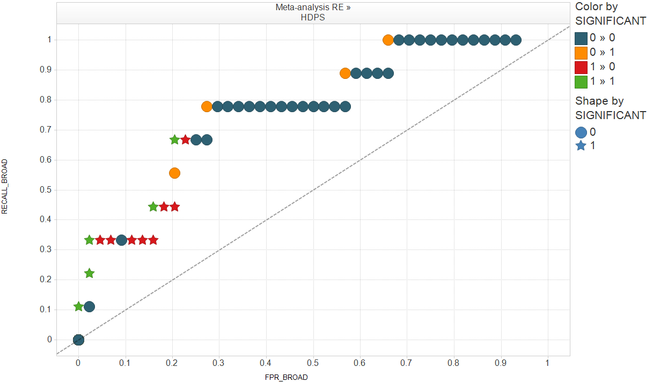
Receiver Operating Characteristic (ROC) curve
True -
False -
False +
True +
NS
Sensitivity
p<.05
ROC plots sensitivity (recall) vs. false positive rate (FPR)
Area under ROC curve (AUC) provides probability that method will score a randomly chosen true positive drug-outcome pair higher than a random unrelated drug-outcome pair
AUC=1 is perfect predictive model, AUC=0.50 is random guessing (diagonal line)
Random-effects estimates from new user cohort design: AUC = 0.77
False positive rate (1-Specificity)

Slide 12
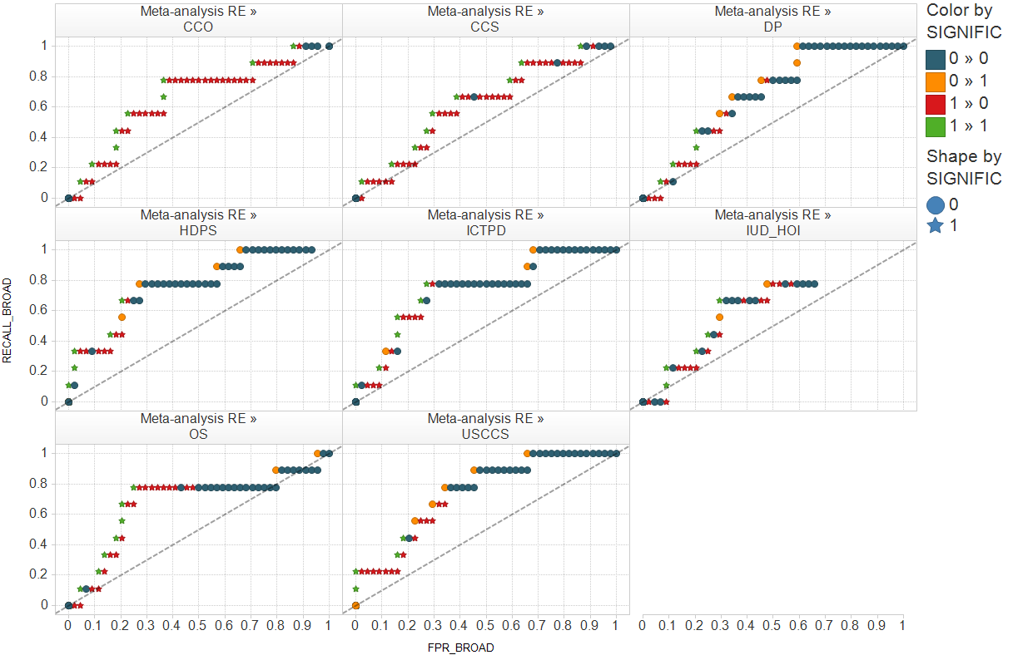
ROC curves of random-effects meta-analysis estimations for all methods
True -
False -
False +
True +
NS
p<.05
Sensitivity
At 50% sensitivity, false positive rate ranges 16%-30%
At 10% false positive rate, sensitivity ranges 9%-33%
AUCs range across methods from 0.58 – 0.77
False positive rate (1-Specificity)

Slide 13
Where do we go from here?
Further exploration of average treatment effects
Increased methods development
Expansion of test cases
Evaluate predictive accuracy
OMOP Symposium: 28 June 2012
New direction:
Patient-centered predictions
Estimate probability of future outcome, based on past clinical observations
Evaluate predictive accuracy

Slide 14
A couple years in the life of a patient in an observational healthcare database
Given a patient’s clinical observations in the past….
…can we predict outcomes for that patient in the future?

Slide 15
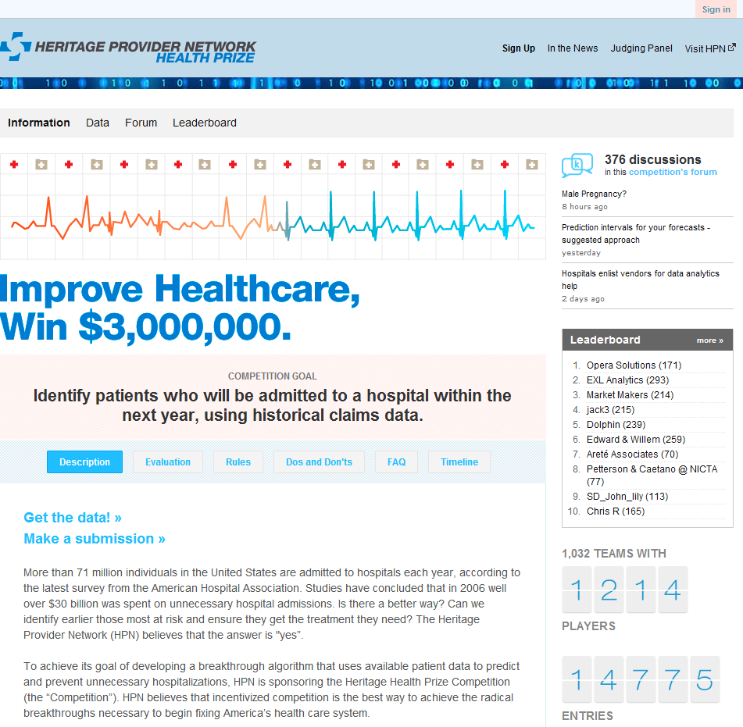
Patient-centered predictive modeling on big data has big value and big interest
http://www.heritagehealthprize.com/

Slide 16
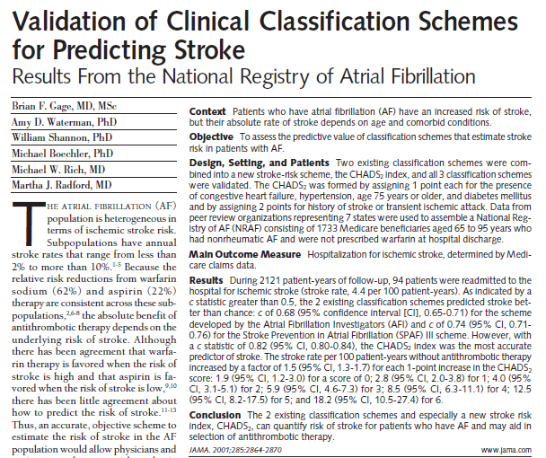
Patient-centered predictive models are already in clinical practice
CHADS2 for patients with atrial fibrillation:
+1 Congestive heart failure
+1 Hypertension
+1 Age >= 75
+1 Diabetes mellitus
+2 History of transient ischemic attack
JAMA, 2001; 285: 2864-2870

Slide 17
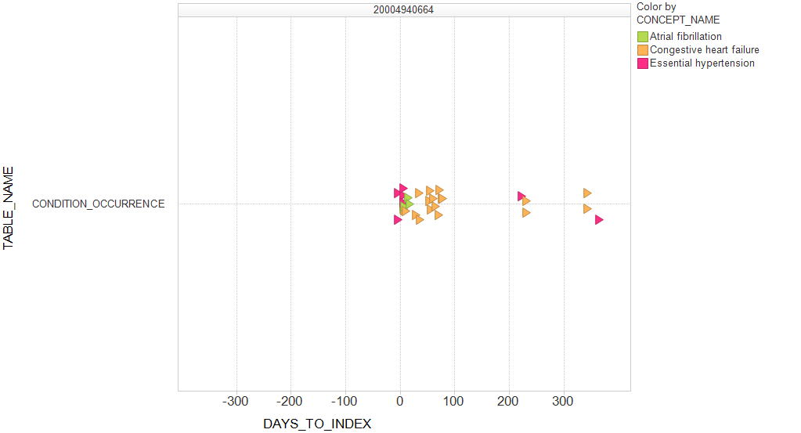
Applying CHADS2 to a patient
Given five pre-defined predictors in the past….
…can we predict stroke in the future?

Slide 18
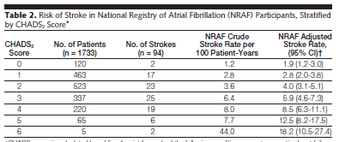
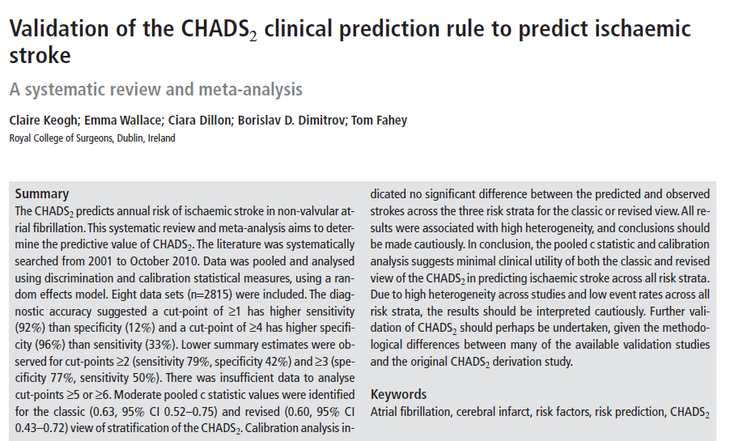
Evaluating the predictive accuracy of CHADS2
AUC = 0.82 (0.80 – 0.84)
JAMA, 2001; 285: 2864-2870
Thromb Haemost 2011; 106: 528–538
AUC = 0.63 (0.52 – 0.75)

Slide 19
Is CHADS2 as good as we can do?
What about other measures of CHADS2 predictors?
  Disease severity and progression
  Medication adherence
  Health service utilization
What about other known risk factors?
  Hypercholesterolemia
  Atherosclerosis
  Anticoagulant exposure
  Tobacco use
  Alcohol use
  Obesity
  Family history of stroke
What about other unknown risk factors?

Slide 20
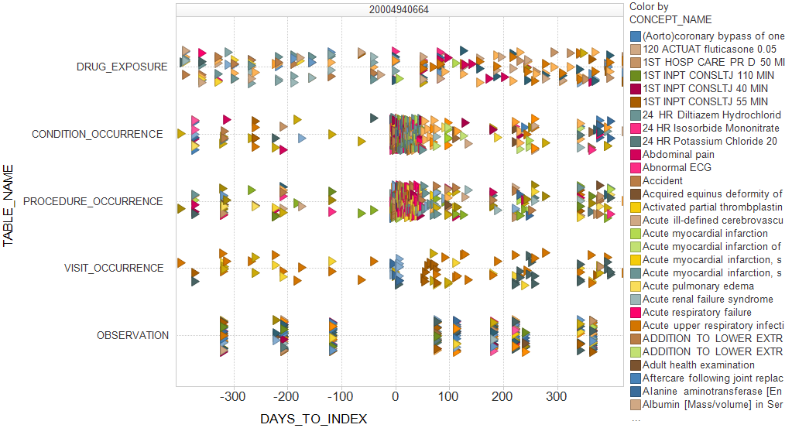
High-dimensional analytics can help reframe the prediction problem
Given all clinical observations in the past….
…can we predict any outcome in the future?
Modern predictive modeling techniques, such as Bayesian logistic regression, can handle millions of covariates. The challenge is creating covariates that might be meaningful for the outcome of interest

Slide 21
Why patient-centered analytics holds promise
Average treatment effects:
Hundreds of drug-outcome pairs
Unsatisfactory ground truth:
  how confident are we that drug is associated with outcome?
  What is ‘true’ effect size?
Questionable generalizability: who does the average treatment effect apply to?
Final answer often insufficient:
  Need to drilldown to explore treatment heterogeneity
  Truth about ‘causality’ is largely unobtainable
Patient-centered predictions:
Millions of patients
Explicit ground truth
  Each patient did or did not have the outcome within the defined time interval
Direct applicability: model computes probability for each individual
Final model can address broader questions:
  Which patients are most at risk?
  What factors are most predictive of outcome?
  How much would change in health behaviors impact risk?
  What is the average treatment effect?

Slide 22
Concluding thoughts
Not all patients are created equally…
  Average treatment effects are commonly estimated from observational databases, but the validity and utility of these estimates remains undetermined
  Patient-centered predictive modeling offers a complementary perspective for evaluating treatments and understanding disease
…but all patients can equally benefit from the potential of predictive modeling in observational data
  Clinical judgment may be useful, but selecting of a handful of predictors is unlikely to maximize the use of the data
  High-dimensional analytics can enable exploration of high-dimensional data, but further research and evaluation is needed
  Empirical question still to be answered: Which outcomes can be reliably predicted using which models from which data?

Slide 23

ABOUT THE SYMPOSIUM
OMOP is a public-private partnership informing on the appropriate use of observational data for studying the real-world effects of medical products. A multi-year methodological research initiative, OMOP has developed a network of administrative claims and electronic health records databases and established a community of methodologists to test the feasibility and utility of large-scale observational analyses. OMOP holds an annual symposium to publicly share insights from the partnership's ongoing research with all stakeholders.
DATE & TIME: Thursday, June 28, 2012 | 8:00 a.m. - 5:00 p.m. Eastern Time
LOCATION: Bethesda North Marriott & Conference Center | 5701 Marinelli Road
North Bethesda, MD 20852, USA
REGISTER TODAY!
http://omop.fnih.org

