Slide 1
The Evidence Evolution
A Pharma Perspective
Prisme SIG, 22.05.12
A. Gaughan
Director, Payer and RWE Informatics | AstraZeneca

Slide 2


In the Beginning.....
One data customer, with predictable habits

Slide 3
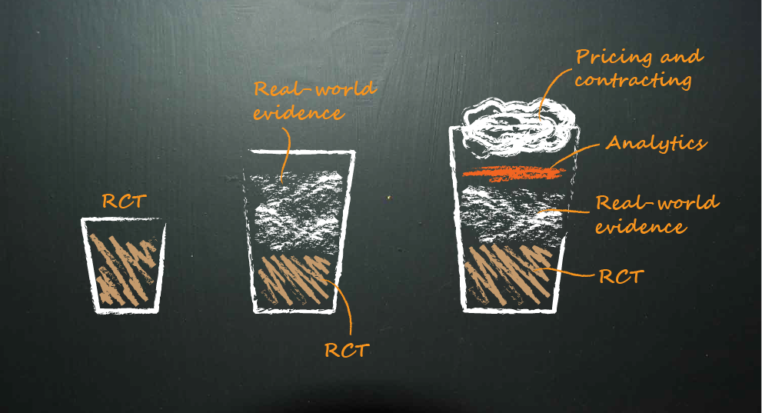
And now.....
Multiple data customers, many different tastes....

Slide 4
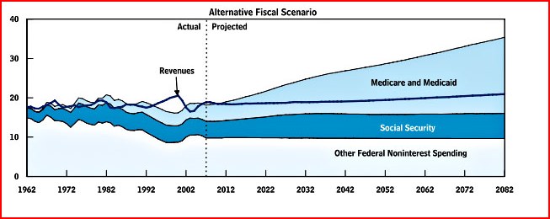
Fuelling the evolution I
“Our frightening fiscal future”*
*Congressional Budget Office, Long Term Budget Outlook, June 2011
And.....

Slide 5

Fuelling the evolution II
“The information explosion”
“The adoption of EHRs in the ambulatory setting has doubled in about two years and the Federal government’s incentive program for Meaningful Use is likely the primary driver. “
Gilad J. Kuperman, AMIA Board Chair

Slide 6
We need to be able to answer the Payer “Moment of Truth” Questions
What am I currently paying for treating this disease? What am I currently paying for treating this disease?
Why do patients need this?
What patients should get it and how can use be limited to appropriate patients?
Can it Work?
Does it Work?
Is it Worth It?
How is your drug better than the alternatives in my specific setting?
Can I afford it and what part of my budget will I use to fund it?
How much is your drug and why is it worth the cost?

Slide 7
Real World Evidence
Application to Pharma
Improving clinical development through understanding treatment and outcome diversity
Minimizing decision uncertainty through demonstrating relevance at product introduction and on market claim validation
Creating a “learning healthcare system” through performance indicators, information and incentives

Slide 8
Influencing clinical development | understanding diversity
RWE

Slide 9
Personalising Healthcare
Population vs. patient level risk/benefit
Total Popn:
RRR 25%; ARR 5%; NNT 20; NNH 100 < £25K/QALY
Popn. Benefit/Risk: +ve
Would have had an event in subsequent 12 months if not on Tx XX
Individual benefit/risk: +++ve
Will have event in subsequent 12 months
Will not have event in subsequent 12 months
Individual benefit/risk:
-ve
Individual benefit/risk: -ve

Slide 10
Personalising Healthcare
Can RWE help in designing clinical trials and clinical pathways?
Total Popn:
RRR 25%; ARR 5%; NNT 20; NNH 100 < £25K/QALY
Popn. Benefit/Risk: +ve
Current treatment patterns (eg site/region of care, prior treatment, concomitant medications, use of other interventions, compliance…)
Patient characteristics (eg. Comorbidity(ies), age, gender…)
Disease characteristics and severity
Diagnostic and laboratory markers (inc. baseline and kinetic variables)
Care management (frequency of follow up, integration of medical team, schedule of assessments)
Economic incentives/barriers (patient, pharmacy, hospital, national …)

Slide 11
Managing uncertainty | claim validation
RWE

Slide 12
Historically, pharma has been focused on pre-launch data to develop value arguments and negotiate for market access
Real-world data enables continued scrutiny and evidence generation
Launch
Proven real-world effectiveness
Modelled clinical
& cost effectiveness in
real-world setting
Proven long-term safety
Outcomes
Proven in broader populations
Proven against Standard Of Care
Efficacy
Safety
RCT evidence
Select populations
Select comparators
Defined time period
Time in lifecycle
Pre-launch data
Post-launch data

Slide 13
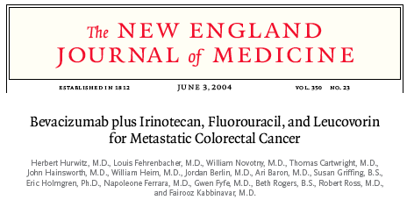

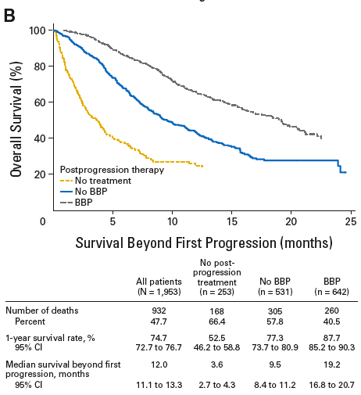
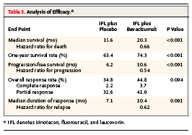
RCTs and Real World Effectiveness
Registry data provide assurance that Avastin outcomes in mCRC RCTs are generalisable to real world
Notes:
Indication at Launch (2004)
5FU based chemotherapy
1L and 2L mCRC
SoC
1L - FOLFOX
2L – FOLFIRI
Oxaliplatin and EGFR mAB launching in same year
Other factors
Generalizability of initial mCRC P3 trial unknown (trial initiated in 2000)
Perception of MOA as “chemo enabler”; tumor progression not result of ‘bevacizumab resistance”
No data on use in treatment beyond progression
Safety assessment for low frequency events of interest

Slide 14
Improving value | the learning healthcare system
RWE

Slide 15
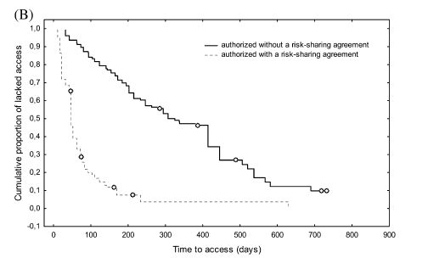
Italian (AIFA) Specialty Product Registry
Pay 4 Performance schemes have managed utilization and driven timely access of high cost oncology therapeutics
Kaplan–Meier curve of regional patient access to oncology products approved by the EMA from 2006 to 2008 in Italy
“Time to market and patient access to new oncology products in Italy: a multistep pathway from European context to regional health care providers,” P. Russo, F. S. Mennini, P. D. Siviero & G. Rasi, Annals of Oncology, March 24, 2010

Slide 16
Towards a learning healthcare system…
Pharma
Domain
Regulator Domain
Payer
Domain
Physician Domain
Product Centric
Popn. Centric
System
Centric
Patient
Centric
Market Entry Conditions
RWE
Quality Indicators/
performance
Remaining Unmet need
RCT
Patient

Slide 17
So what’s AZ doing about it?
RWE

Slide 18




AZ has created an RWE skills centre to combine our expertise with the best in industry data partners
RWE Services
Data Network
Payers
and regulators
Data Partners
R&D Teams
RWE team
Brand Teams
Licensed databases
LMV
,
,
TLV
Analytic Capabilities
Collaboration
Insight
Data access
Notes:
18
18

Slide 19
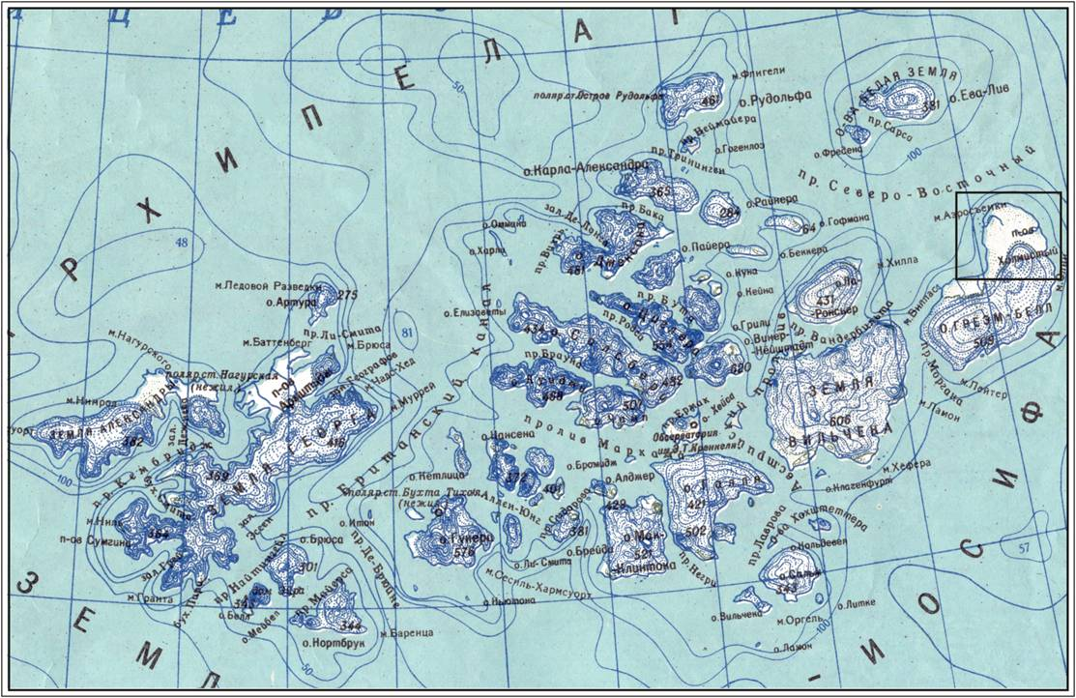
Creating a network of health data
Notes:
So what do I mean by a data strategy?
We can equate healthcare data to a series of unconnected islands- a series of archipelagos. Different islands of data are going to be useful for answering different questions, and building bridges between islands may allow us to answer questions we havent been able to answer before.
What we need to define in our data strategy is- to enable our vision, what must the island network look like? What data islands are we interested in, and which do we need to build bridges between? This is going to be different for different disease areas, and will depend on what data we own already, the demands of our internal portfolio, and the expectations of payers and regulators.
We also need to consider how we make this happen- if some islands are unreachable right now- what can we do about it? Can we enhance data transparency through the leverage of success stories from other areas? Can we leverage our data partners? Steve will talk later about efforts in the EU to drive policy reform on secondary use of HC data.
And finally, we need to consider the how- our priorities and our approach.

Slide 20
A working example
Delaware state ‘Enlightened Community’
AstraZeneca
Christiana Care
Governor’s Office
HealthCore
BCBS DE
Delaware Health Information Network
Medicaid
Notes:
Buffalo – a progressive community
CHS joining the collaboration helps to fill in some of the missing data pieces
Leads to Acceleration

Slide 21



AZ’s Real World Evidence Capability has a global footprint
RWE goals
Access and integrate data based on business and Payer needs
US operational with HealthCore partner. Including US state collaborations (e.g. DE)
Asia-Pacific expansion in early stages
Optimise analytics through the provision of innovate tools and methods
Improve credibility through information integrity and best practices
EU operational with
skill centres operational in UK, Nordics and Spain, plus IMS Health partnership

Slide 22



Four key enablers determine the pace and shape of RWE evolution
Systems Infrastructure
Facilitation of the logistics, data collection and linkages
Legal and Ethical Framework
  Governance structure for how data can be used
  and by
  whom
Methods and
Standards
  Common definitions and standards to evaluate evidence
Stakeholder Trust
  Acceptance
  Trust that data and analyses will not be misused

Slide 23
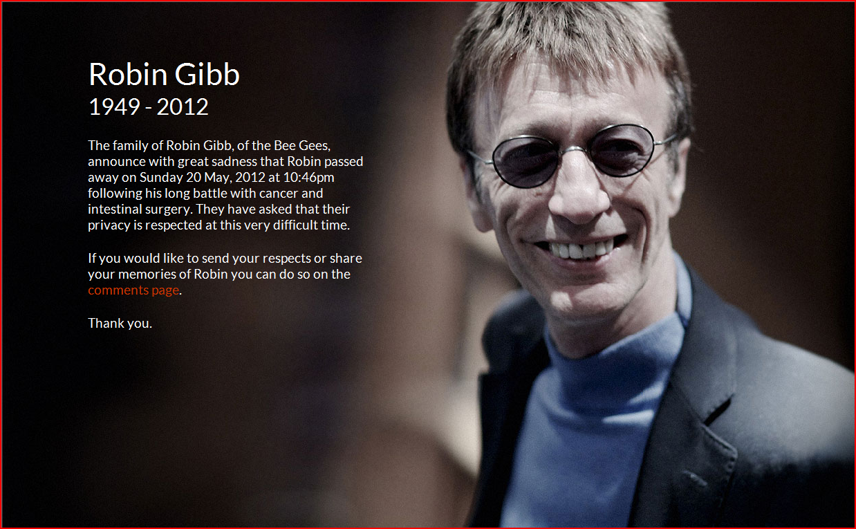

“the notion that evidence alone is neutral or determinative must be abandoned in policy debates; ...The interpretation of evidence depends much on one’s circumstances and values”
Arthur Caplan (JCO 2011)

