Slide 1

eHRs and the European Union – current legislation and future directions.
Dr Richard Fitton

Slide 2
Points to address
The past, present and future data protection data legislation in the UK and Europe
The European Declaration on Human Rights.
The increasing role of the data subject.

Slide 3

E-intelligence overcomes national boundaries

Slide 4
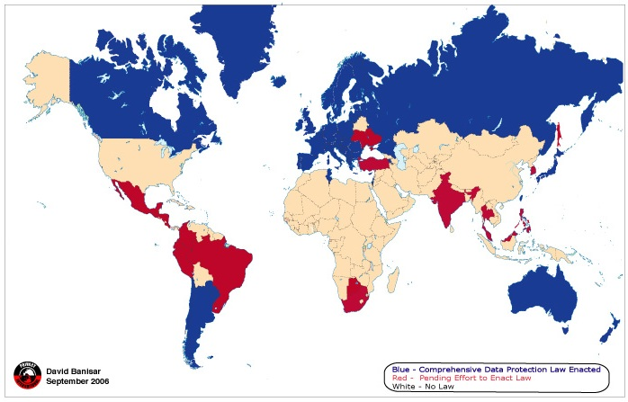
Data protection enactment around the world
Current
The European Data Protection Directive 95/46/

Slide 5
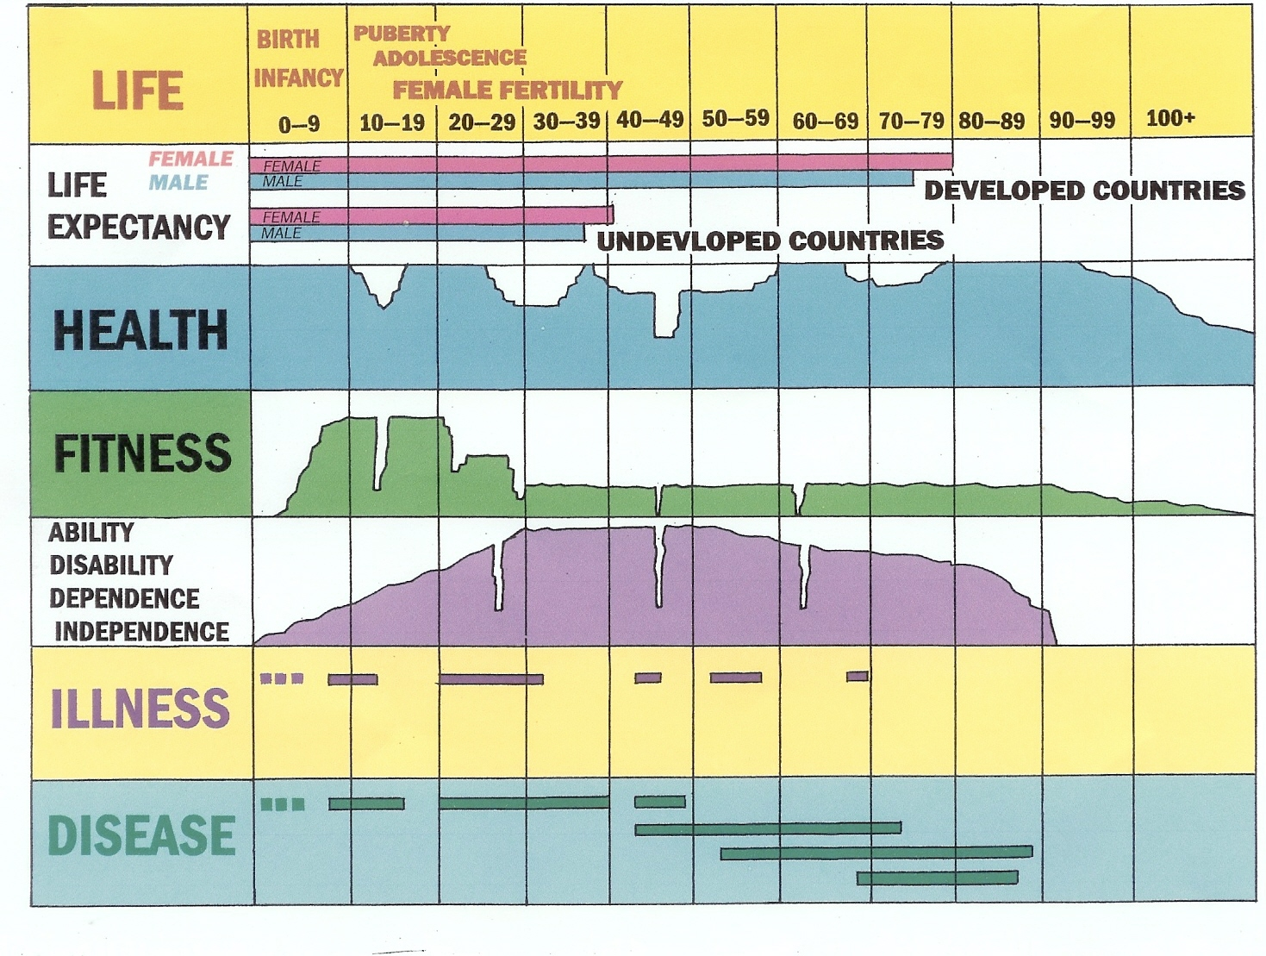
Life, health, independence, disease

Slide 6
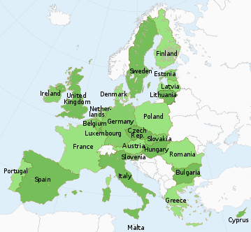
Member States of the European Union
(27 countries – 28 [Croatia] in July 2013)

Slide 7
PRISME Forum SIG 22/05/2012
EUROPEAN COMMISSION
Brussels, XXX
COM(2012) 11/4 draft
Proposal for a
REGULATION OF THE EUROPEAN PARLIAMENT AND OF THE COUNCIL
on the protection of individuals with regard to the processing of personal data and on
the free movement of such data (General Data Protection Regulation)
(Text with EEA relevance)
{SEC(2012) 72}
{SEC(2012) 73}

Slide 8
UNIVERSAL DECLARATION OF HUMAN RIGHTS
Article 3.
  Everyone has the right to life, liberty and security of person.
Article 12.
  No one shall be subjected to arbitrary interference with his privacy, family, home or correspondence, nor to attacks upon his honour and reputation.

Slide 9
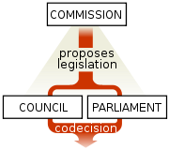
European Commission
The European Commission is the executive body of the European Union. The body is responsible for proposing legislation, implementing decisions, upholding the Union’s Treaty and the general day-to-day running of the Union.

Slide 10
3. LEGAL ELEMENTS OF THE PROPOSAL
3.1. Legal Basis
This proposal is based on Article 16 TFEU¹, which is the new legal basis for the adoption of data protection rules introduced by the Lisbon Treaty.
¹ Treaty on the Functioning of the European Union

Slide 11
European Commission legislative terms
Regulation – has a general scope, is obligatory in all its elements and is directly applicable to all member states of the European Union and constitutes the most powerful form of EU law.
Directives – are only applicable in the member states when the objectives they contained have been transposed into national law.

Slide 12
EUROPEAN COMMISSION
“a proposal for a Regulation of the European Parliament and of the Council on the protection of individuals with regard to the processing of personal data and on the free movement of such data”
(27 countries – 28 in July 2012)

Slide 13
EUROPEAN COMMISSION
“a proposal for a Directive ....with regard to the processing of personal data by competent authorities for the purposes of prevention, investigation, detection or prosecution of criminal offences ...and the free movement of such data.”

Slide 14
Data Sharing Review Report
Richard Thomas, UK Information Commissioner, 2002-2009
Sir Mark Walport, Director and Chief Executive of the Wellcome Trust
http://amberhawk.typepad.com/files/thomas-walport-datasharingreview2008.pdf

Slide 15
Data Sharing Review Richard Thomas Mark Walport
4.11 In summary, the poor level of public trust and confidence in the sharing of personal information provides a critical backdrop to this review .... and highlights the need for substantial improvements in the ways that organisations handle personal information.

Slide 16
Data Sharing Review
Richard Thomas Mark Walport
‘The treatment of individual patients relies on data collected from others.
“... use evidence from other people’s data to treat me, but don’t use my data to help them”.’

Slide 18
Engaging with data/research subjects
“Interdependence is a higher value than independence”
Be proactive
Begin with the end in mind
Put first things first
Think win/win
Seek first to understand, then to be understood
Synergise
Balanced self renewal

Slide 19
Patients and information are the most under-utilised resources in health service provision

Slide 20
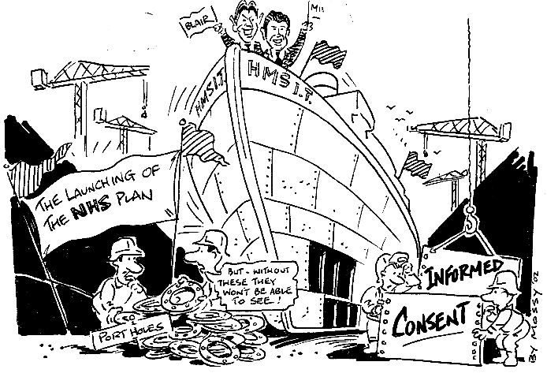
Lessons learned:

Slide 21
DPA¹ Principles for the data subject
Personal data shall be processed fairly and lawfully
Personal data shall be obtained only for one or more specified and lawful purposes
Personal data shall be adequate, relevant and not excessive
Personal data shall be accurate and, where necessary, kept up to date.
¹The UK Data Protection Act 1998

Slide 22
DPA Principles
Personal data processed for any purpose or purposes shall not be kept for longer than is necessary
Personal data shall be processed in accordance with the rights of data subjects
Appropriate technical and organisational measures shall be taken against unauthorised or unlawful processing and ... loss or destruction or damage
Personal data shall not be transferred to a country or territory outside the European Economic Area unless ...

Slide 23
European Draft proposals reflect these
Article 5 sets out the principles relating to personal data processing...in particular:
  the transparency principle,
  the clarification of the data minimisation principle and
  responsibility and liability of the controller.

Slide 24
European Draft proposal
Article 11 introduces the obligation on controllers to provide transparent and easily accessible and understandable information,

Slide 25
European Draft proposal
Article 12 obliges the controller to provide procedures and mechanism for exercising the data subject's rights
Article 14 further specifies the controller's information obligations towards the data subject,
Article 15 provides the data subject's right of access to their personal data,

Slide 26
European Draft proposal
Article 17 provides the data subject's right to be forgotten and to erasure. ......
Article 18 introduces the data subject's right to data portability, i.e. to transfer data from one electronic processing system to and into another

Slide 27
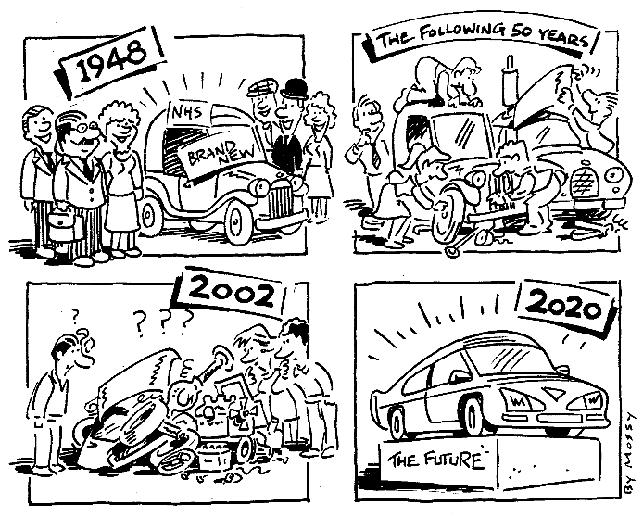
Lessons learned:

Slide 28
Conclusion
The UK Biobank (http://www.ukbiobank.ac.uk/) provides a classic exemplar of how patient data should be collected and managed.

